Slide 1
Friday 13th November.
LO – I can read a text and deduce the meaning of new words using contextual clues.

Slide 2
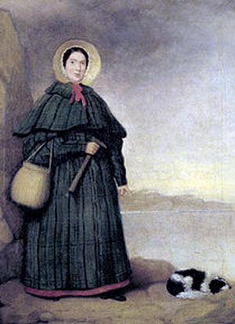
A portrait of Mary Anning.
Fossil hunter.
Born: May 21st 1799
Died: 9th March 1847

Slide 3
Mary Anning was born on May 21st, 1799 in Lyme Regis. When she was only 15 months old, she was struck by lightning but she survived. Mary was named after an older sister who burned to death. She had 6 brothers and sisters, but only one brother lived longer than a couple of years.
Her father was called Richard. He was a cabinet maker, but he didn’t get paid very much. To make more money, he searched for fossils in the cliffs near Lyme Regis and sold them to tourists. He died when Mary was 11 years old, leaving the family without any money.
Fossil collecting was very fashionable in the late 18th and early 19th Centuries. People liked to collect fossils as a hobby similar to stamp collecting. However, as scientists realised how important fossils are to geology and biology, fossil collecting became an important part of science.
Like her father, Mary Anning collected fossils to sell to tourists to make a living. She began to make even more money selling fossils to scientists. She made some very important discoveries, including the first complete skeleton of an ichthyosaur when she was only 12 years old. She also found the first ever skeleton of a plesiosaur and an important fossil pterosaur. The fossils she collected were important evidence that creatures could become extinct, something that had not been recognised before.
When she was in her thirties, Mary was given an income by the British Association for the Advancement of Science because of all the work she had done collecting fossils. At the time, women weren’t allowed to be members of the Geological Society of London, but because of her important work she was made an honorary member. She died of breast cancer when she was 47 years old.

Slide 4
Look at the text in your book. Underline any words that you are unsure of the meaning. Can you read the sentence before and after the one with the unknown word. Does that help you work out the meaning.
As a class, we are going to look at the text and use deduction and contextual clues to work out the meaning of these words.

Slide 5
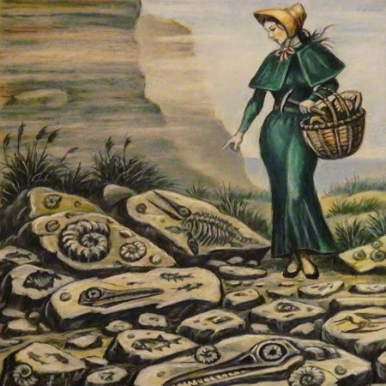

Slide 6
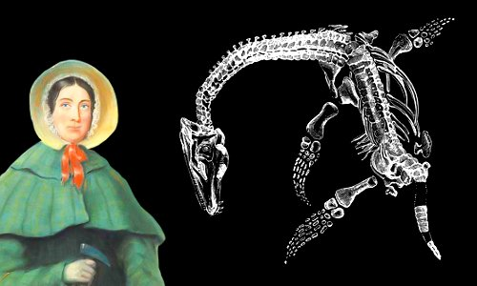

Slide 7
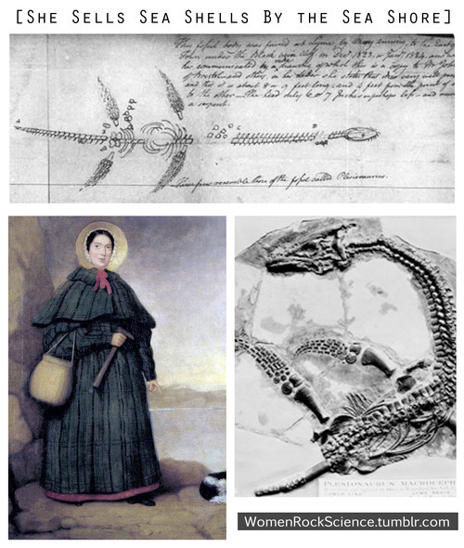

Slide 8
Friday 20th November.
LO – I can make a glossary to help me understand more complex vocabulary associated with a given text.
Make a glossary of the following words from the Marry Anning text.
Biology –
Fossil –
Geology –
Pterosaur - a fossil flying reptile of the Jurassic and Cretaceous periods, with membranous wings supported by a greatly lengthened fourth finger.
Scientist –

