Slide 1
This term in PSHE our topic is: Dreams and Goals
Lesson 3 – A New Challenge

Slide 2
LO: To enjoy facing new learning challenges and working out the best ways for me to achieve them.
LO: To break down a goal into a number of steps and know how others could help me to achieve it.

Slide 3
Vocabulary:
Garden Decoration Dream Goal
Team work Enterprise Design
Cooperation

Slide 4
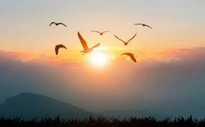
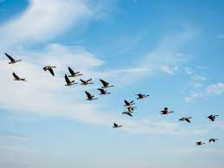
Calm Me
Use the Calm Me script.

Slide 5
Open my mind
In your groups, look at the pictures of gardens. How many garden decorations can you see? Which group can spot the most?

Slide 6
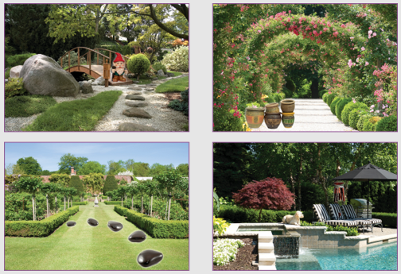
Open my mind

Slide 7
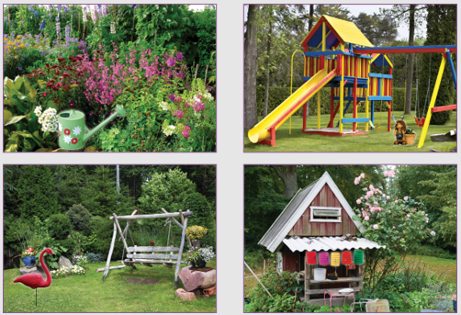
Open my mind

Slide 8
Tell me or show me
Whole School - Garden of Dreams and Goals - Challenge
Each class is going to make things to sell and the money raised will go to the Year 6 chosen charity. The year 3 challenge is to create a garden decoration which can be made and sold. We have a few lessons to get this ready. In your group, have a think about what you could make.

Slide 9
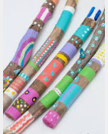
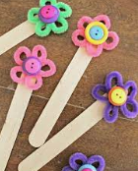
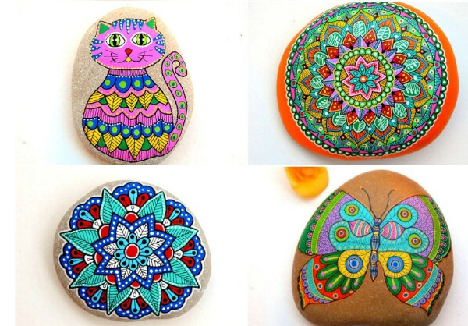
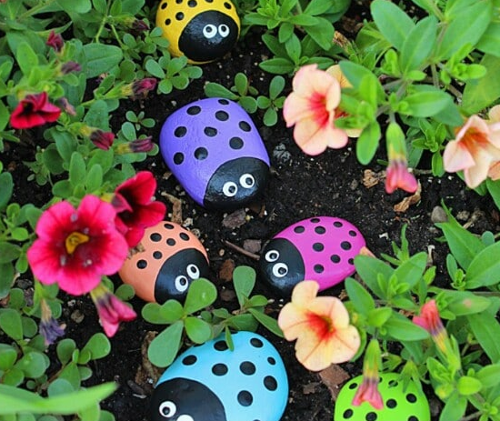
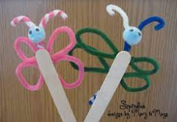
Let’s share some ideas.

Slide 10
Now let’s discuss what is feasible in terms of the time we have and the materials that are available.
If you are at home, think about what you have in the house or garden that you could use.

Slide 11
This is what your team task involves:
Working as a team
Designing a unique product that people would like to buy
Making the product
Deciding on cost
Preparing a leaflet or label for the product
Selling the product

Slide 12
Today you are going to begin to plan and design your team garden decorations.
Then you will start to collect the materials needed for next time.

Slide 13
How are you feeling about your team challenge?
I am feeling…
I am looking forward to…

