Slide 1
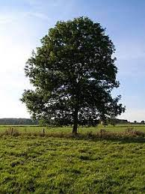
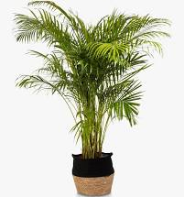
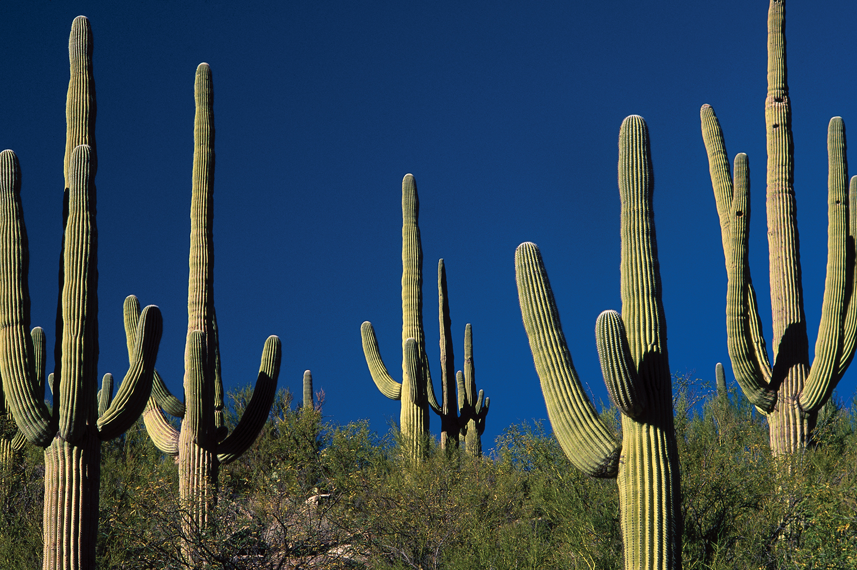
Plants – Growth and Support
Today we are going to start a new Science topic about the growth and support of plants. In today’s lesson, we are going to learn about the different parts of a plant.

Slide 2
LO: To name the parts of a plant.
LO: To begin to use a science model to describe.

Slide 3
Vocabulary
Grow, seed, bulb, (tuber), leaf (petiole), root (root hairs), stem, flower (petals, sepals, stamens, ovary, pollen, eggs), fruit, germination, seedling, water, light, temperature, nutrients, reproduction, pollination (wind, insect), fertilisation, seed, dispersal
This is the key vocabulary linked to plants that we will be learning over the course of the whole Summer term.

Slide 4
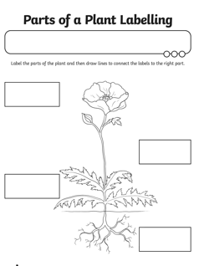
Plants have different parts that do different jobs.
Do you know the names of the different parts of a plant?
Work with a partner to fill in the blank labels on the plant on your activity sheet.

Slide 5
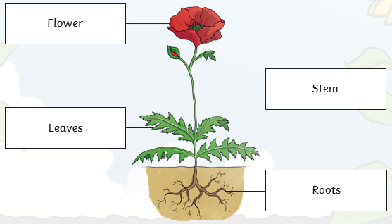
How did you get on?

Slide 6
What jobs do different parts of the plant do?

Slide 7
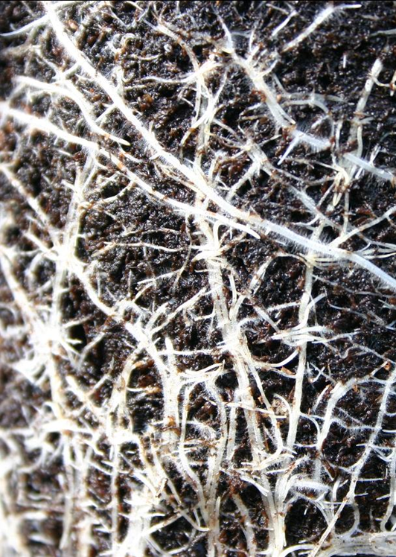
Roots
Where do we find the roots of a plant?
They grow underneath a plant, below the surface of the soil.
Roots are usually long and are covered in small hairs.
What do you think their jobs are?
The roots anchor the plant in the ground.
They absorb water and nutrients from the soil.

Slide 8
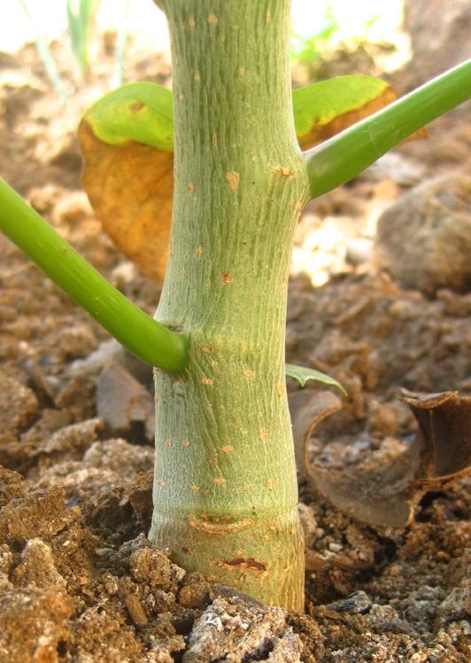
Stem or Trunk
What is a stem or trunk?
Branches, leaves and flowers grow from the stem or trunk.
A trunk is woody, and often has a layer of bark around it.
What job does it do?
The stem or trunk holds the plant up.
It also carries water and nutrients from the roots to the leaves.

Slide 9
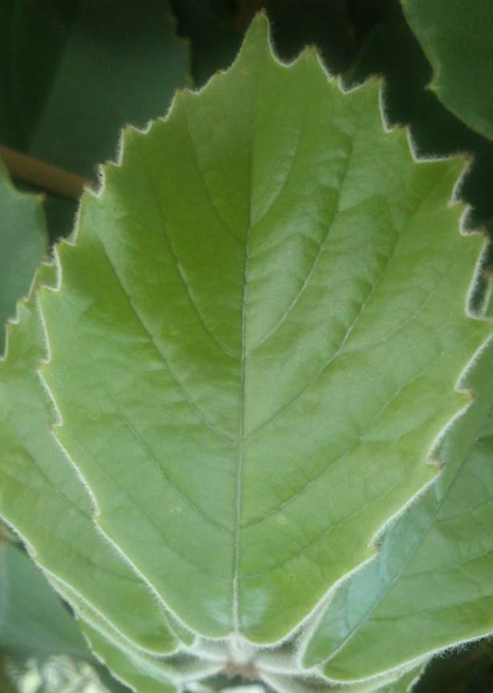
Leaves
What job do leaves do?
The leaves make food for the plant using sunlight and carbon dioxide from the air.

Slide 10
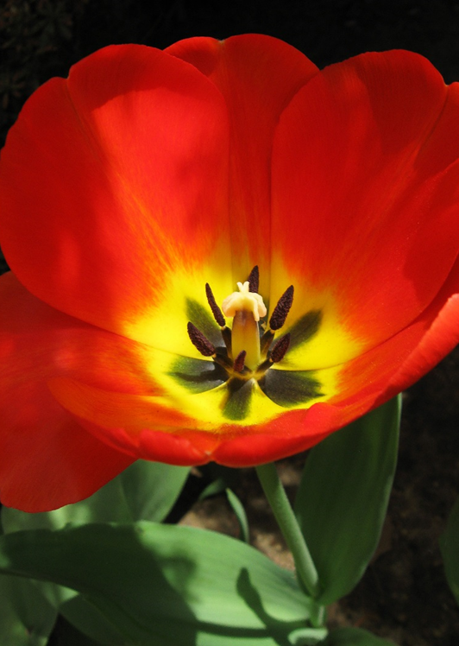
Flowers
Do you know what the flower’s job is?
Flowers are brightly coloured to attract insects and birds.
The insects carry pollen to other flowers.
Flowers use the pollen to make seeds to grow new plants.

Slide 11
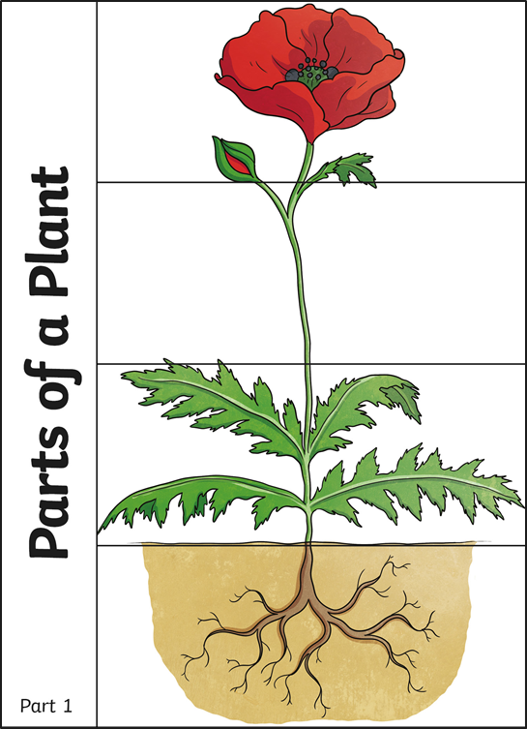
Your task
Your task is to make a folding leaflet to explain the functions of different parts of a plant. We will use this as a guide, but you are going to draw your own plant.

Slide 12
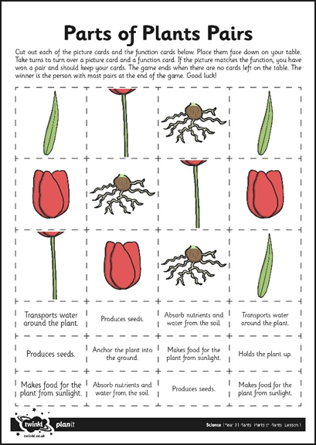
Pairs game
Now you can use the cards to match the parts of a plant to their functions. The winner is the person with the most pairs.

Slide 13
And finally…
We are going to plant something in class and watch what happens over the next few days and weeks. If you are at home, perhaps you can also find something to plant e.g. a broad bean. Watch the clip to see how to do it.
We hope you have fun seeing what happens!

