Slide 1
Wednesday 19th January 2022
LO: To write a finding tale

Slide 2
Today, we are going to finish writing our finding tale.
What do we need to remember?
Let’s check if we have remembered everything…

Slide 3
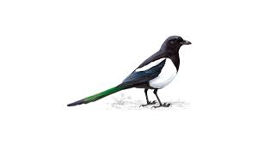
Remember to magpie from the original text as much as you like.

Slide 4
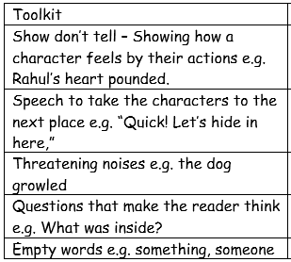
Also remember to include some or all of the features in the suspense toolkit.

Slide 5
Lastly, refer to your plan to help keep your story on track.
Today we are going to write the final paragraph. We will do a shared write in school based on my plan, and then you will go ahead with your own writing.
After that we will spend some time reading our story aloud to our partner and improving our work.

Slide 6
For those of you working from home, here is the final paragraph from the original text.

Slide 7
As you write, remember to keep reading what you have written to check it makes sense. Also check your spelling and punctuation.
I am sure you will remember to use your neatest handwriting too ☺

Slide 8
When you have finished writing, you are going to check your work with your partner.

Slide 9
Put your books open, one on top of the other.
The writer reads their story out loud.
The writer can say if they notice something that can be fixed or improved.
The listener can also make suggestions.
The writer uses their purple polishing pen to make any improvements.
Swap roles.

