Slide 1
Inter Faith Day
Friday 17th November 2021

Slide 2

Inter Faith Week 2021
Inter Faith Week aims to strengthen good inter faith relations, increase awareness of different faith communities in the UK and increase understanding of different religions.
Which religions can you remember?

Slide 3
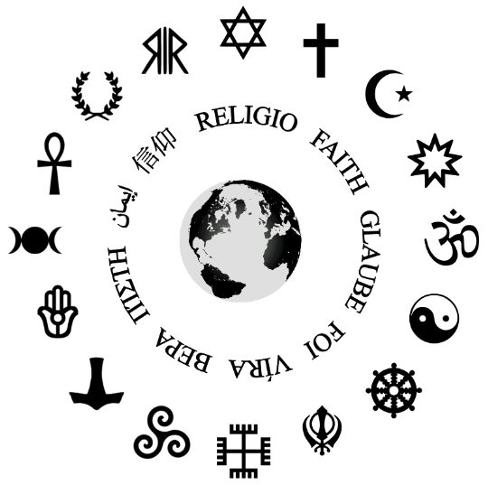
World Religion
There are more than 4,300 religions across the world!
Almost 75% of the world’s population practices Buddhism, Christianity, Hinduism, Islam, and Judaism.
Each of these religions have their own beliefs and values which they follow.
It is important that we understand that other people may have beliefs that are different to our own.
Can you think of any ways that we can show respect when learning with visitors who might hold beliefs different to ours?
Create a video with your class explaining some of those ways you can respect others.

Slide 4
Spirited Art Exhibition
RE is a co-operation between different religions and beliefs. Different religions might have specific beliefs however some may share similarities in their religion and beliefs. Do you know any religions that share similarities?
Can you create a piece of art that reflects respect of different faiths?
This could be a symbol, logo, drawing, painting or any other expressive art design to reflect the theme.
Think about the different faiths that might make up our local area of Gateshead such as Christianity, Judaism and Islam.

Slide 5
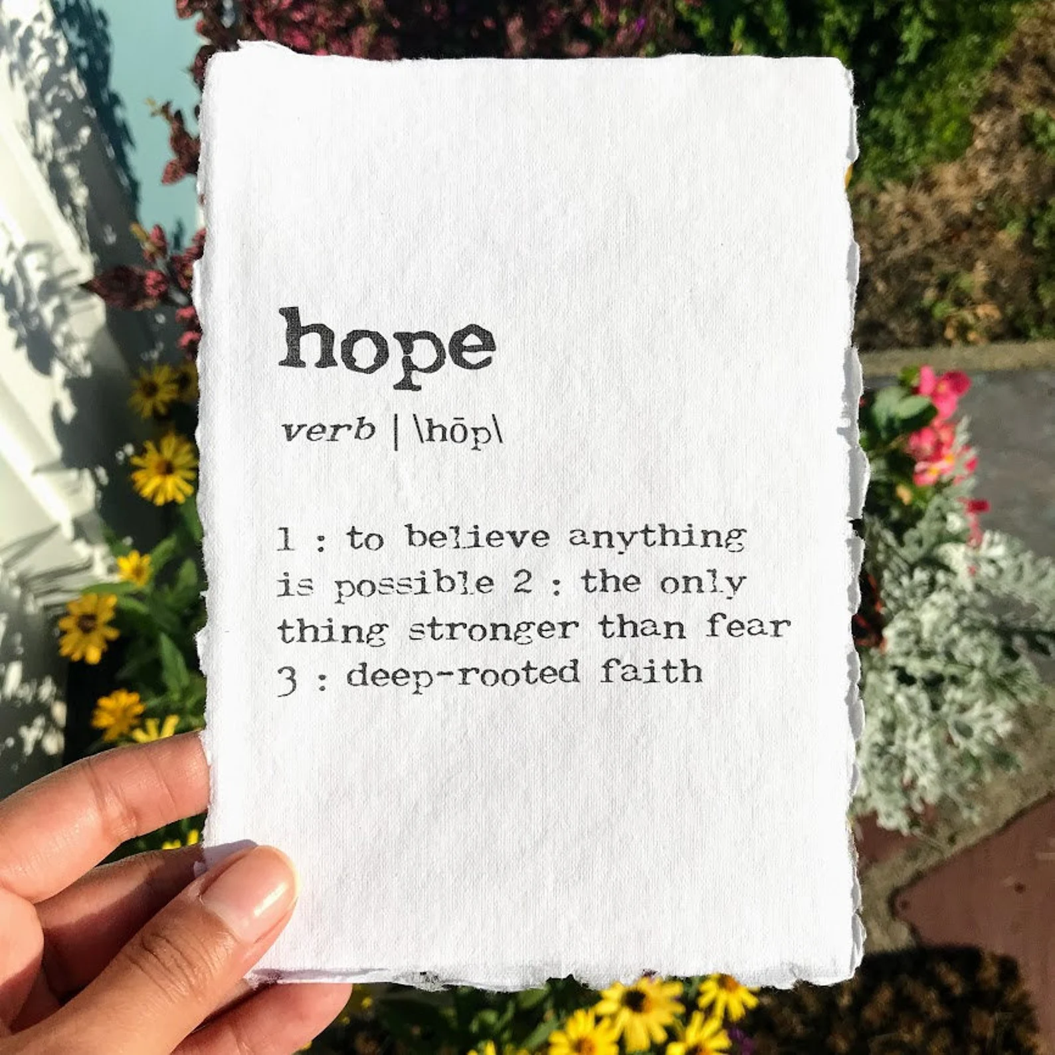
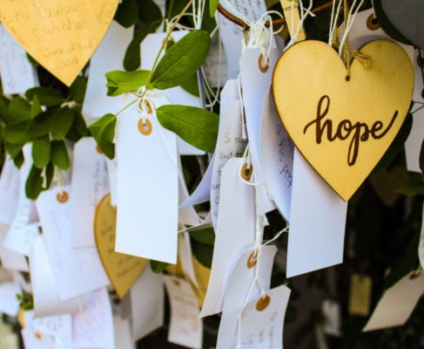
Tree of Hope
At Emmaville, we want to promote the value of hope.
Each of you will be given a luggage tag for you to write a prayer or hope on.
This may be a prayer relating to the respect of other faiths or a hope for the future.
These will all be hung on our school tree of hope.

Slide 6
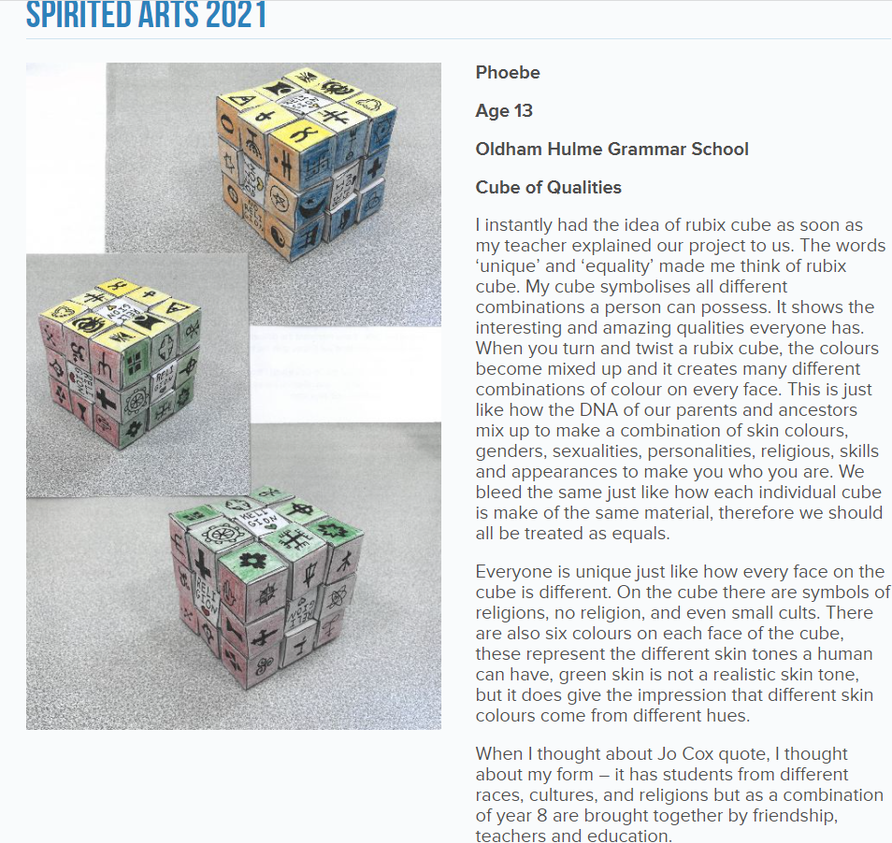
Year 6 Inter Faith Day Art Project

