Slide 1
13.1.22
LO – I can divide 2 digit numbers by 1 digit.

Slide 2
Let’s warm up today…
Let’s chant our 9 x tables using the counting stick.

Slide 3
Complete the number tracks.
Complete the part whole models.
10 | 20
3 | 6
39
42
42
30
40
30

Slide 4
Complete the number tracks.
Complete the part whole models.
10 | 20
30
40
50
60
70
80
90
100
3 | 6
9
12
15
18
21
24
27
30
39
42
42
30
9
40
2
30
12

Slide 5
There are 4 counters in each group.
But the counters have different values. The value of each group must be equal too.

Slide 6
39 ÷ 3 =
13
Tens | Ones

Slide 7
84 ÷ 4 =
21
Have a think
Tens | Ones
Work with your partner. In the same way, use place value counters to work out 86 ÷ 2 = and then 96 ÷ 3.
Then complete question 1 on your sheet.

Slide 8
42 ÷ 3 =
14
But those groups aren’t equal!
Tens | Ones

Slide 9
96 ÷ 4 =
24
Have a think
Tens | Ones

Slide 10
51 ÷ 3 =
17
Have a think
Tens | Ones

Slide 11
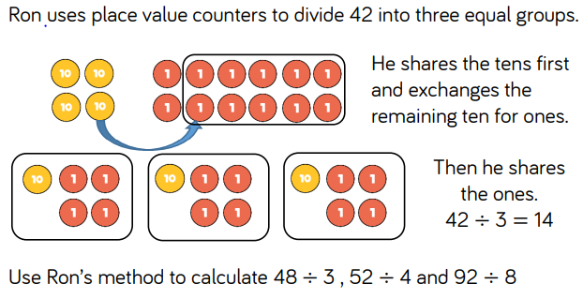
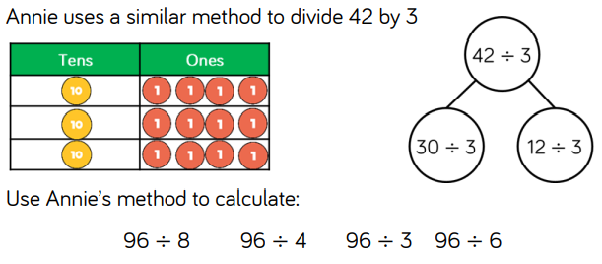
Now complete questions 2 from your sheet.

Slide 12
39 ÷ 3 =
13
42 ÷ 3 =
14
39
42
30
30
9
40
2
12
÷ 3
÷ 3
÷ 3
÷ 3
10
3
10
4
10 + 3 =
13
10 + 4 =
14

Slide 13
51 ÷ 3 =
17
96 ÷ 4 =
24
Have a think
51
96
96
40
16
30
21
80
40
16
÷ 4
÷ 4
÷ 3
÷ 3
÷ 4
÷ 4
÷ 4
10
4
10
7
20
10
4
10 + 7 =
17
24
10 $+$ 10 + 4 =
24
20 + 4 =
Now complete questions 3 and 4 from your sheet.

