Slide 2
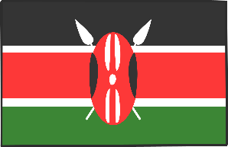
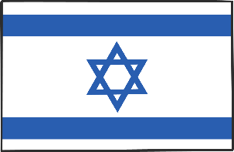
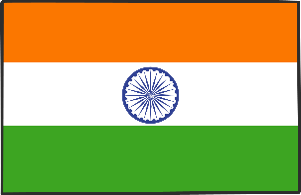
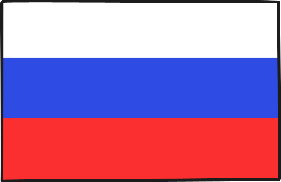
Countries
How many of these countries can you name?
UK
USA
Brazil
China
Kenya
Israel
Australia
India
Russia
Japan

Slide 3
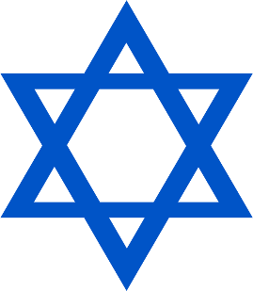
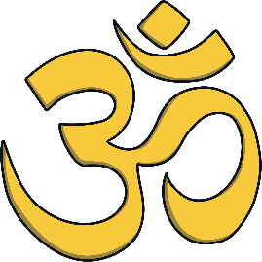
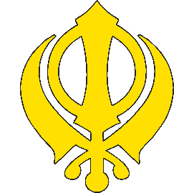
Religions
How many of these religions can you name?
Christianity
Judaism
Hinduism
Buddhism
Sikhism
Islam

Slide 4
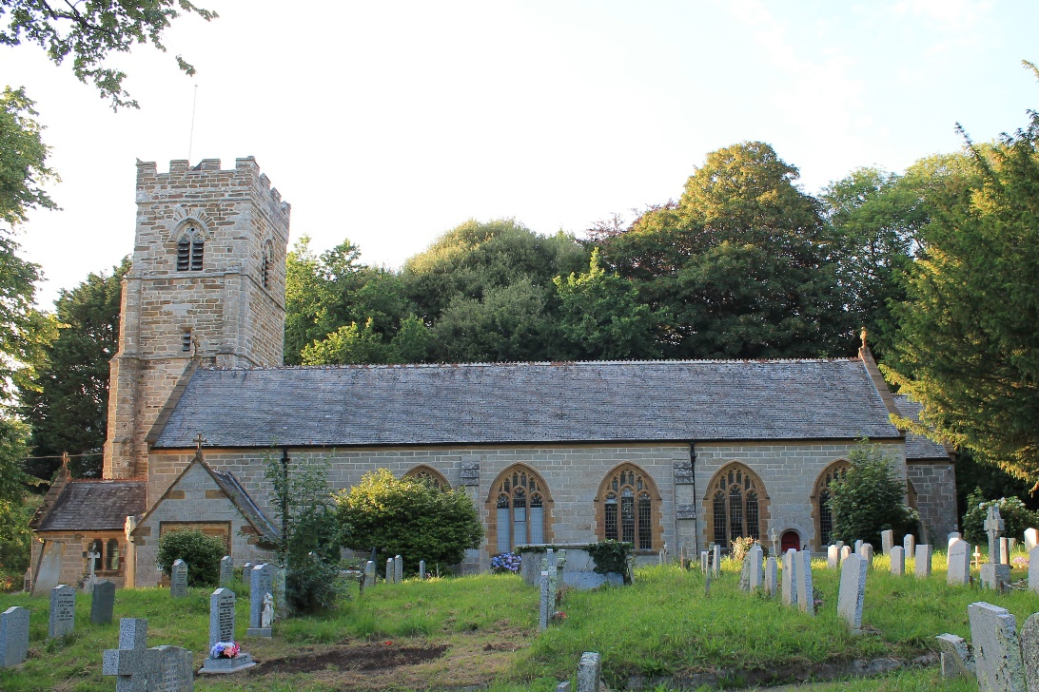
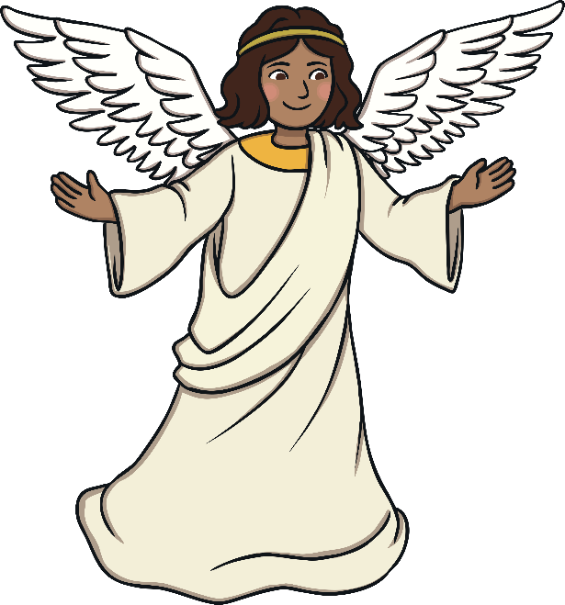
Christianity
Christians are people who believe that Jesus Christ is the Son of God. The holy book of Christianity is known as the Bible.
Many Christians follow Jesus Christ’s teachings in a Christian church.

Slide 5
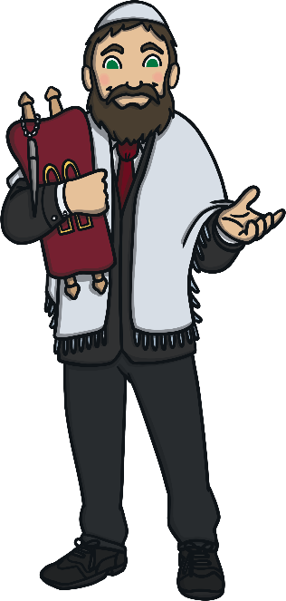
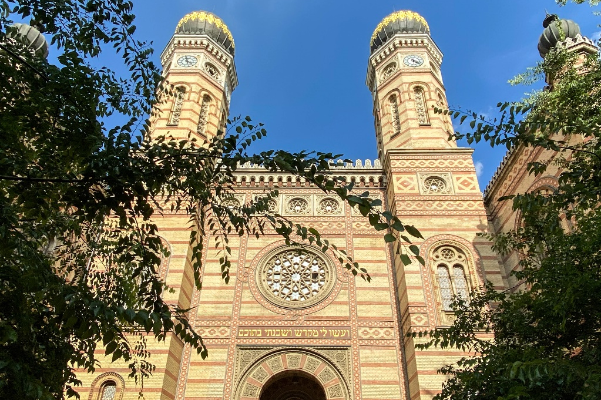
Judaism
The main teachings of Judaism is that there is a God and only one God, Yahweh. God created the universe and only He controls it.
Many Jewish people go to their temple or synagogue to pray. The holy book of Judaism is the Torah.

Slide 6
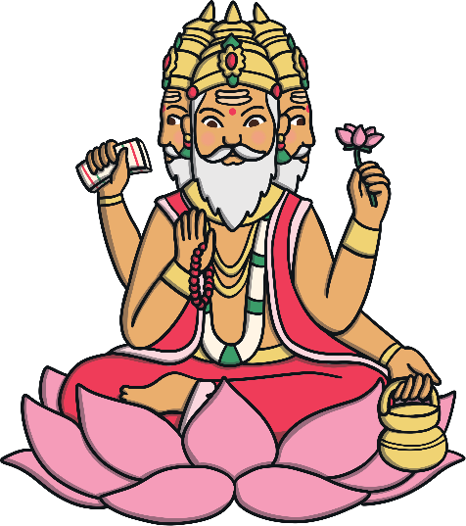
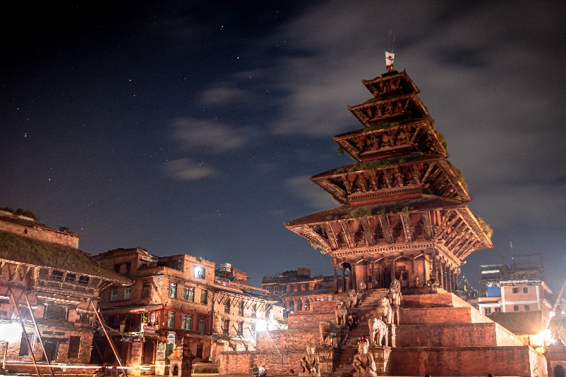
Hinduism
Hindus believe in a spiritual power called Brahman. Brahman is the source of all existence. It is present in everything and every place. Hindus worship many gods. Brahma (not to be confused with Brahman) is thought of as the creator of the universe.
The holy book of Hinduism is the Vedas.
Many Hindus pray in a home or temple known as a mandir.

Slide 7
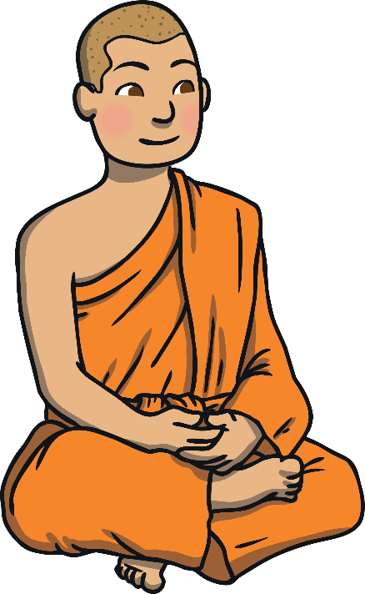
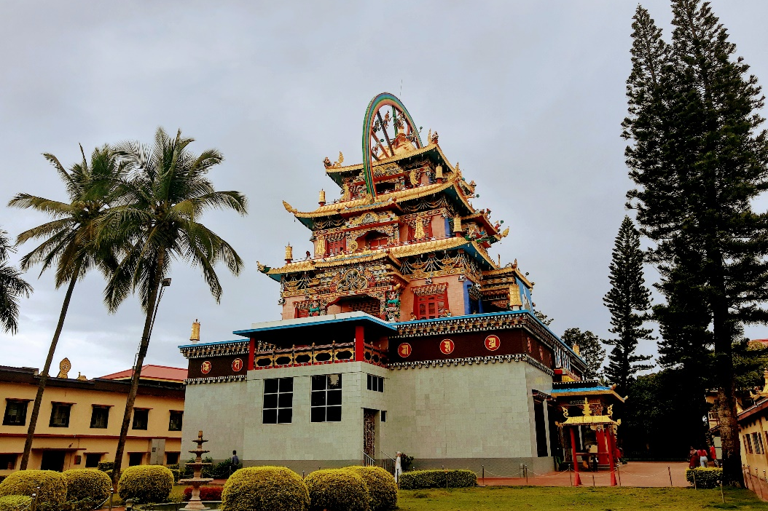
Buddhism
Buddhism is based around the Buddha’s teachings, known as the Four Noble Truths. The holy book of Buddhism is the Tripitaka.
Many Buddhists worship to Buddha in a temple or centre known as a vihara or stupa.

Slide 8
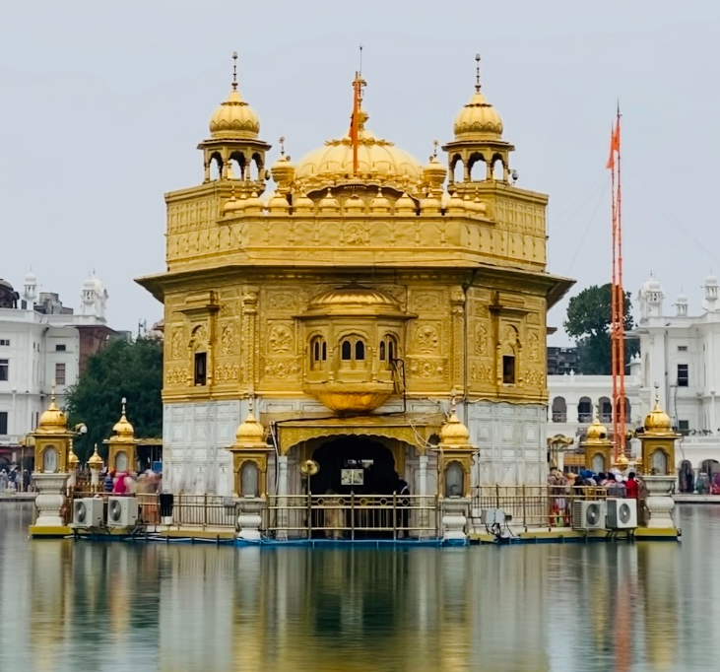
Sikhism
Sikhs believe that there is one God and everyone else is equal in the world. They believe that God is always guiding and protecting them so they must be a good person and act in a way that is good in the eyes of God.
Many Sikhs worship in a temple called a Gurdwara. The holy book of Sikhism is the Granth Sahib.

Slide 9
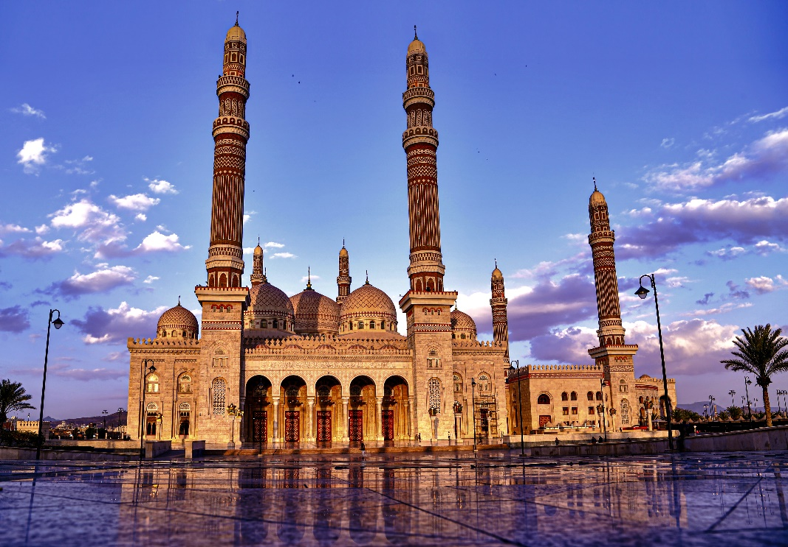
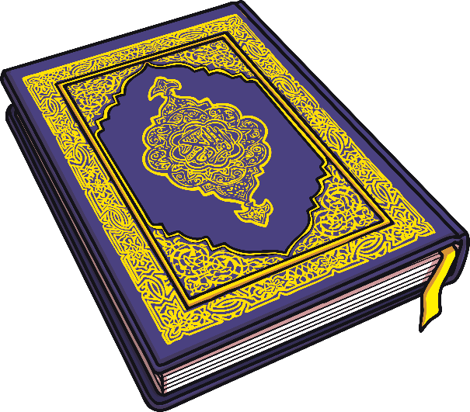
Islam
Muslims follow the Islam religion. They believe in ‘The One True God’, Allah. The holy book of Islam, the Qur’an, is believed to be the word of Allah as told by Muhammad, the prophet of Allah (Peace Be Upon Him).
Muslims gather at a place of worship, called a mosque, for special prayers.

Slide 10
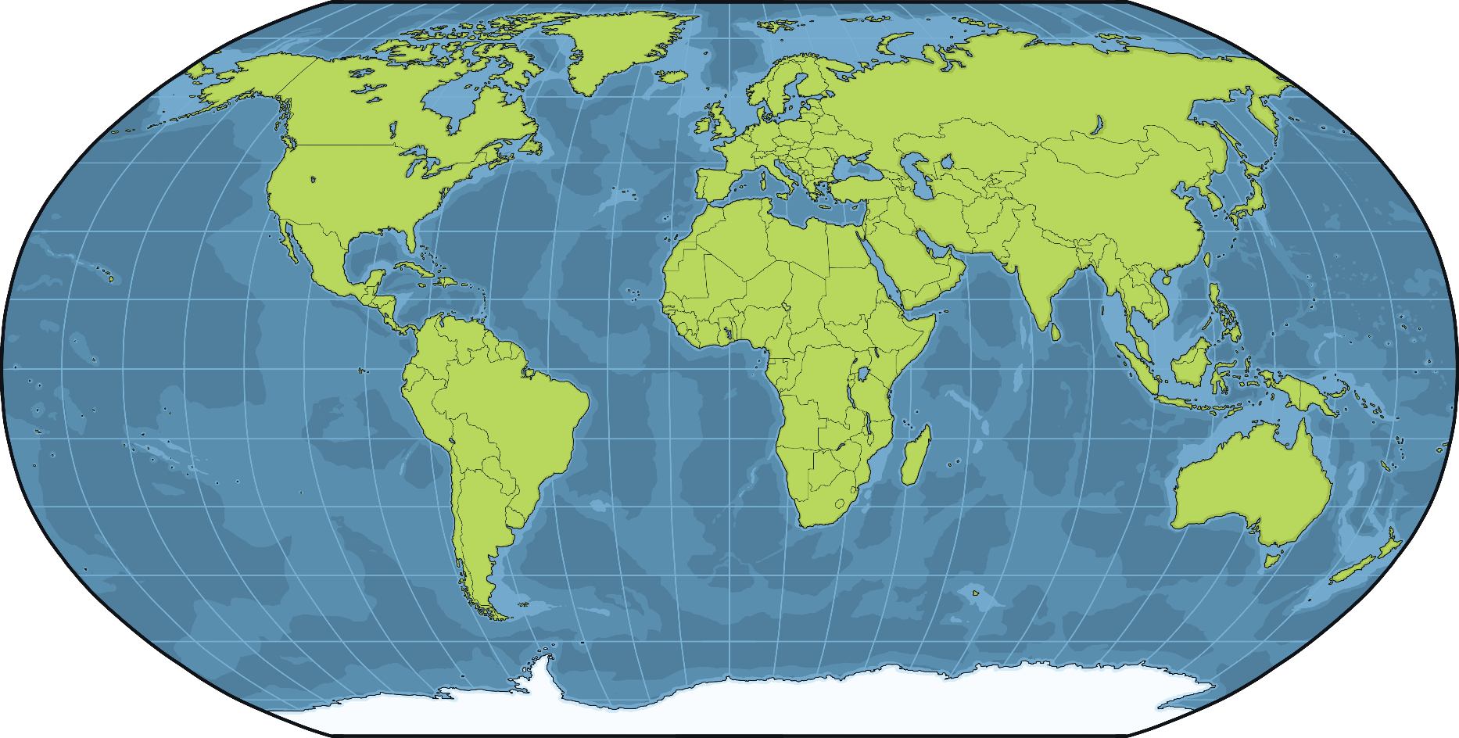
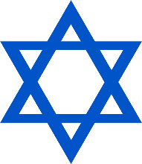
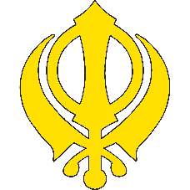
Countries and Religions
Just as some countries can share similar traditions and festivals, they can also share many religions.

Slide 11
World Religion Day
World Religion Day began in the United States in 1950 but is now celebrated worldwide.
One of the youngest religions, the Bahá'í faith, began the celebration.
The Bahá'í faith believe that all religions have things in common, and so teach that all religions should be respected to unite all.

Slide 12
World Religion Day
World Religion Day is held on the third Sunday of January, every year.
World Religion Day is celebrated to promote interfaith understanding, which means involving many different religions and uniting them together.
It is important that there is harmony and that people feel comfortable to unite together, whatever their faith.

Slide 13
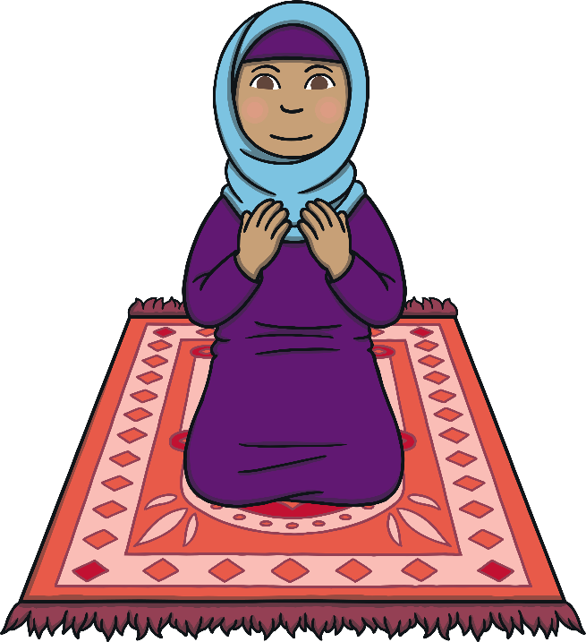
World Religion Day
Many events are held around the world and people are asked to look at the similarities across different religions.
Special religious services are held around the world, celebrating these similarities.
When we learn about other religions, we can work together to create a better world.

Slide 14
One World
Can you think of anything that religions have in common?
the love of a higher being or God
a holy book
a place of worship
Can you think of any more similarities?

Slide 15
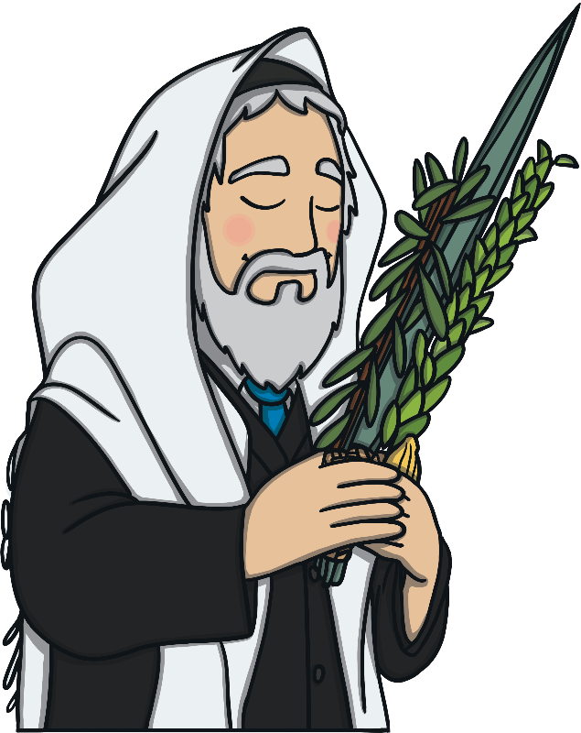
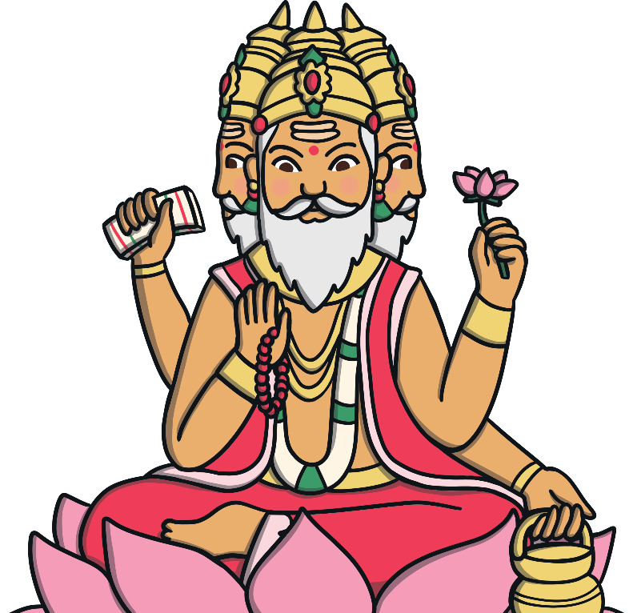
Christianity, Judaism, Hinduism
Christianity
Judaism
Hinduism
In everything, do to others as you would have them do to you.
What is hateful to you, do not do to your fellow man.
What is the sum of duty; do not do to others what would cause pain if done to you.

Slide 16
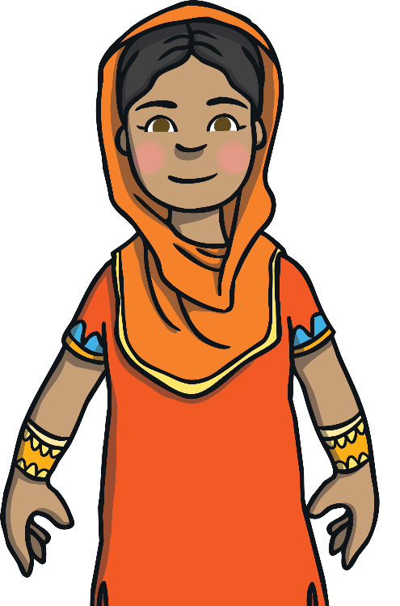
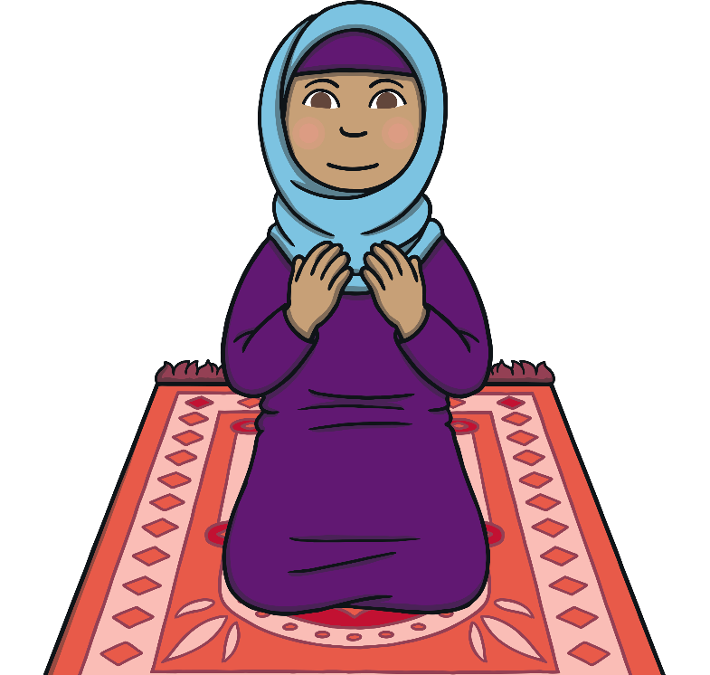
Buddhism, Sikhism, Islam
Buddhism
Sikhism
Islam
Treat not others in ways that you would find hurtful.
I am a stranger to no one and no one is a stranger to me, I am a friend to all.
Not one of you truly believes until you wish for others what you wish for yourself.

Slide 17
Reflection
What do these statements all have in common?
All of these religions share the same message - treat others as you would wish to be treated and love people with respect.

Slide 18
Reflection
Did you spot any words that are repeated?
do
to
others
you
wish
for all
not one
All of these religions share the same message - treat others as you would wish to be treated and love people with respect.

