Slide 1
Thought for the Day – Background information for Adults.
Collective worship in schools aims to provide the opportunity for pupils to worship God, to consider spiritual and moral issues and to explore their own beliefs; to encourage participation and response, whether through active involvement in the presentation of worship or through listening to and joining in the worship offered; and to develop community spirit, promote a common ethos and shared values, and reinforce positive attitudes. Collective worship allows time for personal reflection and prayer.
Acts of collective worship may include exploring an idea or theme, hearing quotes from an individual or a story about someone’s life and their impact in the world, for example. It gives opportunities for pupils to reflect on a diverse range of world views, religious and otherwise. Collective acts of worship can contain some elements which relate specifically to the Christian religion, and, where appropriate, address the special status accorded to Jesus, but when such material is shared with non-Christian pupils it is shared in a spirit and in a manner which is educational in intent. In other words, pupils are informed that Christians believe that Jesus is the Son of God. Christians who attend the act of collective worship might be afforded an opportunity to worship him. However, whilst non-Christian pupils will not be required to worship Jesus, they shall be invited, to encourage the feeling of community, to reflect in silence on what they have heard.

Slide 2
Taken from a Save the Children Document

Slide 3
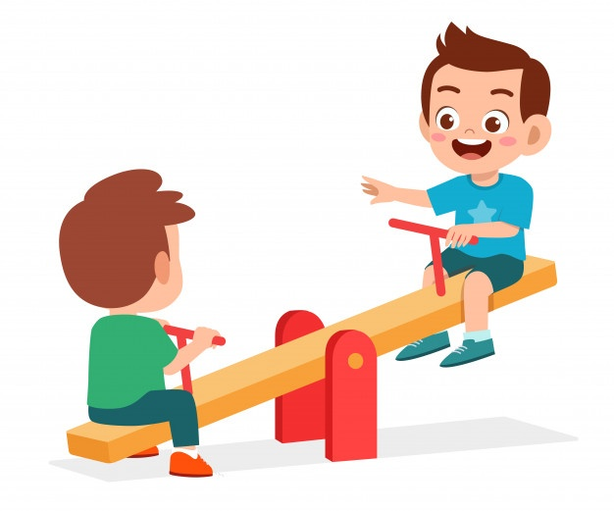
Monday
Friends
Up and down, up and down.
Leo and Michael have fun on the seesaw!
Isn’t it wonderful to have friends to play with.
What games do you play with your friends?
Some people thank God for things in life.
Listen to this prayer and say Amen, if you agree.
Dear God,
I have fun playing with ………….
Thank you for my friends.
Amen.
Adapted from ‘God and Me’ by Penny Boshoff

Slide 4
Tuesday
Families.
How many people are there in your family?
Christians believe that God’s family is made up of all the people who are friends with God, and all the people who know that God is friends with them. That is a lot of people!
Some people like to say thank you to God.
Listen to this prayer and say Amen, if you agree.
Dear God,
thank you for my family.
Thank you that I can belong to your family too.
Amen.
Adapted from ‘God and Me’ by Penny Boshoff

Slide 5
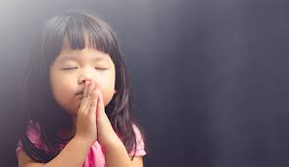
Adapted from ‘God and Me’ by Penny Boshoff
Wednesday
Talking to God.
Christians believe that God loves us and takes care of us, all throughout the day.
Some people like to talk to God at night, before they fall asleep.
They tell God about all the fun they have had, what they have done and what they have learned.
They also say sorry for the things that they have done wrong and ask God to help them tomorrow.
Listen to this prayer and say Amen, if you agree.
Think about what you might say in the quiet gaps.
Dear God,
Thank you for today.
I liked doing……………….
I’m sorry for………………
Please help me tomorrow.
Amen.

Slide 6
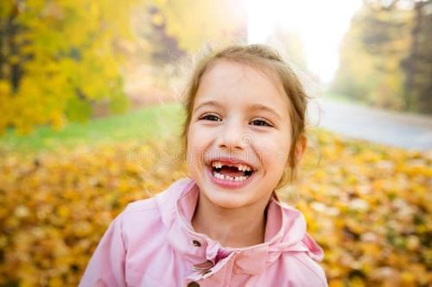
Thursday
Teeth
Teeth are important.
If you didn’t have any teeth you wouldn’t be able to eat anything crunchy or chewy.
Milly’s two wobbly front teeth have come out. Her new, big teeth are growing slowly.
Milly is taking good care of her new teeth. She brushes them carefully and doesn’t
eat too many sweets.
How many teeth do you have?
How do you look after them?
Some people thank God for things in life.
Listen to this prayer and say Amen, if you agree.
Thank you, God, for teeth to bite, crunch, munch and chew.
I’ll keep them bright and clean and white, to last my whole life through.
Amen.
Adapted from ‘God and Me’ by Penny Boshoff

Slide 7
Whole School Focus: Enterprise
Friday
“You don't learn to walk by following rules. You learn by doing, and by falling over.”
Richard Branson
Prayer: Lord, help us to accept that we will make mistakes as we work towards our goals. Help us not to become discouraged by our failures but to learn from them, and give us the strength to pick ourselves up after setbacks and start again. Amen.

Slide 8
Friday
Our School Prayer.
God bless our school.
Bless those who teach,
Bless those who learn,
Bless us with knowledge.
Amen.
What have you enjoyed at school?
What have you learned this week?
Have you helped someone else to learn?
Ask the children to listen to our school prayer.
Remind the children that
Amen means- “I agree”
The children might like to say “Amen” at the end.

