Slide 1
Wednesday 24th November
L.O. To learn about the features of a diary entry.

Slide 2
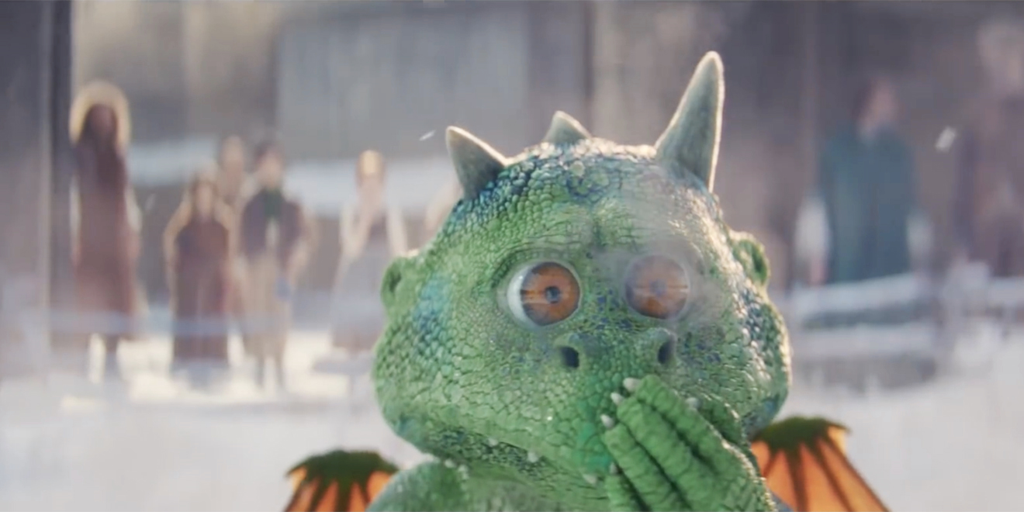
Diary entry
Next week you are going to imagine that you are Edgar, and write a diary extract from his point of view about his eventful day!

Slide 3
When you write a diary entry, you are writing about a day in the life of a real person or character.
It needs to be exciting and interesting to read!
To get this right, just follow a few easy steps...

Slide 4
Date and time
You can write the date at the top of the page like this…
or it can be included in the first few sentences of a diary entry like this...
‘It is past midnight but I am still wide awake because my day has been so exciting.’
This is important because it tells the reader exactly when the diary is being written.

Slide 5
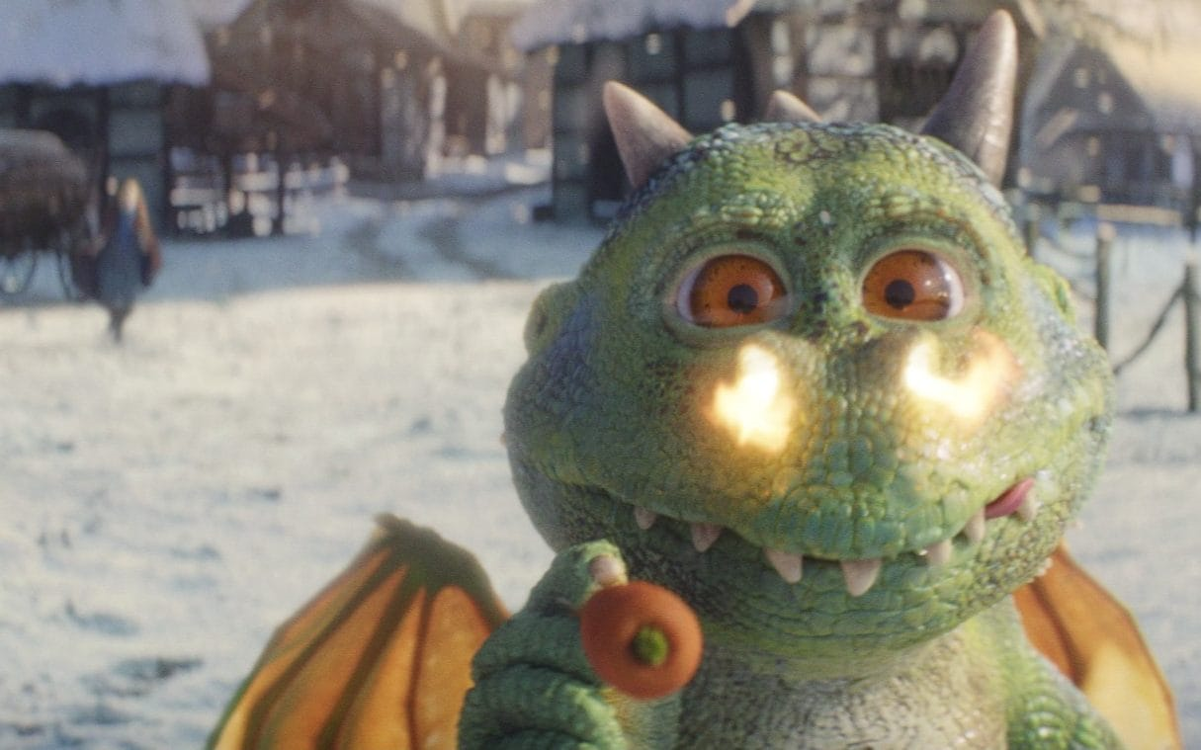
Past tense
When we write a diary, we write in the past tense. This is because we are writing about something that has already happened.

Slide 6
‘I’, ‘my’, ‘we’ and ‘our’
A diary entry needs to be written in first person. So you need to use words like ‘I’, ‘my’, ‘we’ and ‘our’.
I played with the new football I got for my birthday.
When my brother got home, we had pizza for our tea. First person!

Slide 7
Chronological order…
You must write about the events in the order that they happened.
You only need to write about the most interesting and exciting parts of your day.

Slide 8
Describe feelings
A diary is usually a secret place to write how you feel about what has happened to you in the day.
In a diary, you might include feelings, hopes or fears that you wouldn’t want anyone to know about.

Slide 9
Time connectives
A diary is usually describing lots of events. To make sense of when these events happened it is helpful to include time linking words, such as ‘next’, ‘first’ and ‘then’.

Slide 10
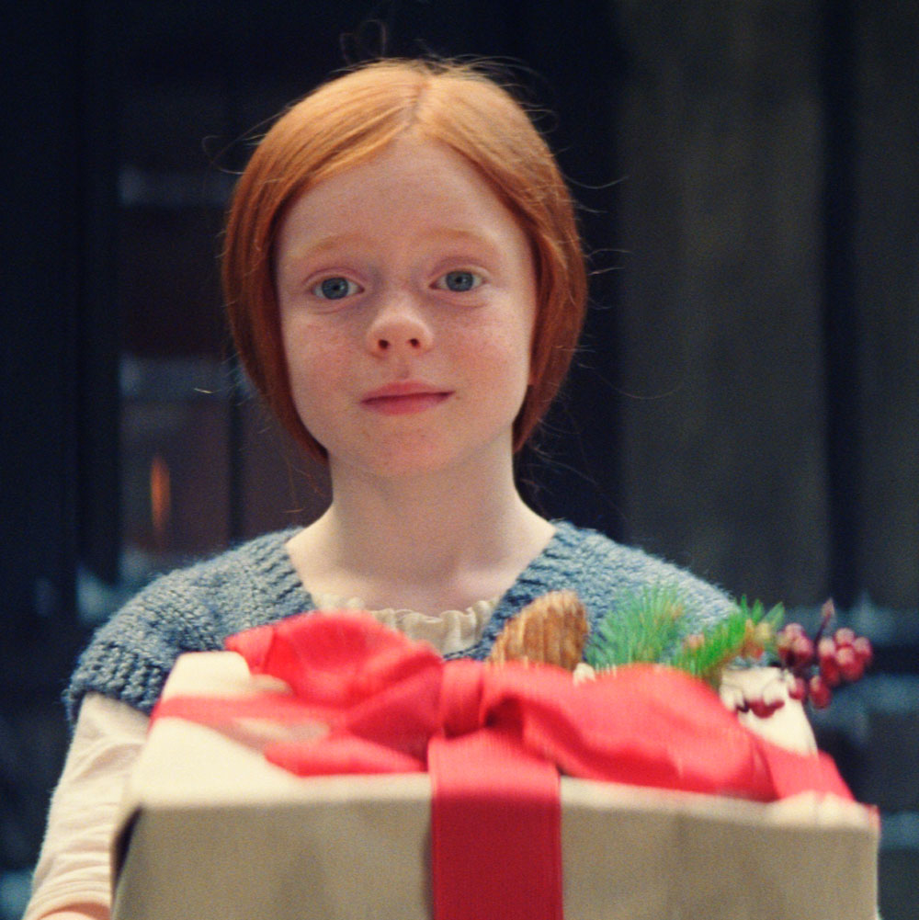
Your task
Working as a class, we will highlight these features in Ava’s diary entry…

