Slide 1
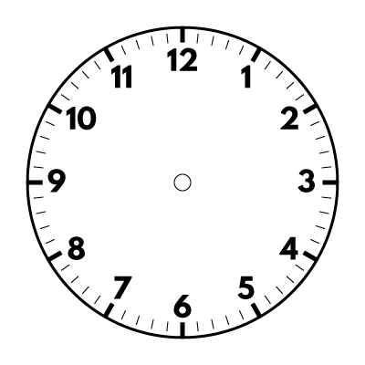
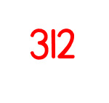
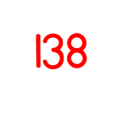
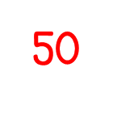
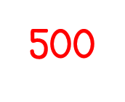
Year 5 | Week 2 | Day 2

Slide 4
1) 12 $×$ 4 $=$
2) 12 $×$ 40 $=$
3) 206 $×$ 3 $=$
4) 206 $×$ 300 $=$

Slide 5
1) 12 $×$ 4 $=$
2) 12 $×$ 40 $=$
3) 206 $×$ 3 $=$
4) 206 $×$ 300 $=$
48
480
618
61,800

Slide 7
132 $×$ 23
Let’s do this together in our books.
Th | H | T | O
 | 1 | 3 | 2
 |  | 2 | 3
$$×$$
3
3
9
6
$($132 $×$ 3$)$
$$+$$

Slide 8
132 $×$ 23
Th | H | T | O
 | 1 | 3 | 2
 |  | 2 | 3
$$×$$
2
3
9
6
$($132 $×$ 3$)$
2
6
4
0
$($132 $×$ 20$)$
$$+$$
3
0
3
6
1
1

Slide 9
326 $×$ 32
Have a think
Th | H | T | O
 | 3 | 2 | 6
 |  | 3 | 2
Let’s do this together in our books.
$$×$$
6
5
2
$($326 $×$ 2$)$
1
$$+$$

Slide 10
326 $×$ 32
$=$ 10,432
Th | H | T | O
 | 3 | 2 | 6
 |  | 3 | 2
$$×$$
6
5
2
$($326 $×$ 2$)$
1
9
7
8
0
$($326 $×$ 30$)$
$$+$$
1
1
0
4
3
2
1
1

Slide 11
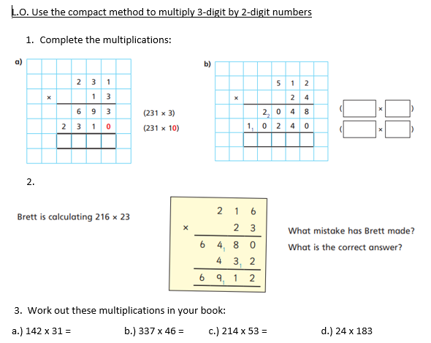
Have a go at the questions 1 - 3 on the worksheet (stick it in)

Slide 12
Dora, Alex and Teddy have worked out 248 $×$ 21
Dora
Alex
Teddy
2,978
5,208
7,688
How can we use estimating to help us check who is correct?
248 $×$ 21
250
20
$$×$$
$=$ 50
25 $×$ 2
250 $×$ 20 $=$ 5,000

Slide 13
Estimate each side of the equation and write $<$, $>$ or $=$ to complete the statement
Have a think
181 $×$ 24
$$<$$
112 $×$ 63
200 $×$
20
100 $×$
60
4,000
6,000

Slide 14
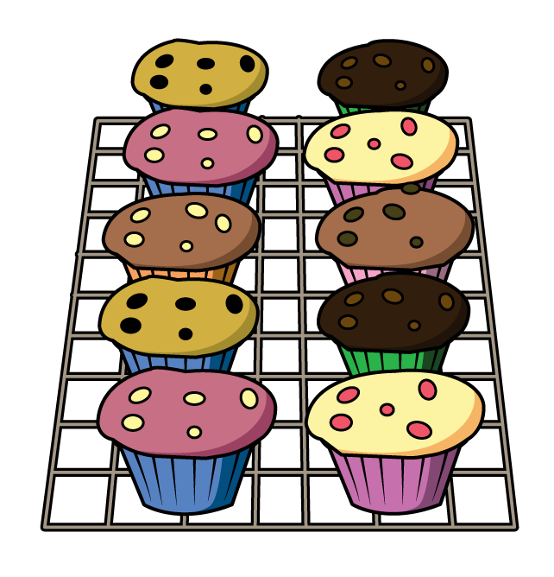
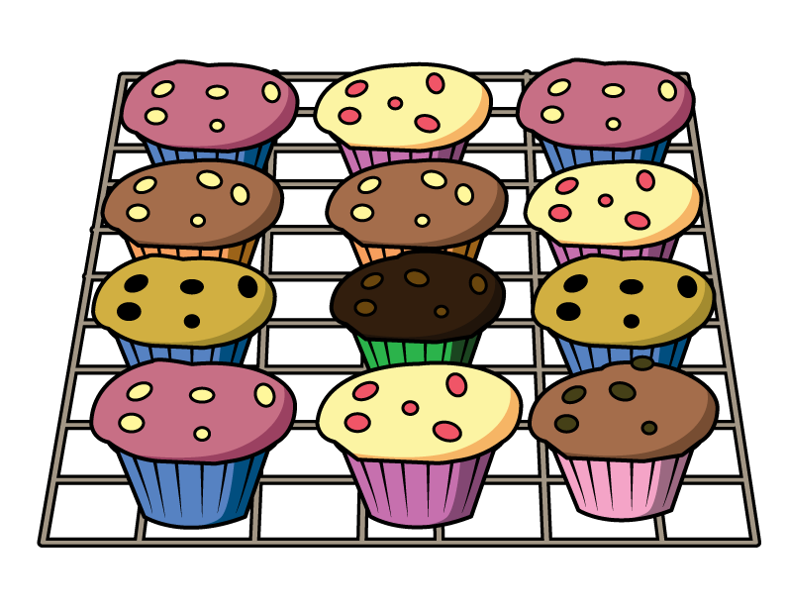
Mo orders muffins for a party.
He orders 12 of box A,
20 of box B
and 14 of box C.
How many muffins does Mo order?
Have a think
Box A
Box B
Box C
12 $×$ 1 $=$
12
20 $×$ 10 $=$
200
14 $×$ 12 $=$
168
14 $×$ 2 $=$ 28
200 $+$ 168 $+$ 12 $=$
380
14 $×$ 10 $=$ 140

Slide 15
380
How many muffins does Mo order?
Each muffin costs 24p. How much does Mo spend on muffins?
Th | H | T | O
 | 3 | 8 | 0
 |  | 2 | 4
9,120p
Have a think
$$×$$
1
5
2
0
$($380 $×$ 4$)$
3
7
6
0
0
$($380 $×$ 20$)$
$$+$$
1
9
1
2
0
1

Slide 16
380
How many muffins does Mo order?
Each muffin costs 24p. How much does Mo spend on muffins?
9,120p
$÷$ 100
100p $=$ £1.00
9120 $÷$ 100
TTh | Th | H | T | O | tth | hth
9
1
2
0
£91.20

Slide 17
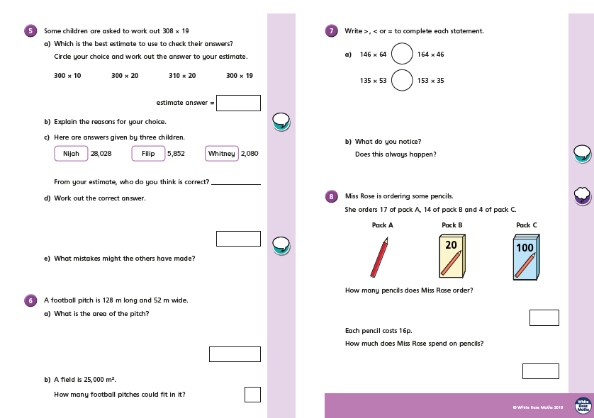
Have a go at the questions 5 - 8 on the worksheet (don’t stick it in – do the working out in your book) and re-number them 4 - 7

