Slide 1

11.2.22
LO – I can count in fractions.

Slide 2




What’s the same? What’s different?
Complete the number lines.
Fill in the missing fractions.
0
1
0
2
0
$\frac{\text{1}}{\text{7}}$
$\frac{\text{2}}{\text{7}}$
$\frac{\text{4}}{\text{7}}$
$\frac{\text{5}}{\text{7}}$
1

Slide 3
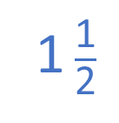


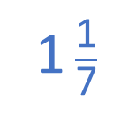






What’s the same? What’s different?
Complete the number lines.
Fill in the missing fractions.
$\frac{\text{1}}{\text{4}}$
$\frac{\text{2}}{\text{4}}$
$\frac{\text{3}}{\text{4}}$
0
1
$\frac{\text{1}}{\text{2}}$
1 $\frac{\text{1}}{\text{2}}$
0
1
2
$\frac{\text{7}}{\text{7}}$
$\frac{\text{8}}{\text{7}}$
0
$\frac{\text{1}}{\text{7}}$
$\frac{\text{2}}{\text{7}}$
$\frac{\text{3}}{\text{7}}$
$\frac{\text{4}}{\text{7}}$
$\frac{\text{5}}{\text{7}}$
$\frac{\text{6}}{\text{7}}$
1
1 $\frac{\text{1}}{\text{7}}$

Slide 5
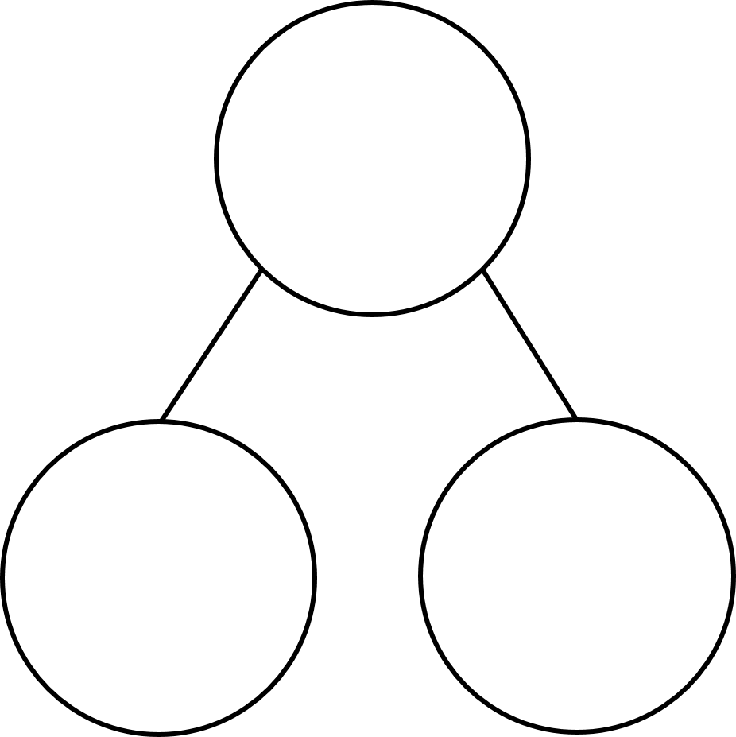


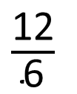
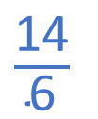
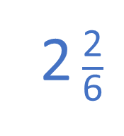

2 $\frac{\text{2}}{\text{6}}$
$\frac{\text{14}}{\text{6}}$
$\frac{\text{6}}{\text{6}}$
1 whole
1 whole
$\frac{\text{6}}{\text{6}}$
$\frac{\text{12}}{\text{6}}$
$\frac{\text{2}}{\text{6}}$
2 wholes
2 sixths

Slide 6


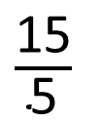

$\frac{\text{18}}{\text{5}}$
$\frac{\text{5}}{\text{5}}$
1 whole
$\frac{\text{15}}{\text{5}}$
$\frac{\text{3}}{\text{5}}$
3 wholes
3 fifths

Slide 7


































$+$ $\frac{\text{1}}{\text{6}}$
1
1 $\frac{\text{1}}{\text{6}}$
1 $\frac{\text{2}}{\text{6}}$
1 $\frac{\text{3}}{\text{6}}$
1 $\frac{\text{4}}{\text{6}}$
1 $\frac{\text{5}}{\text{6}}$
2
2 $\frac{\text{1}}{\text{6}}$
2 $\frac{\text{2}}{\text{6}}$
2 $\frac{\text{3}}{\text{6}}$
2 $\frac{\text{4}}{\text{6}}$
2 $\frac{\text{5}}{\text{6}}$
3
3 $\frac{\text{1}}{\text{6}}$
$\frac{\text{4}}{\text{6}}$
$\frac{\text{5}}{\text{6}}$
$\frac{\text{6}}{\text{6}}$
$\frac{\text{7}}{\text{6}}$
$\frac{\text{8}}{\text{6}}$
$\frac{\text{9}}{\text{6}}$
$\frac{\text{10}}{\text{6}}$
$\frac{\text{11}}{\text{6}}$
$\frac{\text{12}}{\text{6}}$
$\frac{\text{13}}{\text{6}}$
$\frac{\text{14}}{\text{6}}$
$\frac{\text{15}}{\text{6}}$
$\frac{\text{16}}{\text{6}}$
$\frac{\text{17}}{\text{6}}$
$\frac{\text{18}}{\text{6}}$
$\frac{\text{19}}{\text{6}}$

Slide 8


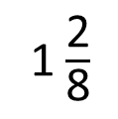




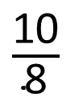
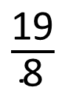

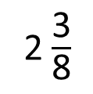


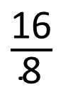


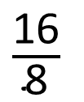

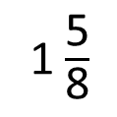

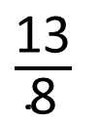
Have a think
$+$ $\frac{\text{3}}{\text{8}}$
$\frac{\text{1}}{\text{8}}$
$\frac{\text{4}}{\text{8}}$
$\frac{\text{7}}{\text{8}}$
$\frac{\text{10}}{\text{8}}$
$\frac{\text{13}}{\text{8}}$
$\frac{\text{16}}{\text{8}}$
$\frac{\text{19}}{\text{8}}$
1 $\frac{\text{2}}{\text{8}}$
1 $\frac{\text{5}}{\text{8}}$
2
2 $\frac{\text{3}}{\text{8}}$
$\frac{\text{10}}{\text{8}}$
$\frac{\text{13}}{\text{8}}$
$\frac{\text{16}}{\text{8}}$
$\frac{\text{19}}{\text{8}}$
$\frac{\text{16}}{\text{8}}$
$\frac{\text{8}}{\text{8}}$
$\frac{\text{2}}{\text{8}}$
$\frac{\text{5}}{\text{8}}$
$\frac{\text{3}}{\text{8}}$
2 wholes
1 whole

Slide 9
Have a go at questions 1 – 2 on the worksheet.
Think carefully about your definitions of mixed fractions and improper fractions.

Slide 10
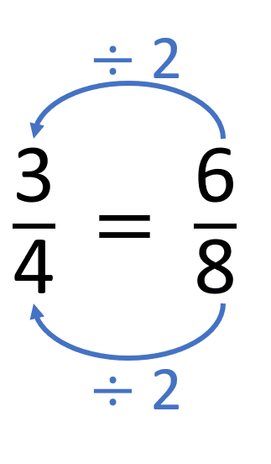
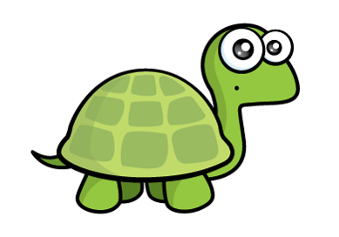
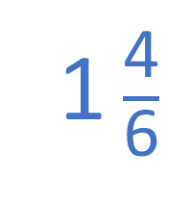

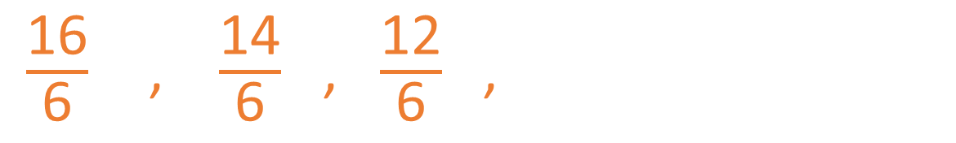
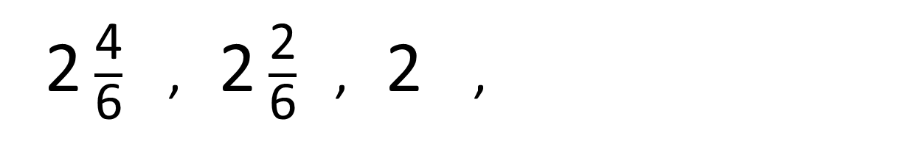
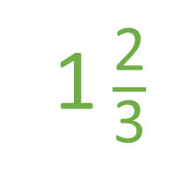

I can think of three different ways to answer this.
Have a think
$−$ $\frac{\text{2}}{\text{6}}$
1 $\frac{\text{2}}{\text{3}}$
2 $\frac{\text{4}}{\text{6}}$ , 2 $\frac{\text{2}}{\text{6}}$ , 2 ,
1 $\frac{\text{4}}{\text{6}}$
$\frac{\text{10}}{\text{6}}$
$\frac{\text{16}}{\text{6}}$ , $\frac{\text{14}}{\text{6}}$ , $\frac{\text{12}}{\text{6}}$ ,

Slide 11



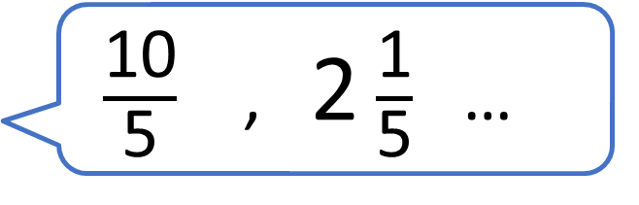
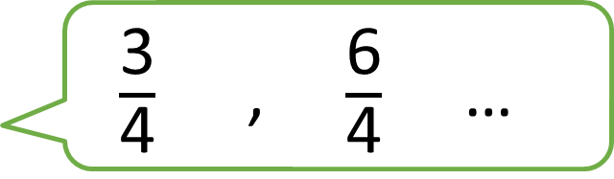
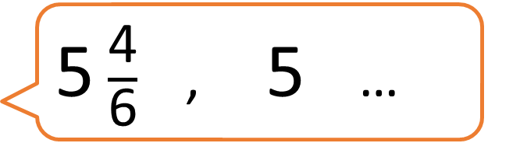
$\frac{\text{10}}{\text{5}}$ , 2 $\frac{\text{1}}{\text{5}}$ …
Have a think
5 $\frac{\text{4}}{\text{6}}$ , 5 …
$\frac{\text{3}}{\text{4}}$ , $\frac{\text{6}}{\text{4}}$ …
Who will reach 3 wholes first?

Slide 12
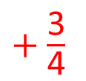

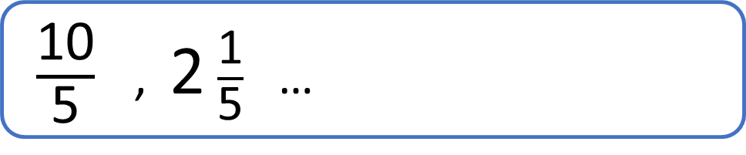
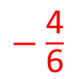
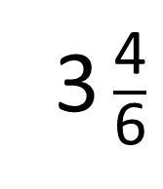


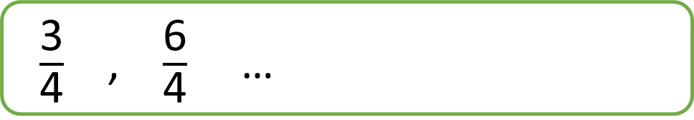
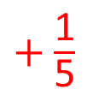
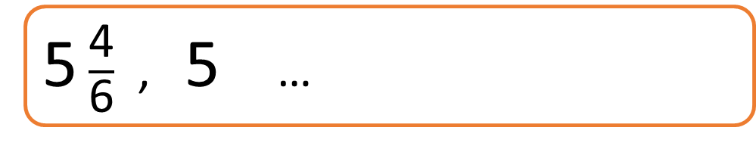
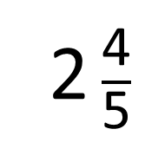

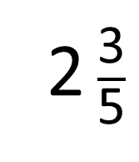
$\frac{\text{10}}{\text{5}}$ , 2 $\frac{\text{1}}{\text{5}}$ …
2 $\frac{\text{2}}{\text{5}}$
2 $\frac{\text{3}}{\text{5}}$
2 $\frac{\text{4}}{\text{5}}$
3
$+$ $\frac{\text{1}}{\text{5}}$
4 $\frac{\text{2}}{\text{6}}$
5 $\frac{\text{4}}{\text{6}}$ , 5 …
3 $\frac{\text{4}}{\text{6}}$
3
$−$ $\frac{\text{4}}{\text{6}}$
$\frac{\text{3}}{\text{4}}$ , $\frac{\text{6}}{\text{4}}$ …
$\frac{\text{9}}{\text{4}}$
$\frac{\text{12}}{\text{4}}$
$+$ $\frac{\text{3}}{\text{4}}$
Ron will reach 3 wholes first.

Slide 13
We will work through the rest of the questions together.

Slide 14
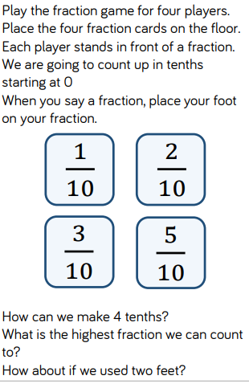
In 4s, use the four fraction cards and see what answers you come up playing this fraction game.

