Slide 1
Forces and Magnets
This half term, our science topic is:

Slide 2
LO: To know what a force is.
LO: To begin to use a science model to describe.

Slide 3
Vocabulary
force push pull contact force
distance force gravity force arrow
movement (associated terminology) magnetic magnetism poles (north, south) attract repel non-magnetic
These are some of the words we will be using over the course of the unit.

Slide 4
What do you think a force is?
Let’s have a look at the video on the next slide to find out more.

Slide 5
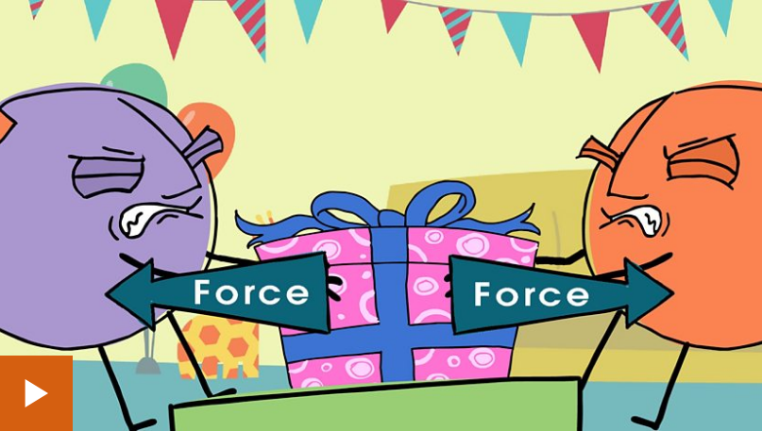
What is a force?

Slide 6
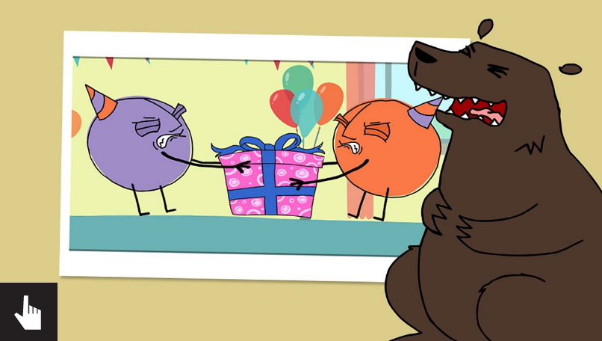
Now let’s try this activity…

Slide 7
Let’s have some fun and investigate pushes and pulls!
BEFORE: say what you think might happen.
AFTER: say what actually happened.
WHY: can you explain why?
Try the following activities…

Slide 8
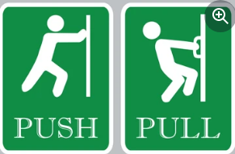
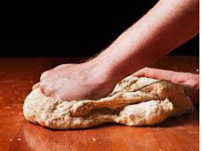
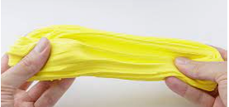
First, change the shape of materials by twisting, stretching, squashing etc. Identify the action as a push or a pull. You could use paper, modelling clay etc.

Slide 9
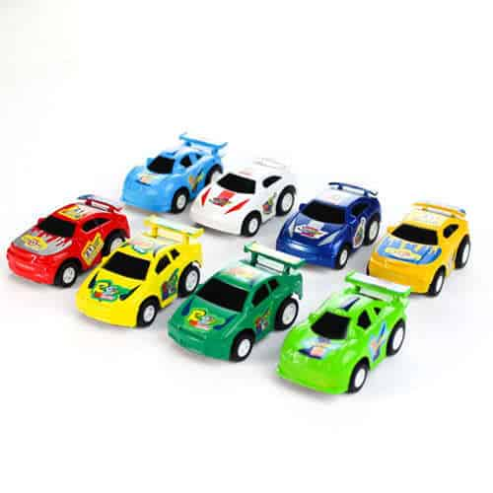
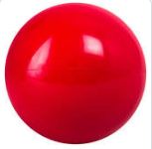
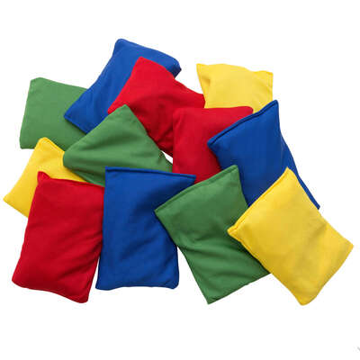
Next, use toy cars, bean bags, etc. Make them move / move faster / slower / further. Identify the size of the push or pull.

Slide 10
Then, draw a science model to show what has happened using force arrows. Remember a bigger force is represented by a bigger arrow and a smaller force is represented by a smaller arrow.
Can you write what has happened and why?

Slide 11
Tell your partner 3 things you have learnt about forces.

