Slide 1
Forces and Magnets
This half term, our science topic is:

Slide 2
LO: To know a material that magnets are attracted to.
LO: To follow written instructions to create a magnet game.

Slide 3
Vocabulary
force push pull contact force
distance force gravity force arrow
movement (associated terminology) magnetic magnetism poles (north, south) attract repel non-magnetic
These are some of the words we will be using over the course of the unit.

Slide 4
Today we are going to create a
Magnet Maze game!

Slide 5
What is a maze?

Slide 6
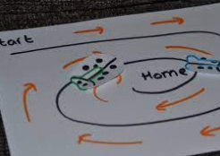
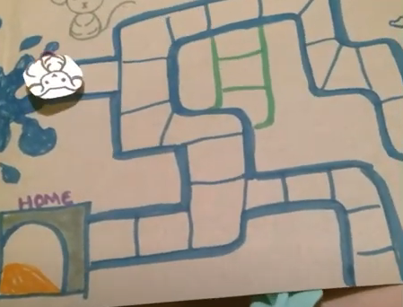
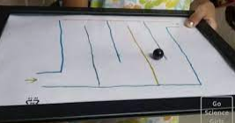
What is a maze?

Slide 7
But, today’s task is a little bit different from usual.
I am not going to TELL you what to do.
I am not going to SHOW you what to do.

Slide 8
Challenge - Follow written instructions
The challenge is for you and your partner to follow the written instructions for making a magnet maze game.

Slide 9
What have you discovered from making and playing your game?
Tell your partner a material that magnets are attracted to.

