Slide 1


Slide 2
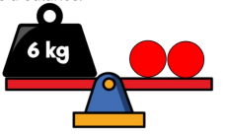
Year 3 | Week 10 | Day 2

Slide 4

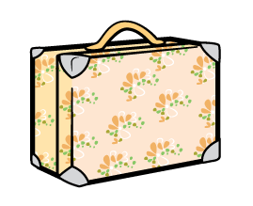

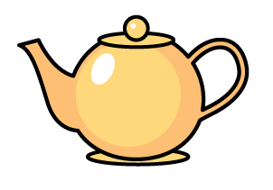
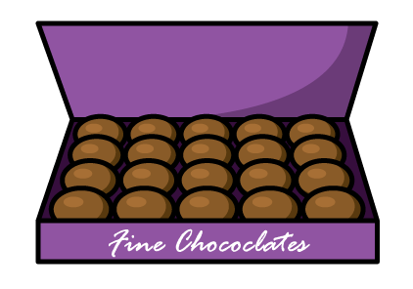
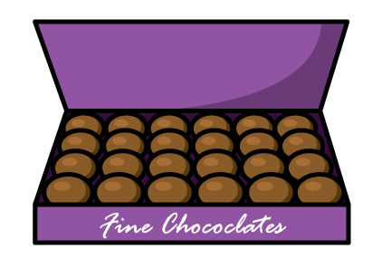
Which bag will hold more luggage?
2) Which item would you expect to hold more tea?
or
Which box holds the most chocolates?

Slide 5
Which bag will hold more luggage?
2) Which item would you expect to hold more tea?
or
Which box holds the most chocolates?

Slide 7
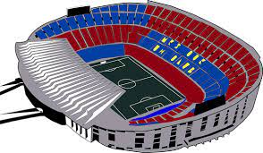
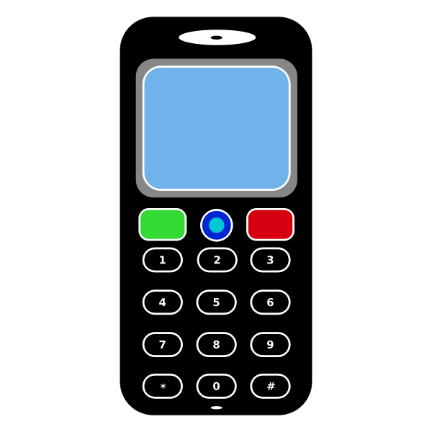
What do we mean by capacity?
Capacity is the amount that something can contain.
The football stadium has a capacity of 90,000 people.
The phone’s memory has a capacity of 64 GB.

Slide 8
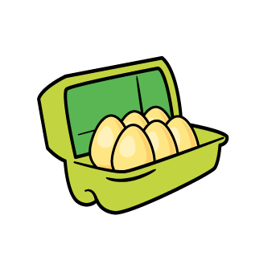

This egg box has a capacity of 6 eggs.
Have a think
Whitney eats an egg for breakfast.
1) How many eggs are now in the box? ____ eggs
2) What is the box’s capacity? ____ eggs
5
6

Slide 9
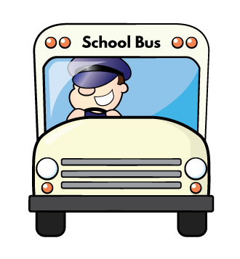
A bus has 45 seats.
Some people board the bus.
There are now 10 empty seats.
Have a think
How many people have boarded the bus?
35
What is the capacity of the bus?
45

Slide 10
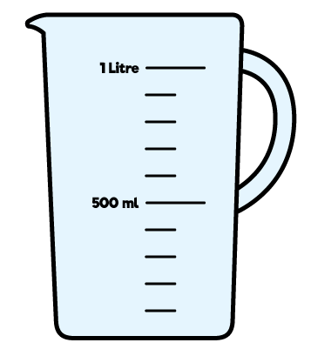

1) The jug is empty.
What is the jug’s capacity?
0 litres
1 litre
More than 1 litre
Have a think
2) Some water is poured into the jug.
What is the jug’s capacity?
500 ml
1 litre
More than 1 litre

Slide 11
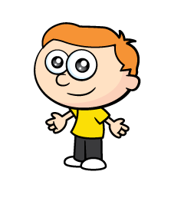


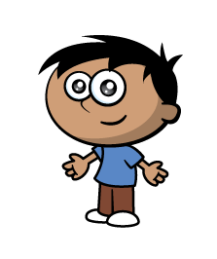
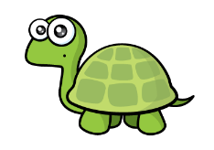
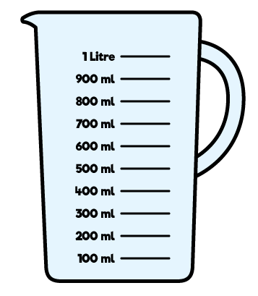
Which has the greater capacity?
We can use the jug to check.

Slide 12
The bucket has a capacity of 5 jugs.
The fish bowl has a capacity of 3 jugs.
So the bucket has a greater capacity.

Slide 13
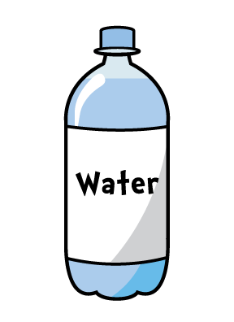
But Tiny, these are both smaller than the jug
Which has the greater capacity?
We can use the jug to check.
Have a think

Slide 14
The mug has a capacity of 500 ml
The bottle has a capacity of 500 ml

Slide 15
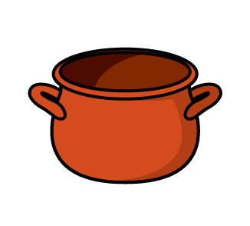

Have a think
Find a variety of containers.
Can you predict which has the smallest and greatest capacity and put them in order?
Now measure the capacity of each to check.
(If you don’t have a measuring jug at home, you can use e.g. a cup to find out which has the smallest and greatest capacity)

