Slide 1
RECAP: Structure of the Earth and Plate Tectonic Theory
Wednesday 19th January 2021
Learning Objectives:
I can begin to understand what causes earthquakes and volcanic eruptions.
Play Taboo to recap what we learnt last week – 5 mins

Slide 2
Plenary: Taboo!
I am going to choose some volunteers from the classroom.
They come to the front and behind them I put up a slide with a key word and a picture.
The rest of the class have to describe what the key word is without actually saying the word!

Slide 3
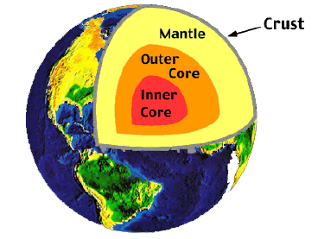
Crust

Slide 4
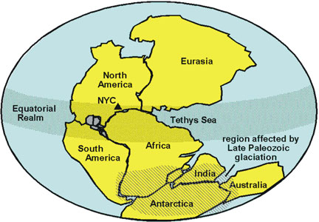
Pangaea

Slide 5
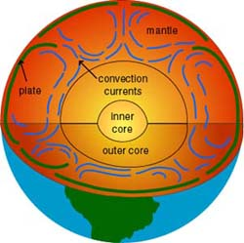
Convection Currents

Slide 6
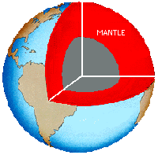
Mantle

Slide 7
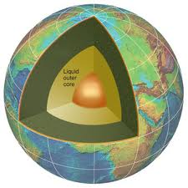
Outer Core

Slide 8
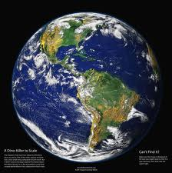
Earth

Slide 9
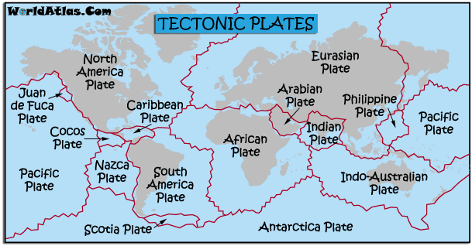
Tectonic plates

Slide 10
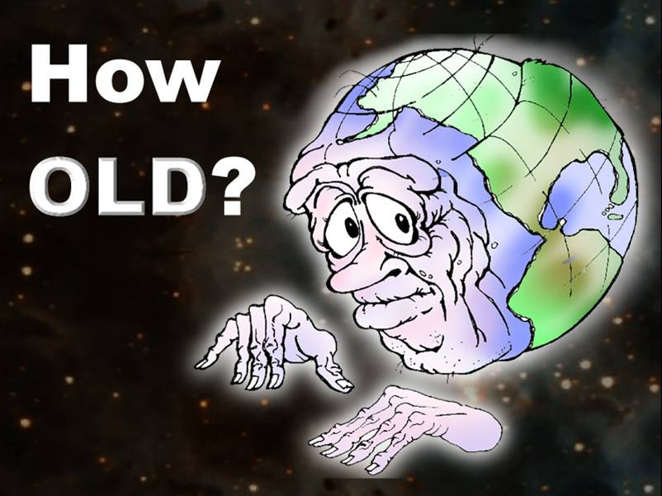
4.5 billion years

Slide 11
Physical Processes that affect the Lithosphere
Lithosphere - the solid outer part of the Earth.
Tectonic Plate – (also known as a lithosphere plate) are pieces of land that connect together on the Earth’s outer shell.
Volcano – a rupture in the crust of the Earth that allows hot lava, volcanic ash and gases to escape from a magma chamber below the surface.
Earthquake – a sudden violent shaking of the ground as a result of movement with the earth’s crust.
Tectonic Plate – (also known as a lithosphere plate) are pieces of land that connect together on the Earth’s outer shell.

Slide 12
Wednesday 19th January.
LO - I know what a volcano is and also the location of the world’s volcanoes.

Slide 13
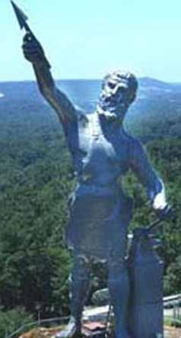
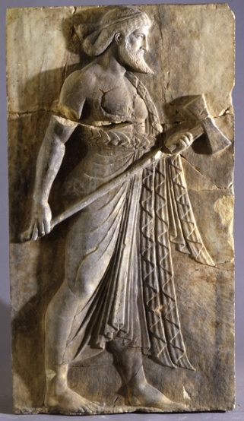
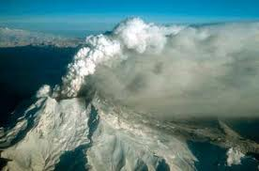
Did you know?
The word "volcano" comes from the little island of Vulcano in the Mediterranean Sea off Sicily. Centuries ago, the people living in this area believed that Vulcano was the chimney of the forge of Vulcan -- the blacksmith of the Roman gods. They thought that the hot lava fragments and clouds of dust erupting from Vulcano came from Vulcan's forge as he beat out thunderbolts for Jupiter, king of the gods, and weapons for Mars, the god of war.

Slide 14
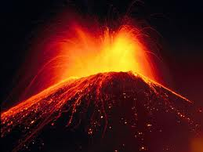
What is a volcano?
Volcanoes
are dramatic evidence
of the powerful forces at work inside the Earth. Eruptions of ash, gas and lave destroy entire cities and kill large numbers of people.
Volcanoes are like giant safety valves that release the pressure that builds up inside the Earth.

Slide 15
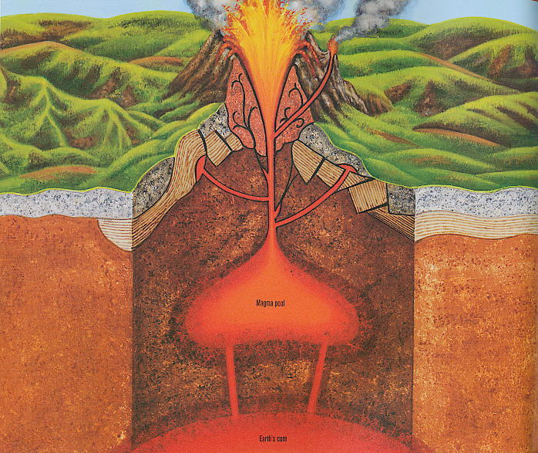
A volcano is a mountain that opens downward to a pool of molten rock below the surface of the earth. When pressure builds up, eruptions occur. Gases and rock shoot up through the opening and spill over or fill the air with lava fragments.
Deep in the earth it is very hot. It is so hot that rocks melt. The melted rock is called magma. The magma is lighter than the rocks around it so it rises. Sometimes it finds a crack or hole in the earth’s crust and bursts through. This is how a volcano begins.
Eruptions can cause lateral blasts, lava flows, hot ash flows, mudslides, avalanches, falling ash and floods. Volcano eruptions have been known to knock down entire forests. An erupting volcano can trigger tsunamis, flash floods, earthquakes, mudflows and rock falls.

Slide 16
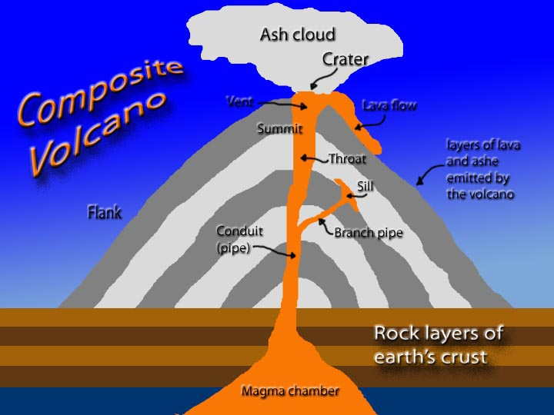
What causes volcanoes to erupt?
The Earth's crust is made up of huge slabs called plates, which fit together like a jigsaw puzzle. These plates sometimes move.
The friction causes earthquakes and volcanic eruptions near the edges of the plates. The theory that explains this process is called plate tectonics.
Between the Earth's crust and the mantle is a substance called magma which is made of rock and gases.
When two plates collide, one section slides on top of the other, the one beneath is pushed down. Magma is squeezed up between two plates.

Slide 17
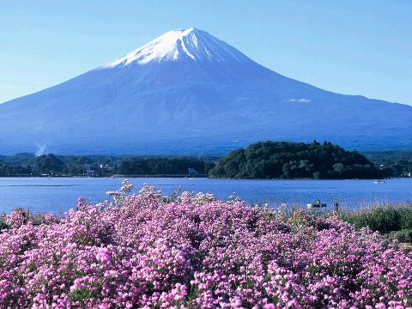
Types of Volcanoes
There are 3 different types of volcanoes:
Active - eruptions can be anytime and often.
Dormant - has been a while since it has erupted, but could at anytime.
Extinct, meaning it hasn't erupted in a very long, long time so it probably won't ever again.
Mount Fuji in Japan is a dormant volcano

Slide 18
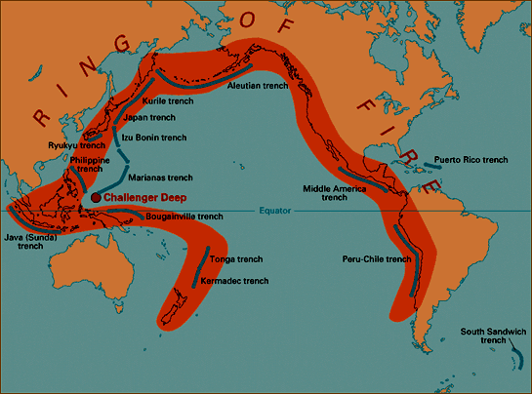
What is the Ring of Fire?
The Pacific Ring of Fire is an area of frequent earthquakes and volcanic eruptions encircling the basin of the Pacific Ocean. The Ring of Fire is about 25000 miles long and has 452 volcanoes and is home to over 70% of the world's active and dormant volcanoes. Ninety percent of the world's earthquakes and 81% of the world's largest earthquakes occur along the Ring of Fire.

Slide 19
In your books answer these questions
Can you write a sentence of no more than 20 words explaining where the Pacific Ring of Fire is?
How long is the Pacific Ring of Fire?
How many volcanoes can be found on the Pacific Ring of Fire?

Slide 20
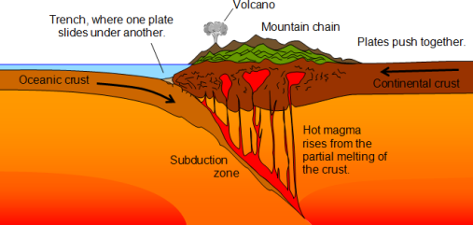
Physical Process
The Pacific Ring of Fire is a result of plate tectonics. Sometimes when tectonic plates collide it causes a process called subduction. This means one plate is pushed below another. The heat and the pressure forms mountains and volcanoes.

Slide 21
What does the word “subduction” mean?
What does the word “dormant” mean?
What ocean does the Pacific Ring of Fire arc around?
What is the name of the plates that collide to cause subduction?

Slide 22
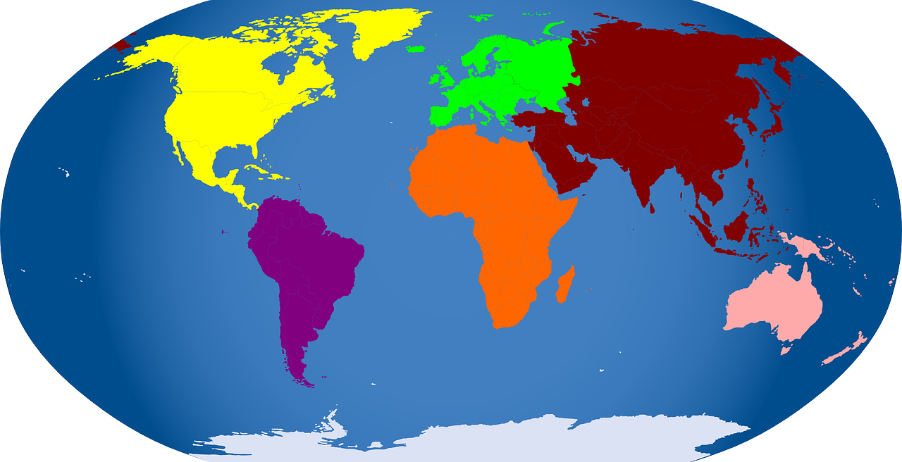
Date: ____________
LI: To locate the world’s famous volcanoes.
Mount Etna Mauna Loa Paracutin
Mount St Helens Aconcagua Hekla
Nevado del Ruiz Mount Thira Vesuvius
Krakatoa Popocatépetl Pelée
Mount Fuji Pinatubo Cotopaxi
Can you find the names of these famous volcanoes?
Use an atlas or the internet to help you.
Arctic Ocean
9
2
10
15
1
3
4
11
7
12
14
Atlantic Ocean
Pacific Ocean
Pacific Ocean
5
Indian Ocean
6
13
8
Southern Ocean
1. _____________ 5. _____________ 9. _____________ 13. _____________
2. _____________ 6. _____________ 10. _____________ 14. _____________
3. _____________ 7. _____________ 11. _____________ 15. _____________
4. _____________ 8. _____________ 12. _____________

Slide 23
Date: ____________
LI: To locate the world’s famous volcanoes.
Can you find the names of these famous volcanoes? Use an atlas or the internet to help you.
Arctic Ocean
9
2
10
15
1
3
4
11
7
12
14
Atlantic Ocean
Pacific Ocean
Pacific Ocean
5
Indian Ocean
6
13
8
Southern Ocean
Nevado del Ruiz _____ Mount Etna _____ Vesuvius _____ Pelée _____
Mount Thira _____ Aconcagua _____ Paracutin _____ Hekla _____
Popocatépetl _____ Krakatoa _____ Pinatubo _____ Fuji _____
Mount St Helens _____ Mauna Loa _____ Cotopaxi _____

Slide 24
Map of Famous World Volcanoes
Arctic Ocean
Atlantic Ocean
Pacific Ocean
Pacific Ocean
Indian Ocean
Southern Ocean

Slide 25
Date: ____________
LI: To locate the world’s famous volcanoes.
Mount Etna Mauna Loa Paricutin
Mount St Helens Aconcagua Hekla
Nevado del Ruiz Mount Thira Vesuvius
Krakatoa Popocatépetl Pelée
Mount Fuji Pinatubo Cotopaxi
Can you find the names of these famous volcanoes?
Use an atlas or the internet to help you.
Arctic Ocean
9
2
10
15
1
3
4
11
7
12
14
Atlantic Ocean
Pacific Ocean
Pacific Ocean
5
Indian Ocean
6
13
8
Southern Ocean
1. _____________ 5. _____________ 9. _____________ 13. _____________
2. _____________ 6. _____________ 10. _____________ 14. _____________
3. _____________ 7. _____________ 11. _____________ 15. _____________
4. _____________ 8. _____________ 12. _____________
Mauna Loa
Nevado del Ruiz
Hekla
Krakatoa
Mount St Helens
Cotopaxi
Vesuvius
Pinatubo
Paricutin
Mount Pelée
Mount Etna
Mount Fuji
Popocatépetl
Aconcagua
Mount Thira

Slide 26
Plenary: What do you call:
a) A volcano that has not erupted for 10,000 years?
Extinct
b) A volcano that is erupting at the moment?
Active
c) A volcano that has erupted before but is currently sleeping.
Dormant
Notes:
Answers:
Extinct
Active
Dormant
Image credits:
Volcanic eruption – Pexels@pixabay.com

