Slide 1
Friday 21st January L.O. – I can forage for natural materials to make a picture frame.

Slide 2
Last week we created our own colour palette and silhouette. This week we are going to do some Design and Technology and create a picture frame for our work.

Slide 3
It’s up to you what you want your picture frame to look like but follow the PowerPoint through for inspiration, guidance and tips.
Have a look at these pictures for inspiration. Choose some ideas that you like and create 2 or 3 designs of your own based on these or any other ideas you have.

Slide 4
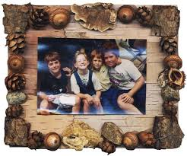
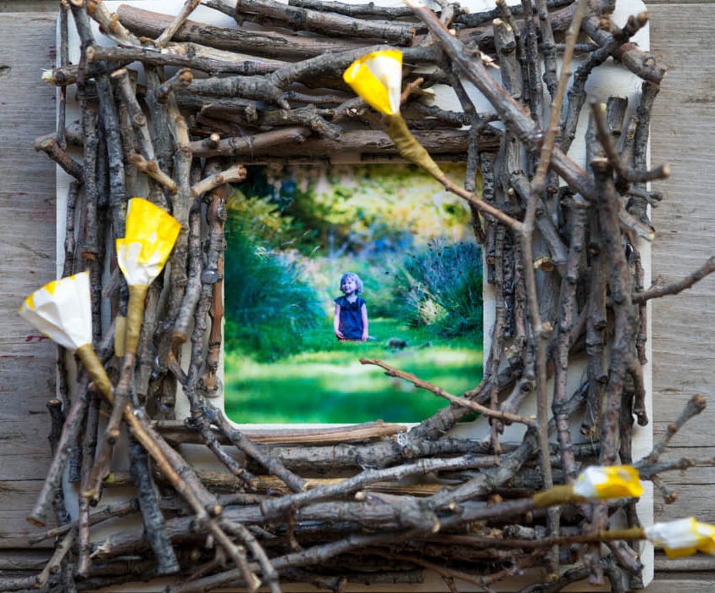
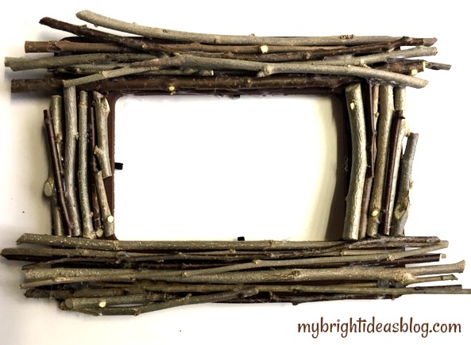
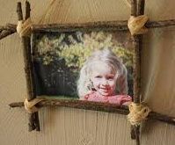

Slide 5
The first thing to think about is what resources you have available to use.
These are the typical things you will need for this task.
A pencil
A ruler
Glue and/or Sellotape
Scissors
Cardboard / card / paper
For a natural frame you might also need
Sticks
String / twine / ribbon
Decoration eg pine cones / acorns / shells / origami decorations

Slide 6
Once you have decided on the type of frame you would like to make create a final design.
Things to consider to help you with your final design.
Size.
How big does your picture space need to be? - Your Tudor Portrait is A5 size.
Shape
Your Tudor watercolour painting should be a portrait rectangle so the picture space should also be a portrait rectangle.
Decoration
Think about the colours within your portrait. What colour scheme will match your artwork?

Slide 7
How To Make a Natural Frame.
Some video examples;
https://www.youtube.com/watch?v=skXiLF37Luw
https://www.youtube.com/watch?v=DJPa2RpEOwk
Gather your equipment
Card
Scissors
Ruler
Pencil
Colours
Sticks
Glue
String / twine / ribbon
Decoration

Slide 8
Some video examples;
https://www.youtube.com/watch?v=skXiLF37Luw
https://www.youtube.com/watch?v=DJPa2RpEOwk
Step by Step Guide.
Step 1 – Make the backing for the frame.
Cut a piece of card or paper so that it gives you a 2cm border all the way around your picture. Then, stick your painting to the middle of this.

Slide 9
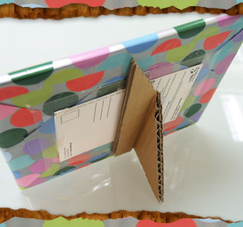
Step 2 – Make the Stand.
Cut a fairly large triangle (make sure it's a few inches smaller than the frame) out of a piece of rigid cardboard. Fold an inch or so of the wide side over and crease it. Glue the cardboard onto the back of the frame and bend it over so it makes a stand.

Slide 10
Step by Step Guide.
Step 3 – Organise the twigs to make the frame.
Organise your twigs so you have similar lengths together. You could trim the twigs so each bundle is the same length or leave them different lengths if you would prefer a more rustic natural look.
Step 4 – Bundle the twigs.
Wrap the twine / string / ribbon securely around each end of the twig bundle and knot it tightly.

Slide 11
Step by Step Guide.
Step 5 – Organise the bundles to make the frame.
Organise your bundles around so they frame the portrait and use the twine / string / ribbon to join them together. Once you have down that, glue the frame onto the cardboard backing stand. (If you do not have glue you could make a hole in the card and use string to attach it to the frame.
Step 6 – Decorate your frame.
Use glue (or string) to attach your decorations to the frame.

