Slide 1
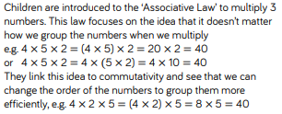
Teacher notes.

Slide 2
05.01.21
LO. I can multiply 3 single digit numbers.
Let’s talk through these problems as a class.

Slide 3
05.01.21
LO. I can multiply 3 single digit numbers.
Let’s talk through these problems as a class.

Slide 4
05.01.21
LO. I can multiply 3 single digit numbers.
TTYP and show your working in your book.
Write the calculation out in your book then answer it.

