Slide 1

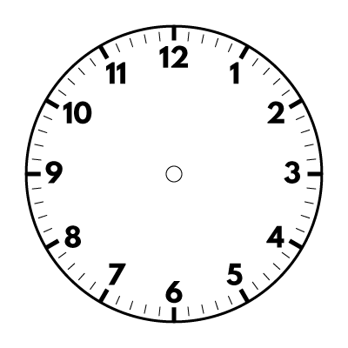
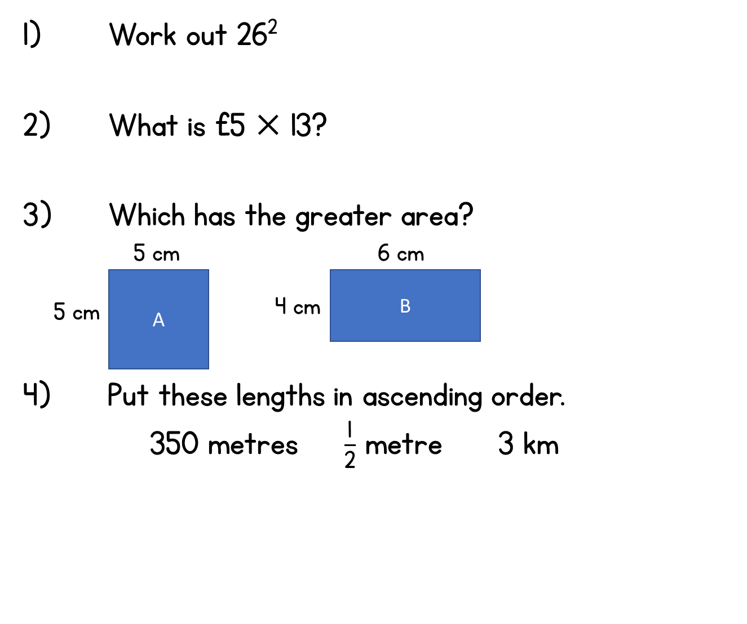
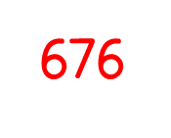


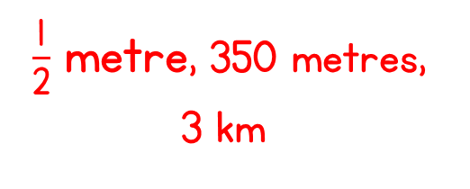
Year 5 | Week 2 | Day 4

Slide 2


Slide 4


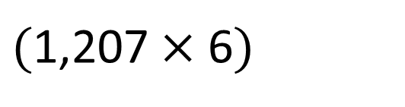
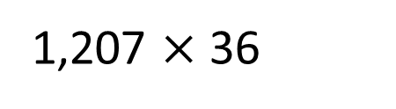
1,207 $×$ 36
TTh | Th | H | T | O
 | 1 | 2 | 0 | 7
 |  |  | 3 | 6
$$×$$
7
2
4
2
$($1,207 $×$ 6$)$
1
4
$$+$$

Slide 5
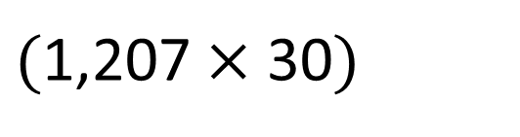
1,207 $×$ 36
TTh | Th | H | T | O
 | 1 | 2 | 0 | 7
 |  |  | 3 | 6
$$×$$
7
2
4
2
$($1,207 $×$ 6$)$
1
4
$$+$$
3
6
2
1
0
$($1,207 $×$ 30$)$
2
4
3
4
5
2
1

Slide 7

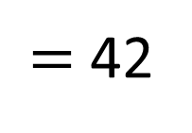
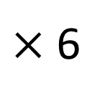
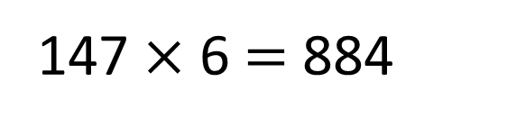

7
$×$ 6
$=$ 42
147 $×$ 6 $=$ 884
Th | H | T | O
 | 1 | 4 | 7
 |  |  | 6
$$×$$
8
8
2
2
4

Slide 8

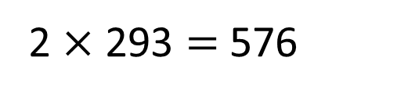
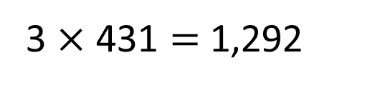
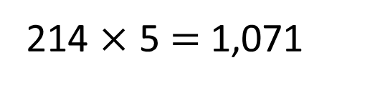
Have a think
Could these calculations be correct?
214 $×$ 5 $=$ 1,071
2 $×$ 293 $=$ 576
3 $×$ 431 $=$ 1,292
Could be correct | Definitely incorrect

Slide 9
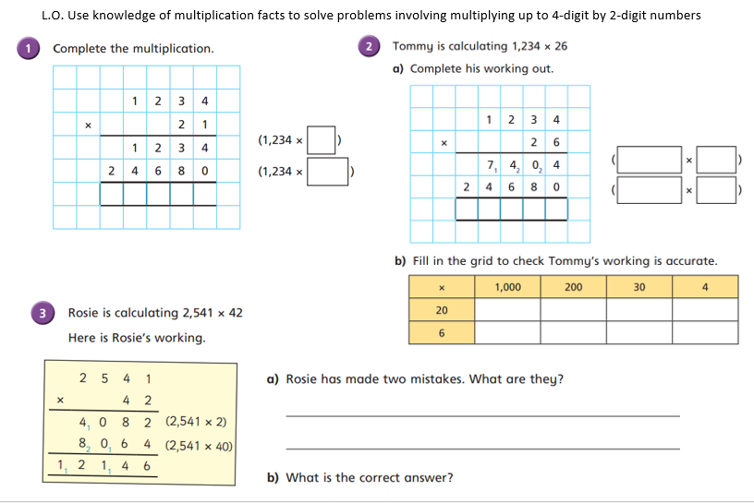
Have a go at the questions on the worksheet, up to question 6. Stick the first sheet (with 1- 4) in your books.

Slide 10
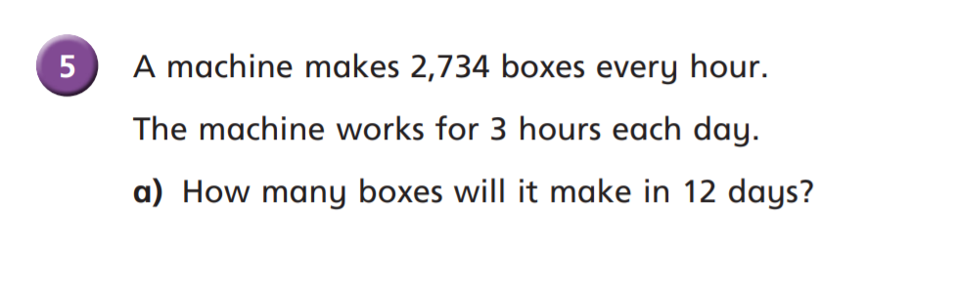




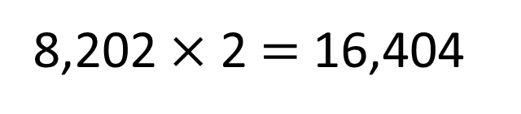
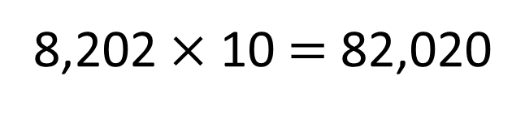
TTh | Th | H | T | O
 | 8 | 2 | 0 | 2
 |  |  | 1 | 2
Th | H | T | O
2 | 7 | 3 | 4
 |  |  | 3
8,202 $×$ 10 $=$ 82,020
8,202 $×$ 2 $=$ 16,404
$$×$$
$$+$$
$$×$$
1
6
4
98,424
0
4
1
8
2
0
2
$$+$$
8
2
0
2
0
1
2
1
9
8
4
2
4

Slide 11
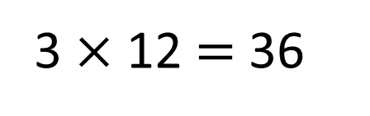
TTh | Th | H | T | O
 | 2 | 7 | 3 | 4
 |  |  | 3 | 6
3 $×$ 12 $=$ 36
$$×$$
1
6
4
0
4
4
2
2
$$+$$
8
2
0
2
0
2
1
1
9
8
4
2
4

Slide 12
Have another go at question 6 on the worksheet

Slide 13



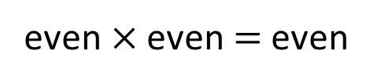

What is the smallest product you can make that’s also an odd number?
5
2
7
3
6
Th | H | T | O
odd$×$ odd $=$ odd
3
6
odd$×$ even $=$ even
2
7
$$×$$
5
even$×$ even $=$ even
$$+$$
Have a think

Slide 14
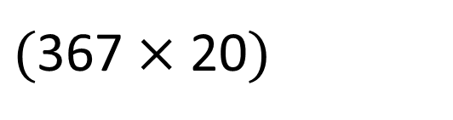
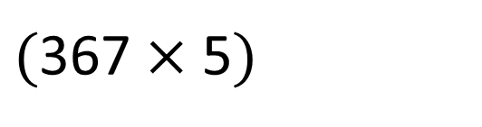
What is the smallest product you can make that’s also an odd number?
5
2
7
3
6
Th | H | T | O
3
6
7
$$×$$
2
5
1
8
3
5
$($367 $×$ 5$)$
3
3
$$+$$
7
3
4
0
$($367 $×$ 20$)$
1
1
9
1
7
5
Have a think

Slide 15
Do the rest of the questions

Slide 16
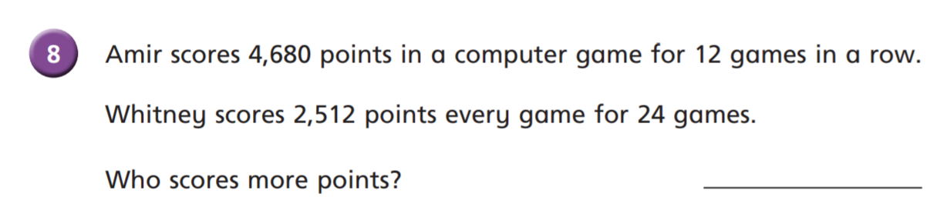


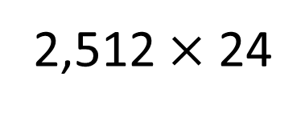


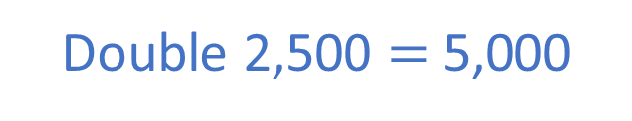
Whitney scores more.
6
12
4,680 $×$ 12
2
doubled?
halved
4
2,512 $×$ 24
The product of 6 and 4 is 24
Double 2,500 $=$ 5,000
4,680 $<$ 5,000
The product of 12 and 2 is 24
If you double one factor and halve the other factor, the product will remain the same.

