Slide 1
The Bare Necessities

Slide 2
The Bare Necessities
First, we will listen to the song and read the lyrics
https://www.youtube.com/watch?v=RRP5NNKTVBY

Slide 3
The Bare Necessities
Now, we will watch the scene from the movie.
https://www.youtube.com/watch?v=08NlhjpVFsU

Slide 4
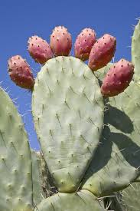
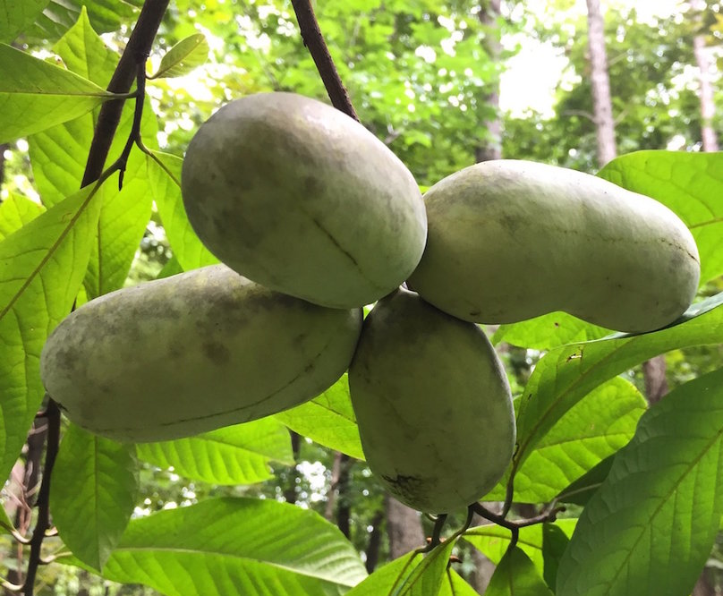
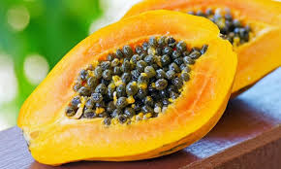
Vocabulary Check
Forget about your worries and your strife
I mean the bare necessities
I couldn't be fonder of my big home
pawpaw prickly pear

Slide 5
Partnered Talk
What do you think the word necessity means?
Does it sound like any other words you know?

Slide 6
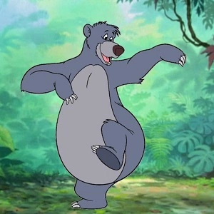
Individual Thinking
Why is it funny that this character sings the bare necessities?

Slide 7
Partnered Talk
What can we learn about the character of Baloo from this song? What does it tell us about his personality.

Slide 8
Solo Work
What do you believe are the Bare Necessities of life?
How might they be different if you lived in the jungle?

