Slide 1
STEM Enrichment week
6th December until 10th December.

Slide 2
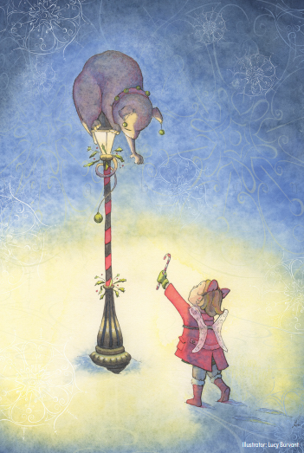
Monday 6th December.
LO – I can write creatively about an image.

Slide 4
Look at this image. TTYP about what you can see.
In your book, write down some ideas, words, phrases that spring to mind when you look at this image.

Slide 7
Spend some time TTYP, think about what is happening in the picture. If you used your senses, what might you hear, see, feel, taste and smell?
Take a few minutes to discuss this.

Slide 8
Use the template to write down your ideas about this picture of kindness. Choose vocabulary carefully to paint a picture in the reader’s head.
Write creatively – your work might be chosen for the Writer of the Month Board!
Good luck ☺

Slide 9
Thursday 9th December.
LO – I can write a review of a movie.

Slide 10
Talk to someone at home about the plot (the story), the characters, what you enjoyed, what you would change.

Slide 11
Friday 10th December.
LO – We can deliver a presentation to share information, with clarity and thought of audience.

Slide 12
Over the week, we have looked at a toaster and how it works. Remember when we looked at the toaster and we found out how it worked. We are going to work in groups of 6 to present this information. You need to decide in your groups how you are going to share the information, whether you need pictures to help the descriptions. Everyone in the group needs to speak in the presentation.

Slide 13
Let’s think about oracy and what we need to do to present well.
Think about how you are standing, the pace at which you deliver your lines and the audience.

Slide 14
We have already looked at the toaster, how it works and the Science behind it.
Today, you must make a short presentation to share this information. You have this session to complete this work.
Enjoy ☺ and good luck.

Slide 15
I hope you have enjoyed the week.

