Slide 1
08.11.21
LO: Subtract a 1-digit number from a 3-digit number - crossing 10.

Slide 2
Learning Journey – Addition and Subtraction
In this unit we will…
Add and subtract multiples of 100
Add and subtract 1s
Add and subtract 3-digit and 1-digit numbers – not crossing 10
Add a 2-digit and 1-digit number – crossing 10
Subtract a 1-digit number from a 3-digit number – crossing 10
Subtract a 1-digit number from 2-digits – crossing 10
Add 3-digit and 1-digit numbers – crossing 10
Add and subtract 3-digit and 2-digit numbers – not crossing 100
Subtract a 2-digit number from a 3-digit number – crossing 100
Add 3-digit and 2-digit numbers – crossing 100
Add and subtract 100s
Subtract a 2-digit number from a 2-digit number – crossing 10
Add two 2-digit numbers – crossing 10 – add ones and add tens
Spot the pattern – making it explicit

Slide 3
Vocabulary:
Digit
number bond
addition
subtraction
column method
mental method
exchange
place value grid

Slide 6
How many pencils will be left?
10 pencils
435 $−$ 4 $=$ 431
100
pencils
100
pencils
10 pencils
100
pencils
100
pencils
10 pencils
I’ve been sent to fetch 4 pencils

Slide 7
How many pencils will be left?
10 pencils
100
pencils
100
pencils
10 pencils
100
pencils
100
pencils
431 $−$ 6 $=$ 425
10 pencils
Please can I have 6 pencils?

Slide 8
Work out 515 $−$ 6
Hundreds | Tens | Ones
515 $−$ 6 $=$ 509

Slide 9
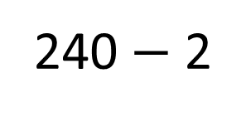
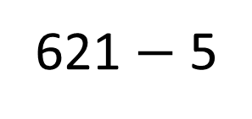
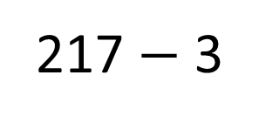
Have a think
217 $−$ 3
621 $−$ 5
240 $−$ 2
Exchange not needed | Exchange needed

Slide 10
Have a go at the question…

Slide 11
Use this method to calculate:
322-4 322-7 435-7

Slide 12
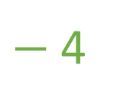
233 – 8
Use 2 jumps on the number line
$−$4
$−$4
223
224
225
226
227
228
229
230
231
232
233
We could jump back 4 and then another 4

Slide 13
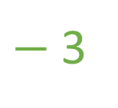
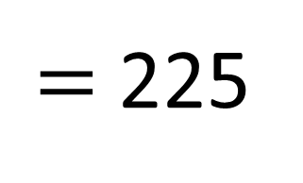
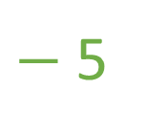
$=$ 225
233 – 8
Use 2 jumps on the number line
$−$5
$−$3
223
224
225
226
227
228
229
230
231
232
233
First jump back 3
Then jump back 5
Oooh now I see what to do.

Slide 14
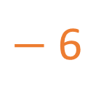
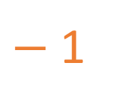
What number is Froggy hiding?
231 – 7 $=$ 224
$−$6
$−$1
223
224
225
226
227
228
229
230
231
232
233

Slide 15
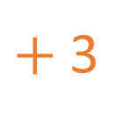
What number is Froggy hiding?
233 – 6 $=$ 227
$+$3
$+$3
223
224
225
226
227
228
229
230
231
232
233

Slide 16
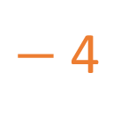
What number is Froggy hiding?
228
228
232 – 4 $=$ 223 $+$ 5
$+$5
$−$4
223
224
225
226
227
228
229
230
231
232
233

Slide 17
Have a go at the rest of the worksheet

Slide 18
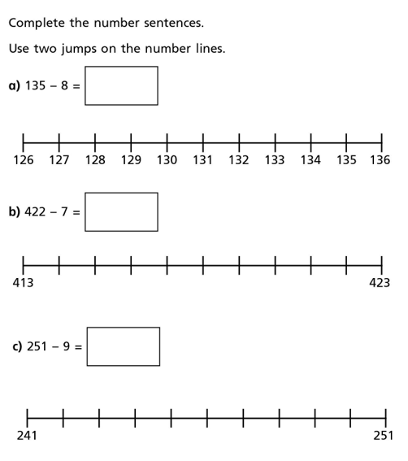

Slide 19
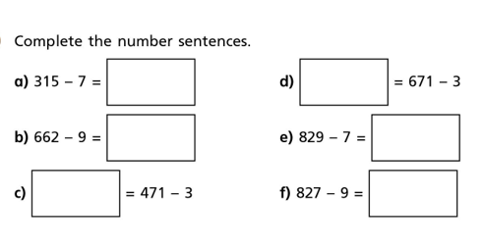

Slide 20
Complete the ‘★ Star Challenge’ if you finish this question.

Slide 21
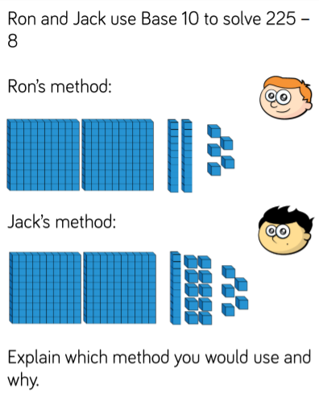
★ Star Challenge!
If you finish your work, can you complete this challenge. Go through it as a class at the end of the lesson.

