Slide 2
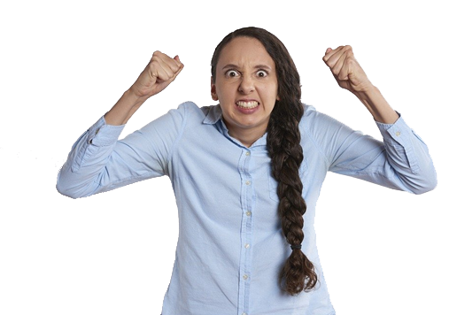
How Are They Feeling?
Look at this photograph. How do you think that this person is feeling?
What makes you think that?
Inference Iggy asks…
Could they be feeling another emotion but still look the same?
Next
Next

Slide 3
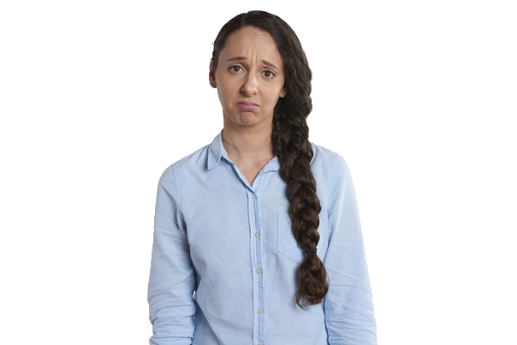
How Are They Feeling?
Now, look at another photograph of the same person.
How do you think that they are feeling now?
What makes you think that?
Inference Iggy asks…
How do you know that their mood has changed?
Next
Next

Slide 4
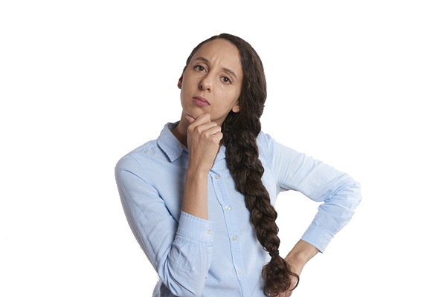
How Are They Feeling?
Finally, look at this photograph.
How do you think that they are feeling now?
Inference Iggy asks…
What are they doing with their face and their body to make you think that?
Next
Next

Slide 5
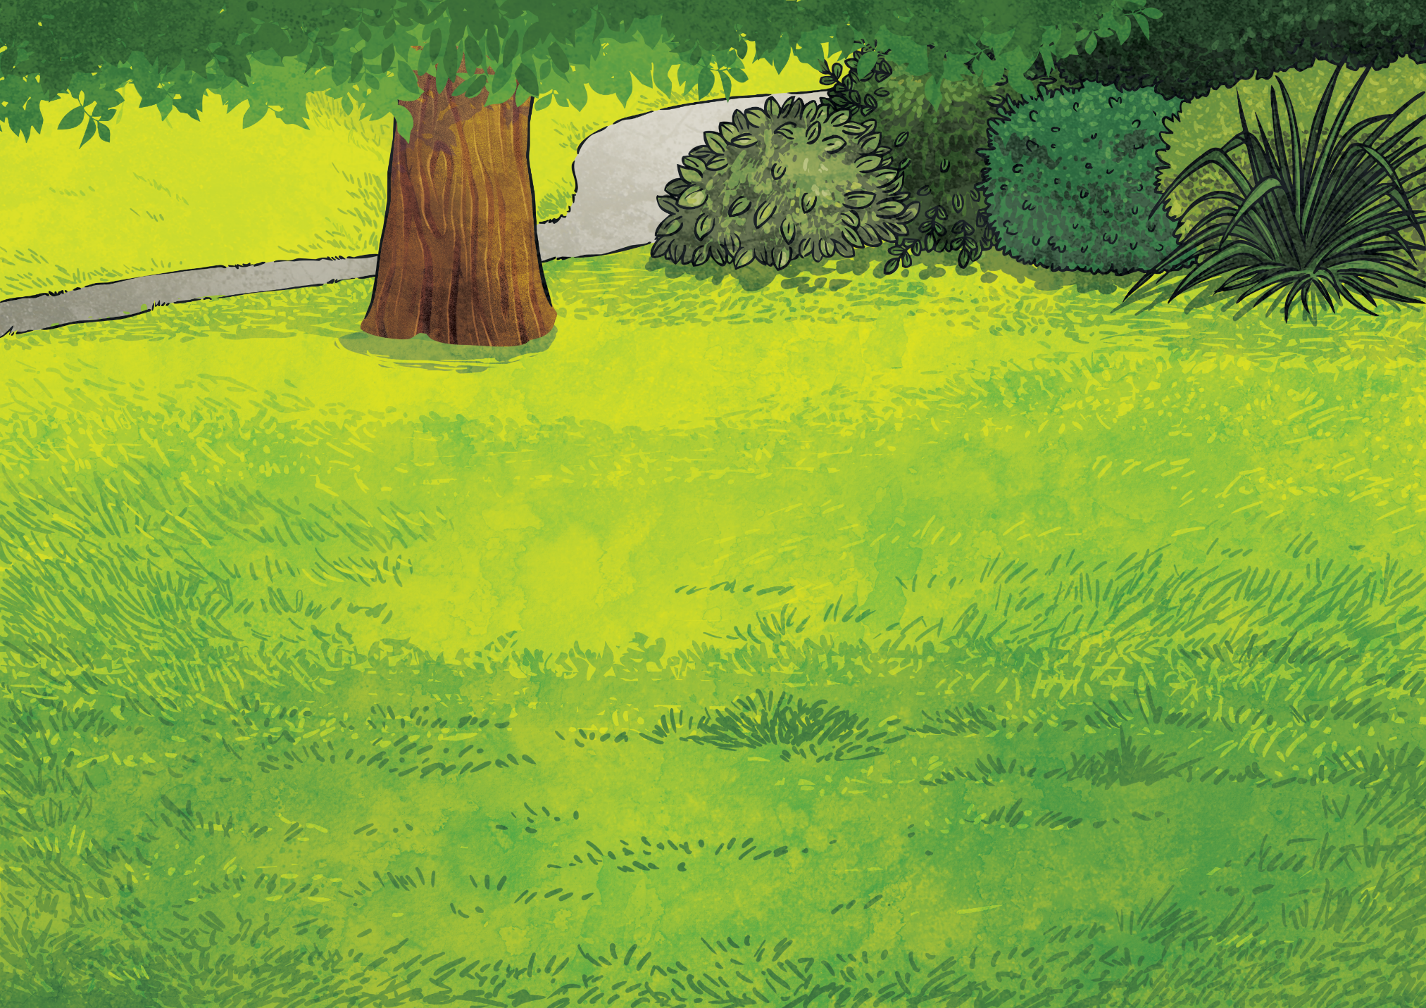
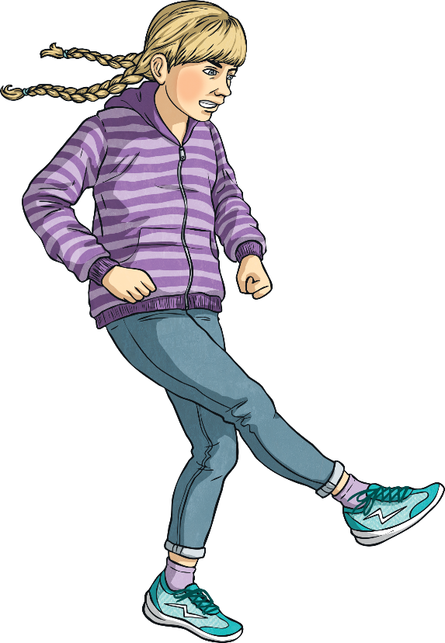
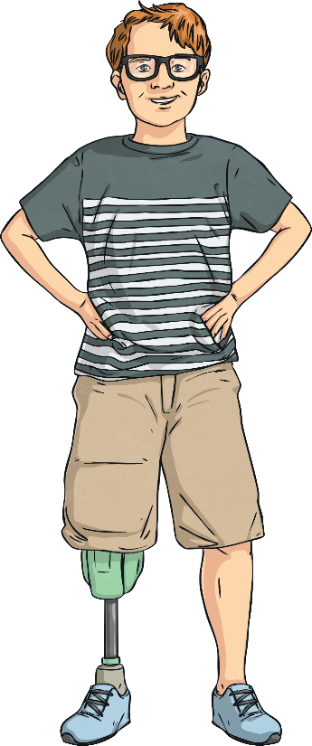
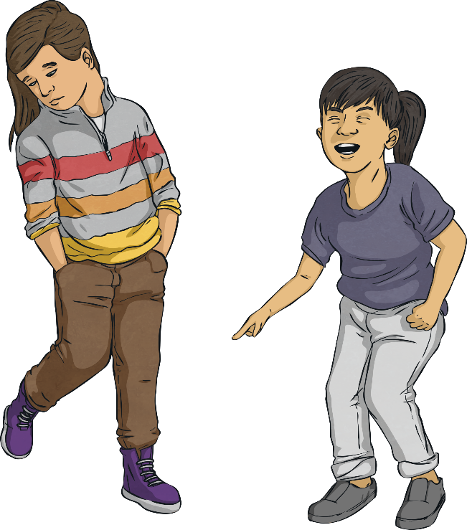
Showing Their Feelings
People rarely tell you how they are feeling using words.
Click on each key point to learn more about how we show our feelings.
More commonly, they show how they are feeling using three key things:
their body language;
their facial expression;
their actions.
The things that you do and the way that you interact with your surroundings to show your attitudes, feelings and reactions to a situation.
The way that you move your body and pose to show your attitudes or feelings.
The way that you move your face to show how you are feeling or how you are reacting to a situation.
their facial expression;
their body language;
Back
Back
Back
their actions.
Next

Slide 6
Show Me Charades
Use the spinner to choose an emotion.
unwell
scared
furious
upset
excited
embarrassed
scared
upset
unwell
furious
embarrassed
excited
Show that emotion using your facial expression and body language.
Please wait…
Spin
Next

Slide 7
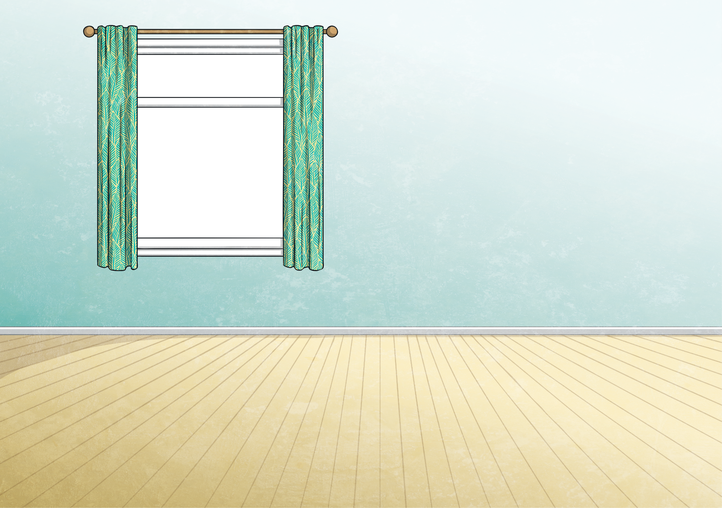
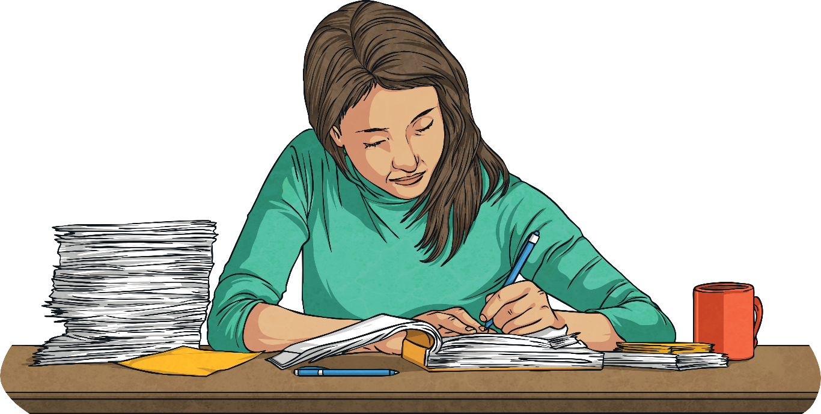
Key Characteristics
Use the spinner to choose an emotion.
If you were asked to imagine somebody who feels tired, what picture springs to mind?
Next
What is their facial expression?
What is their body language like?
What actions are they doing?
Next

Slide 8
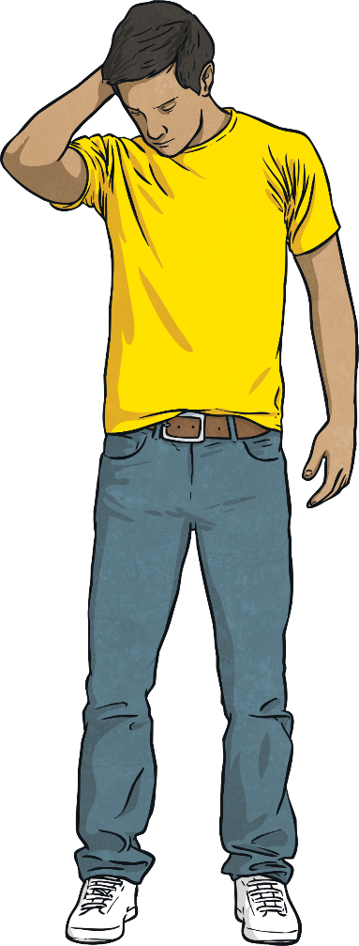
Key Characteristics
If an author was trying to convey that a character is tired, they might write:
Facial Expression:
Body Language:
‘He looked expression- less but his mouth drooped downwards at the corners.’
‘His shoulders slumped and his arms hung lifelessly by his sides. His head slowly began to tilt downwards.’
Actions:
‘He opened his mouth and yawned, like a lion roaring in the savannah. His heavy eyelids lowered.’
Next

Slide 9
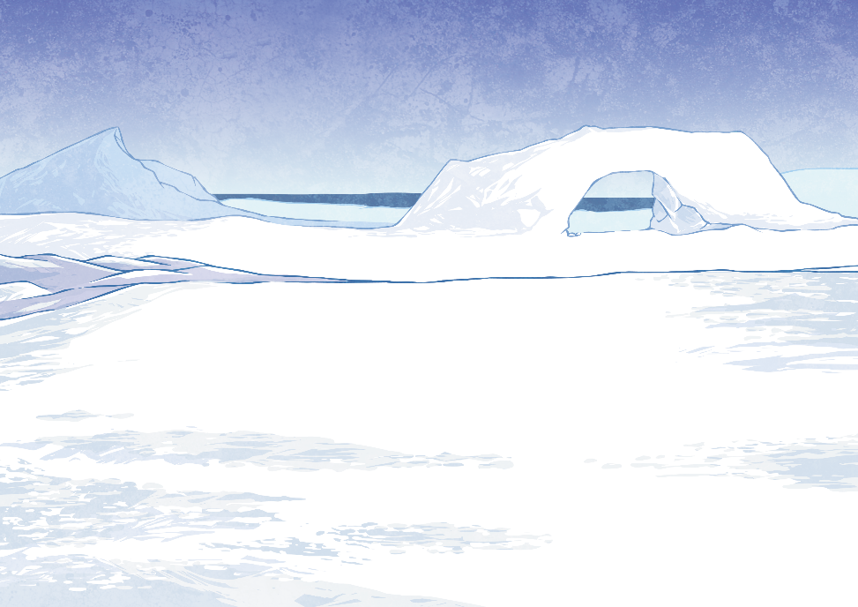
Key Characteristics
If you were asked to imagine somebody who feels cold, what picture springs to mind?
Next
What is their facial expression?
What is their body language like?
What actions are they doing?
Next

Slide 10
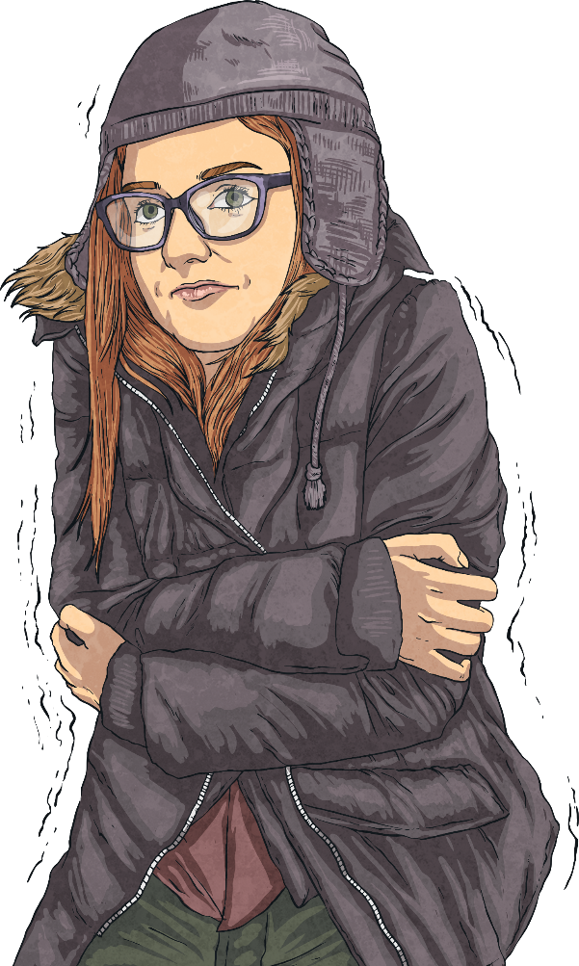
Key Characteristics
If an author was trying to convey that a character is cold, they might write:
Facial Expression:
Body Language:
‘Her brow was furrowed and her eyes narrowed as if she were struggling to see.’
‘Her shoulders touched her ears as her whole body tensed. She crossed her arms defensively.’
Actions:
‘Rubbing her hands together as if wringing a cloth, her teeth involuntarily chattered as she turned her back to the harsh wind.’
Next

Slide 11
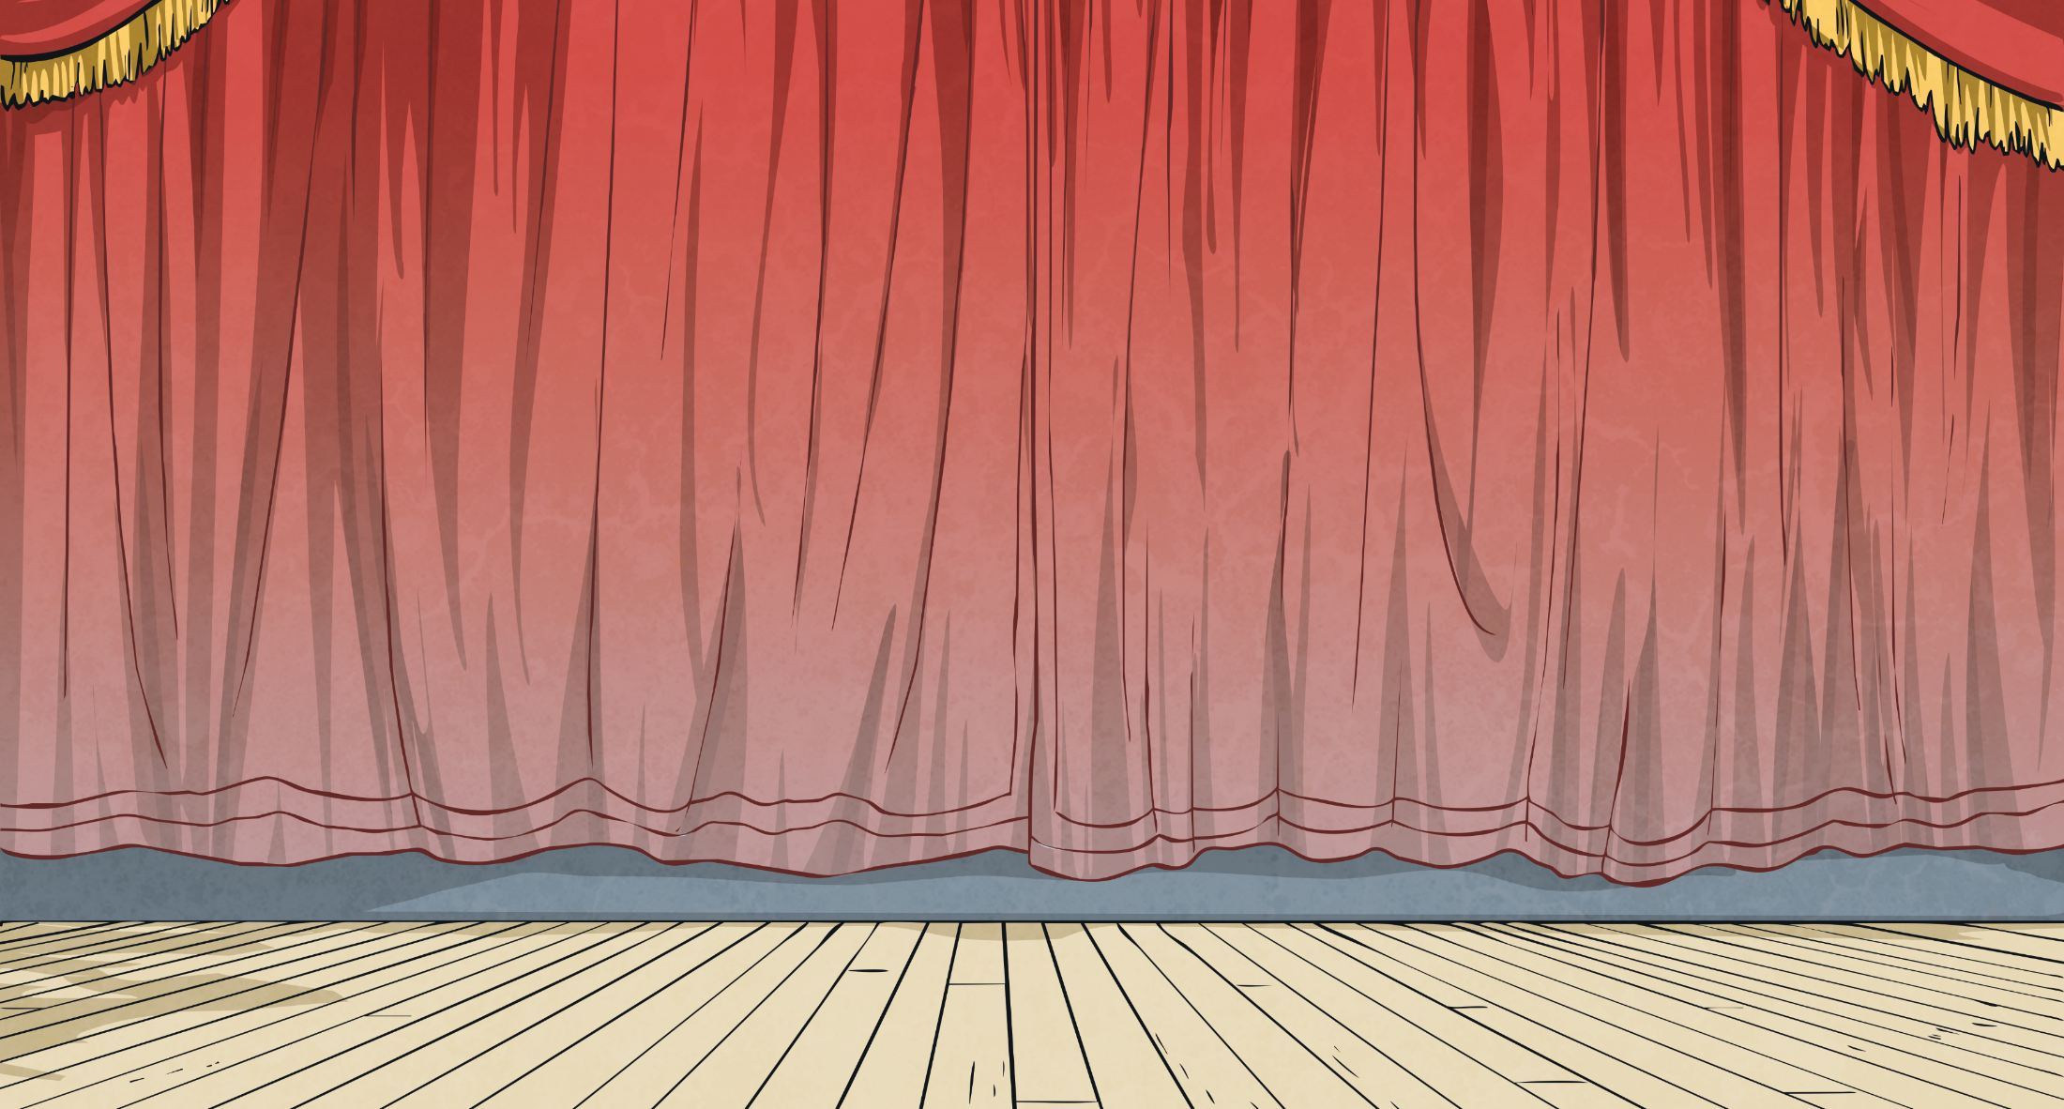
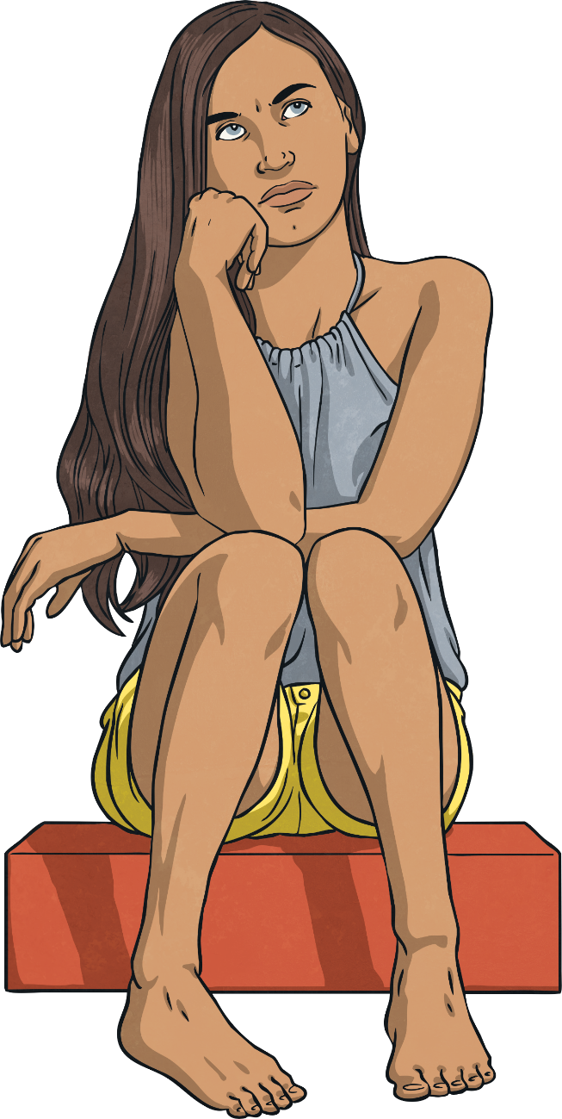
Key Characteristics
Clarity Is Key
If an author was trying to convey that a character is cold, they might write:
When trying to show your reader how your character feels, keep in mind that lots of different feelings can share the same traits.
Facial Expression:
Body Language:
‘Her brow was furrowed and her eyes narrowed as if she were struggling to see.’
‘Her shoulders touched her ears as her whole body tensed. She crossed her arms defensively.’
For example, someone might get red cheeks if:
they are embarrassed
they are hot
they are very angry
they are shy
Actions:
‘Rubbing her hands together as if wringing a cloth, her teeth involuntarily chattered as she turned her back to the harsh wind.’
It is important to always be clear with your description so that the reader knows exactly how your character feels.
Next

Slide 12
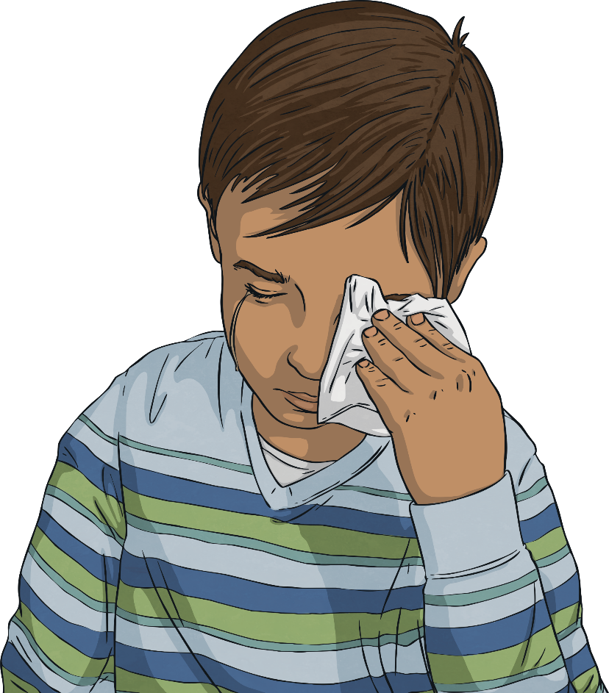
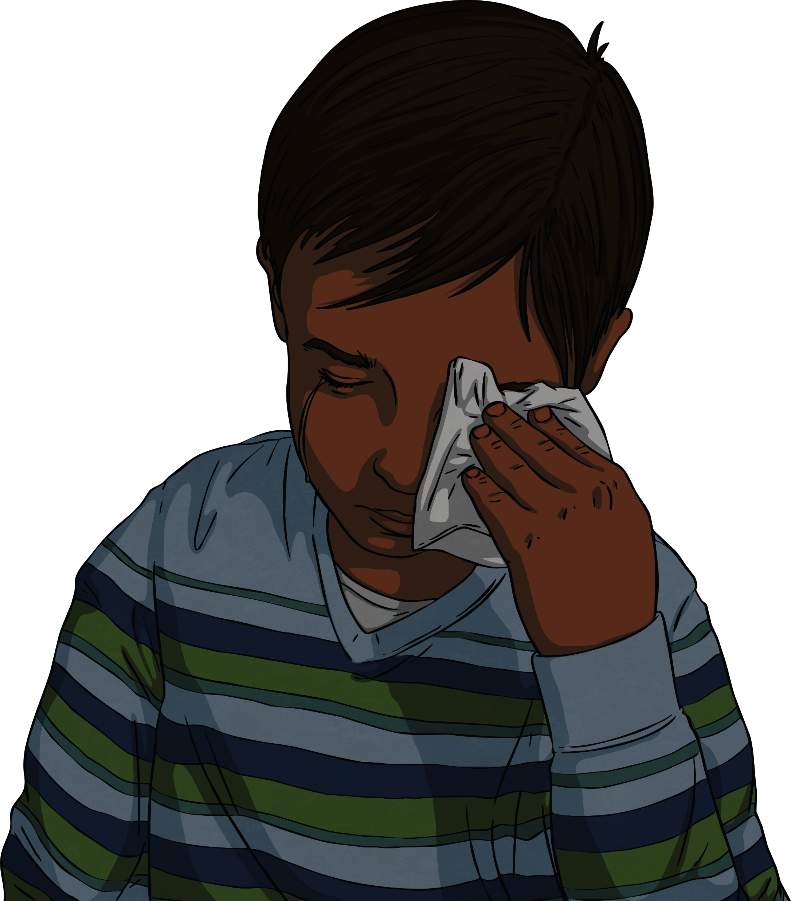
Guess How
Read this character description and infer how the character feels.
Think about how you know.
Inference Iggy
?
Sam lowered his gaze to the floor. Stifling a sniffle, he let out a pained sigh as he raised his tear-stained tissue and dabbed his eyes. His lip quivered like jelly and his heart ached as he thought about what Fran had just said.
Click here to reveal a picture of Sam.
Does this help you to infer how he is feeling?
Next

Slide 13
Guess How
Read this character description and infer how the character feels.
Think about how you know.
Inference Iggy
?
Erin’s hands curled tightly into fists and she raised them to her chest. A broad, toothy grin painted itself across her face and her eyes squeezed shut. She could feel an almost electrical energy buzzing through her veins.
Click here to reveal a picture of Erin.
Does this help you to infer how she is feeling?
Next

Slide 14
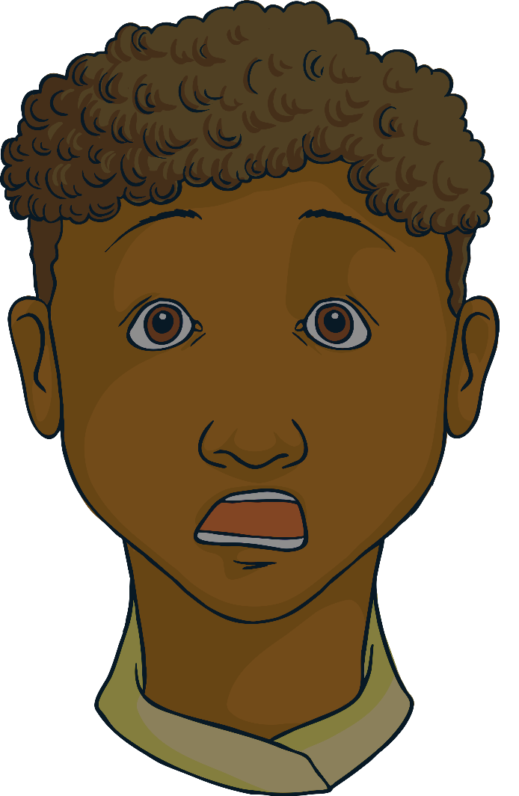
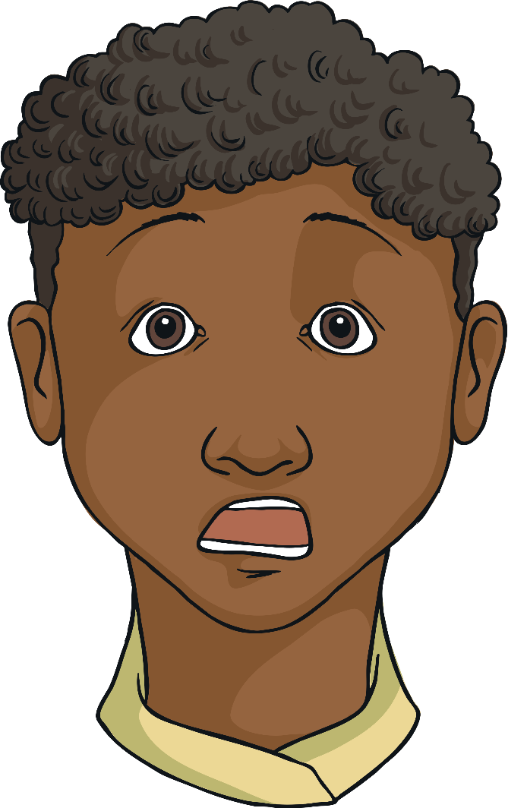
Guess How
Read this character description and infer how the character feels.
Think about how you know.
Inference Iggy
?
Renz’s face dropped. His cheekbones lowered as his eyes became wider than he thought possible. His mouth gaped and he could feel his breathing quicken as his heart thumped in his chest. He stared intently at the door handle, recoiling backwards and instinctively trying to hide.
Click here to reveal a picture of Renz.
Does this help you to infer how he is feeling?
Next

Slide 15
Guess How
Read this character description and infer how the character feels.
Think about how you know.
Inference Iggy
Great work!
Next

