Slide 1
Wednesday
Tens and ones
(Practical)

Slide 2
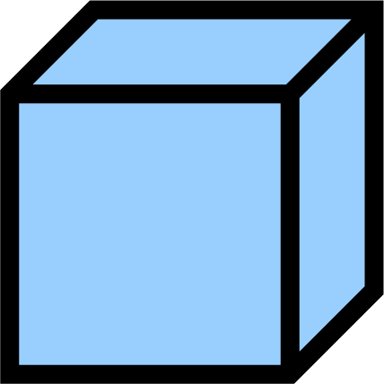
Using Base 10 build the numbers.
1 ten and 7 ones

Slide 3
Using Base 10 build the numbers.
2 tens and 6 ones

Slide 4
Using Base 10 build the numbers.
3 tens and 2 ones

Slide 5
Using Base 10 build the numbers.
3 tens and 9 ones

Slide 6
Using Base 10 build the numbers.
4 tens and 5 ones

Slide 7
Using Base 10 build the numbers.
12

Slide 8
Using Base 10 build the numbers.
24

Slide 9
Using Base 10 build the numbers.
35

Slide 10
Using Base 10 build the numbers.
43

Slide 11
Using Base 10 build the numbers.
48

Slide 12
Pick a card on the table.
Build the number on the place value grid using base 10
Write the number you’ve made on your whiteboard.

Slide 13
Which Base 10 shows a number greater than 21 but less than 25?

