Slide 1
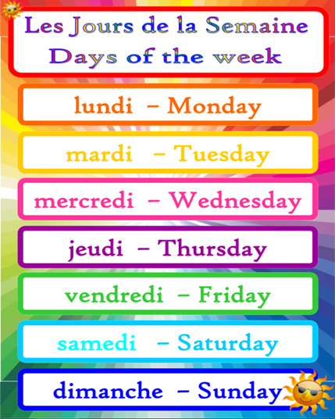
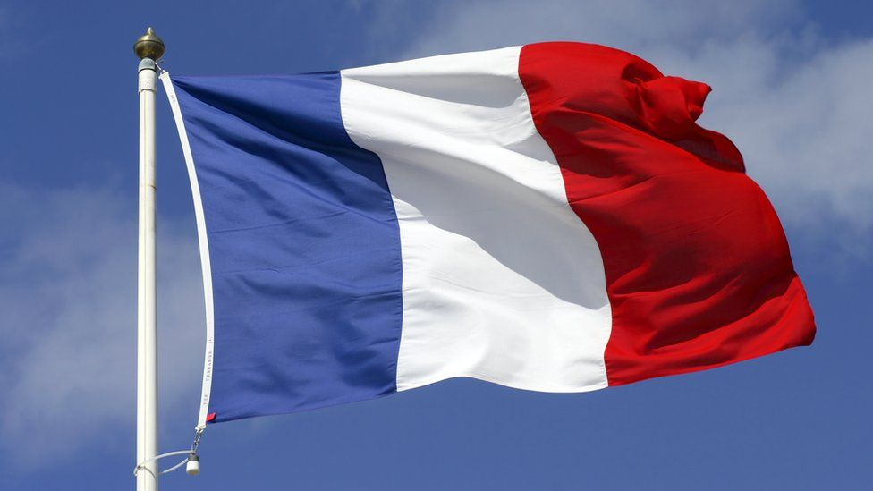
Days of the Week in French

Slide 2
Listen to and learn to sing the days of the week song on the next slide. You will probably need to listen to it a few times and practise it. The days of the week in French start with lundi which is Monday.

Slide 3
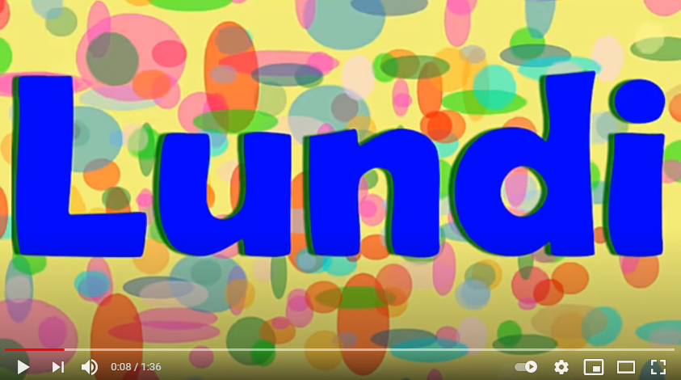

Slide 4
Here are the days of the week in French written next to the day of the week in English:
lundi – Monday mardi – Tuesday mercredi – Wednesday jeudi – Thursday vendredi – Friday samedi – Saturday dimanche – Sunday
There is something different about the way French people write days of the week. Can you spot it?

Slide 5
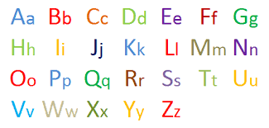
Yes, that’s right. They don’t use a capital letter to start each day, but in English we do use a capital letter to start each day.

Slide 6
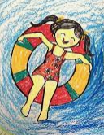
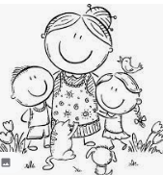
Your task is to write each day of the week in French and draw something that you do on that day. For example, if you go swimming on a Monday, and go to Grandma’s on a Tuesday, you might do this: lundi mardi

