Slide 1
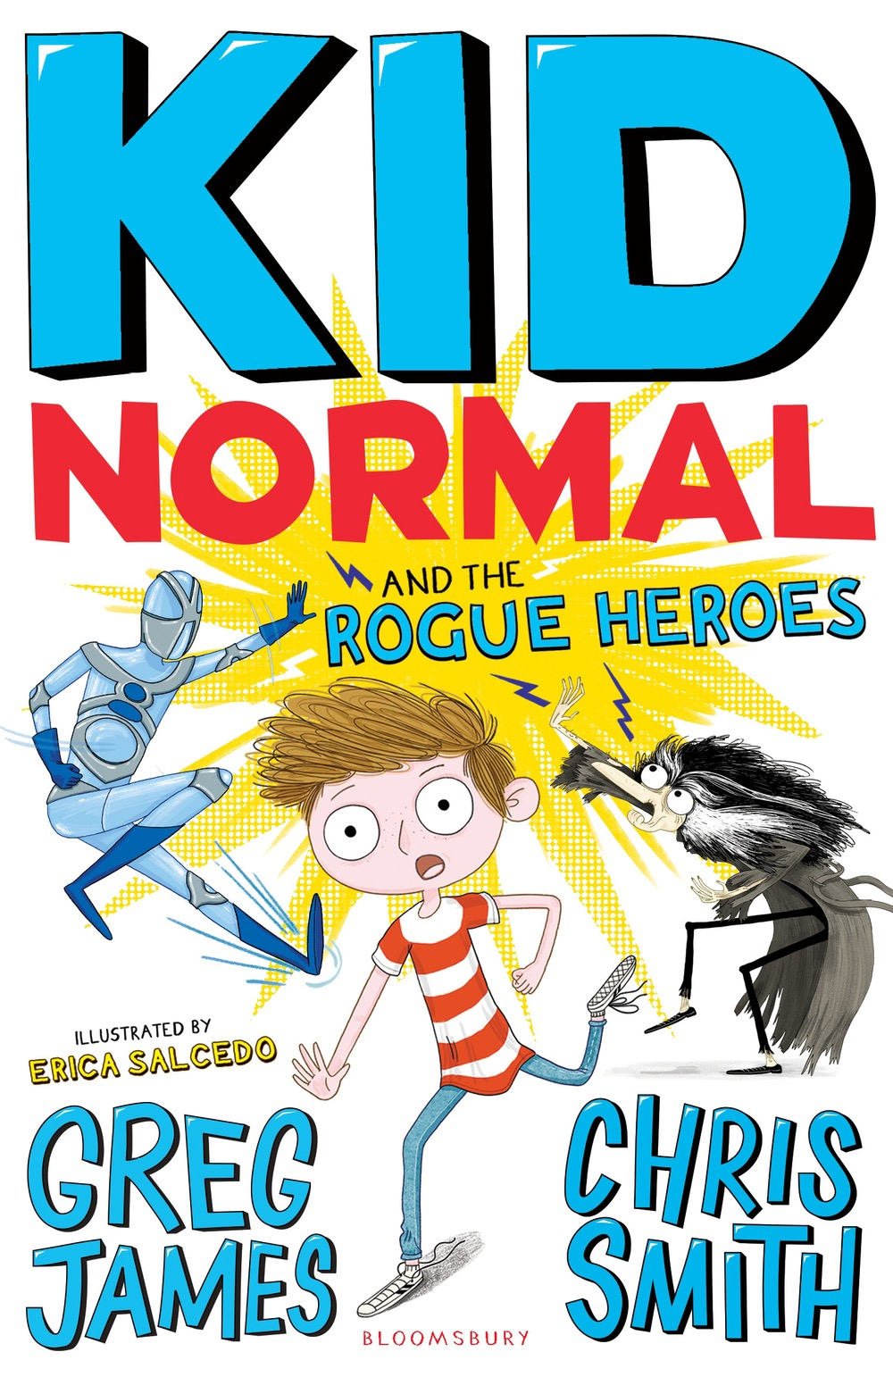
Kid Normal and the Rogue Heroes
By Greg James and Chris Smith

Slide 2
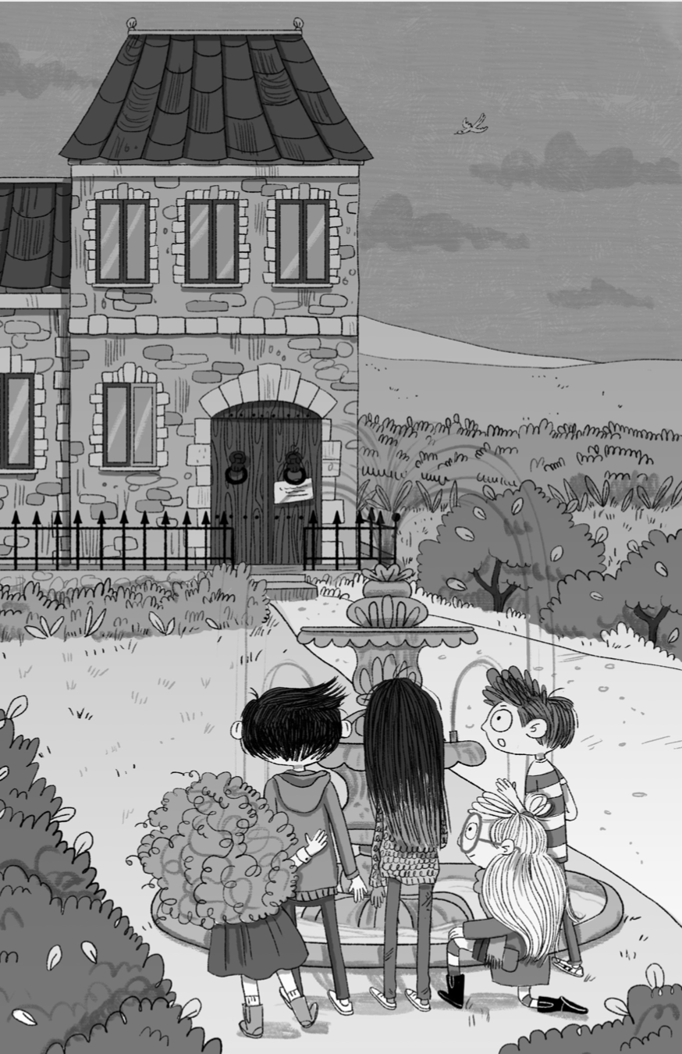
Individual Thinking
Before reading the extract…
Look at the illustration on page 4.
What predictions can you make about the book can you make from it?
Write your predictions in full sentences.

Slide 3
Vocabulary Check
notorious – Something famous or well-known, but usually for a bad reason.
ornamental – Something that is decorative or nice to look at.

Slide 4
Extract
Read up to ‘- no, no and no.’ on page 3.
Discuss the predictions you made, have any of them been accurate so far?

Slide 5
Quick Start
What is the main characters name?
What is the group of heroes he is in called?
Where was the robbery taking place?

Slide 6
Partnered Talk
Do you think this is a good opening for this story? Why?
Discuss with your partner.

Slide 7
Individual Thinking
‘The five members of the Super Zeroes crunched up the gravel driveway in front of them.’
Why do you think Murph’s group are called the ‘Super Zeroes’?

Slide 8
Partnered Talk
If you had no superpowers like Murph, what personal qualities might you need to be a hero and why?
Discuss with your partner.

Slide 9
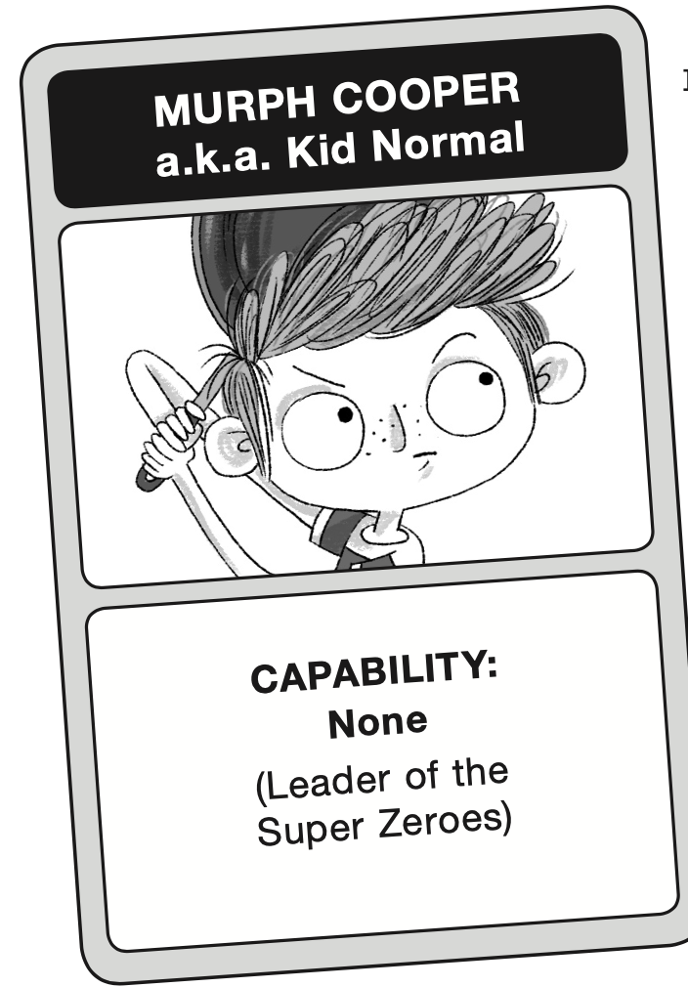
Solo Work
Although he’s in a group of superheroes, Murph is given the nickname ‘Kid Normal’. How do you think he feels about this? Have you ever felt like the odd one out? Do you think anyone is really ‘normal’?
Write a short paragraph explaining your answer.

