Slide 2
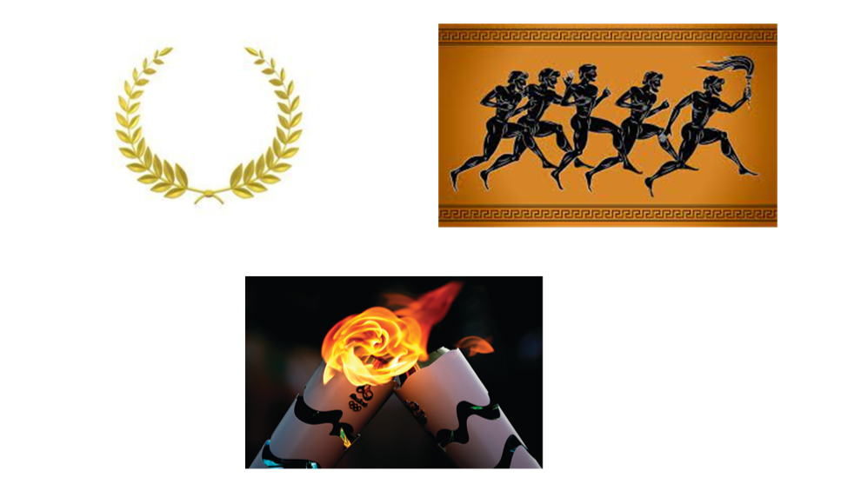

Slide 3
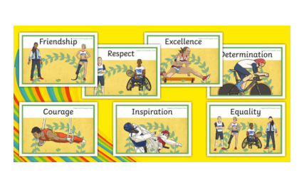
Olympic Values

Slide 4
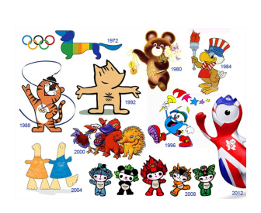
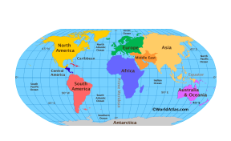

Slide 5
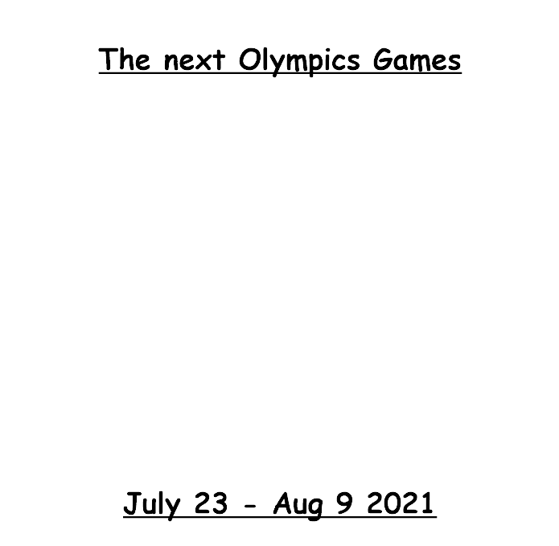
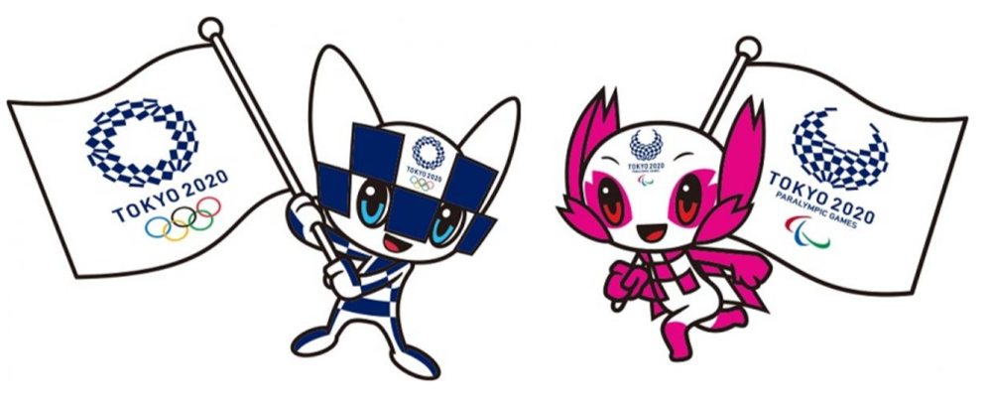

Slide 7
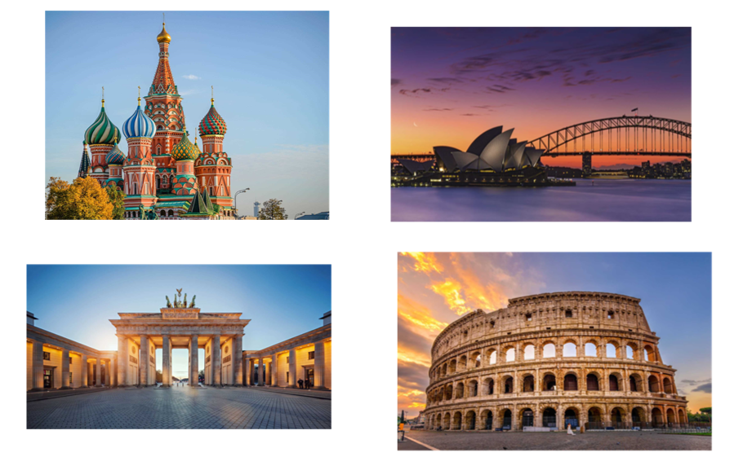

Slide 9
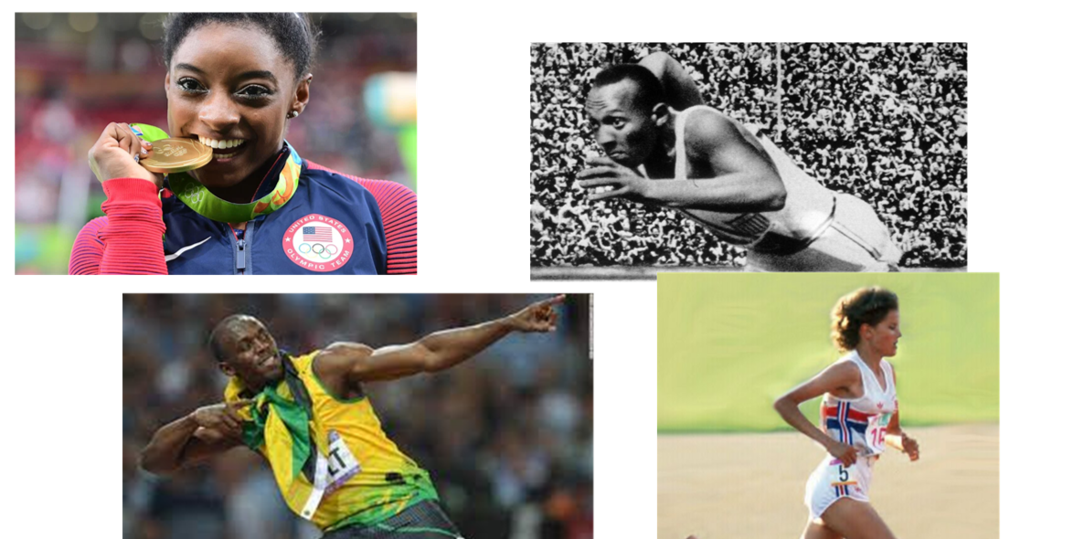

Slide 10
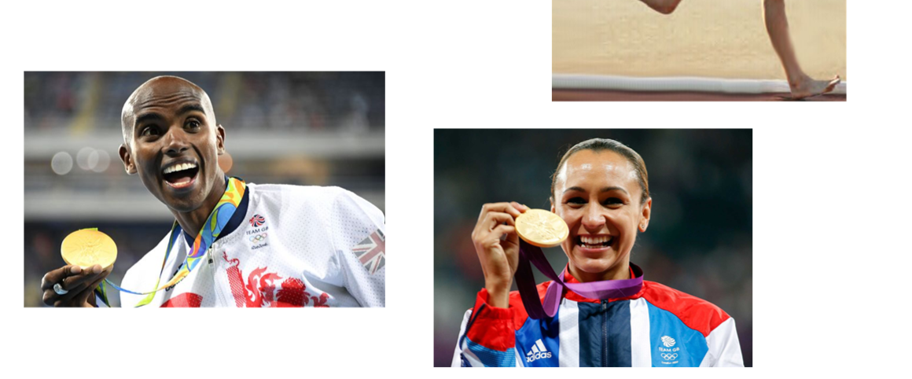

Slide 11
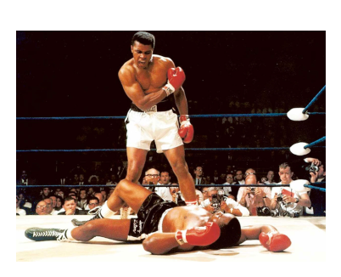
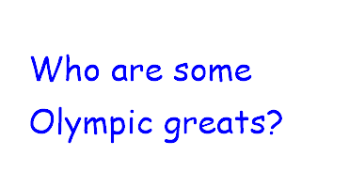
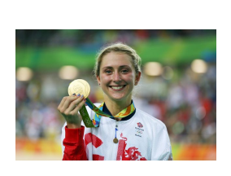
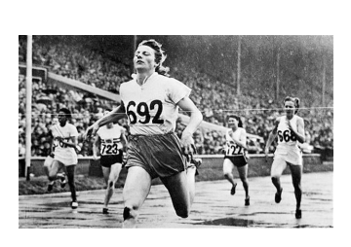
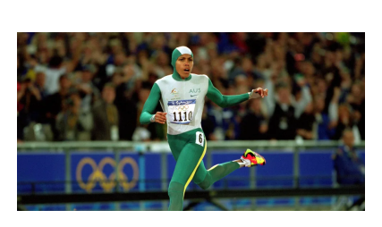
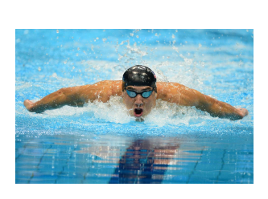

Slide 13
A - Z Olympics Quiz
Can you complete each letter of the alphabet with either an Olympic sportsmen, event, city or county or Olympic related word e.g. flame or rings?
(anyone who gets x or z should get a gold medal!)

Slide 14
Some of the things that are happening this week…
- Beat your personal best
- Compete in house tournaments
- Design an Olympic mascot
- Create healthy food for an Olympic athlete
- Learn about famous Olympic athletes
- Learn about an iconic Olympic games
- Create Olympic theme art
- Explore geography with the Olympics
- Design and celebrate a garden party
- Get dressed up (in your fancy pants clothes)
- Make and fly kites

