Slide 1
Monday 22nd November 2021
LO: To understand the text.
LO: To use a dictionary to find the definitions of unknown words

Slide 2
Monday 22nd November 2021
LO: To use a dictionary.

Slide 3
Now that we have learnt to say the text we are going to make sure that we understand it all. When we say the text today, underline or keep a note of any words that you are unsure of. Then we are going to use a dictionary to find the definitions of these words. Let’s say the text again…

Slide 4
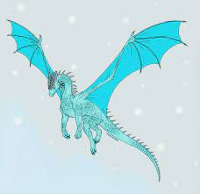
The Kingston Frost Dragon

Slide 5
The Kingston Frost Dragon is a type of dragon.

Slide 6
Have you ever wondered what a Frost Dragon looks like? In fact, they are similar to the majority of dragons. Like most dragons, they have huge wings, large jaws, a spiny back and a long tail. Typically, they are a sparkling white colour. However, some have been spotted that are an icy blue. Furthermore, their teeth are made of diamonds and look like icicles.
(This paragraph continues on the next slide)

Slide 7
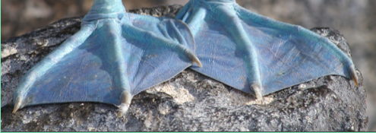
The main feature of this dragon is that it does not breathe flames. They breathe frost and snow. A few dragons of this variety have the ability to breathe on any creature and freeze it to stone. Additionally, they all have webbed feet that they use for swimming.

Slide 8
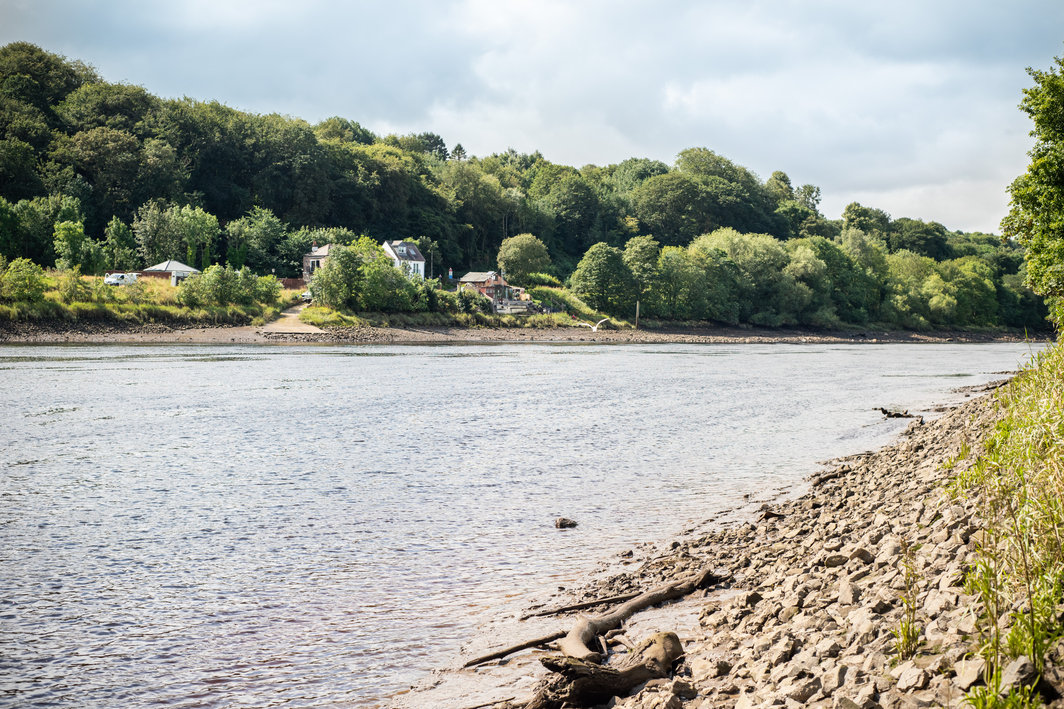
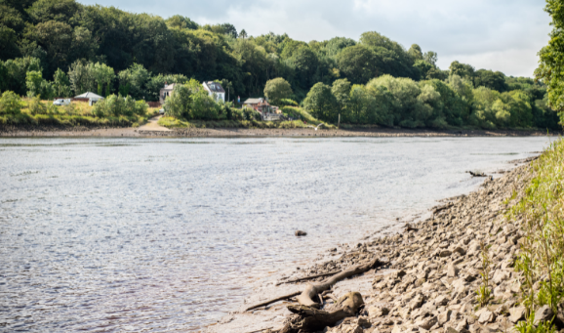
The Frost Dragon lives by the River Tyne. It hides in the tops of trees and is difficult to see because most of them can become almost invisible. This dragon likes to hide in frosty fields or mist. This makes them difficult to track down. They only come out at night and tend to move round the countryside when it is snowing or misty.

Slide 9
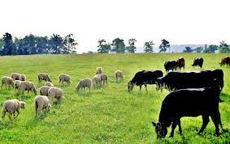
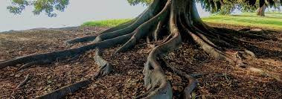
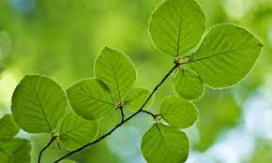
Are Frost Dragons dangerous? Many humans fear these dragons because they believe that they eat only princesses. However, this is not true. They will steal cattle and sheep but actually have never been known to attack a human. Indeed, in the summer, they are more likely to eat the roots of trees and fresh leaves than animals. This habit makes their skin glow a strange green colour.

Slide 10
The most interesting thing about a Frost Dragon is that they tell great stories. They can enchant people with their tales that have been known to last over a year long. Indeed, many people believe that the story of a thousand and one nights was actually told by a patient Frost Dragon! It has been suggested that they might be able to tell stories in schools.

Slide 11
Let’s just remind ourselves how to use a dictionary. Remember, the more you practise this, the better you will get.

Slide 12
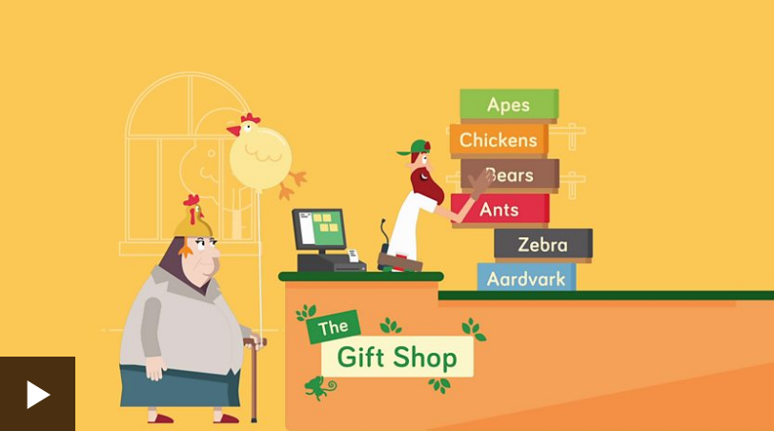
A dictionary is a list of words or phrases and their definitions (what they mean).
Dictionaries are arranged in alphabetical order.
They help you to spell or understand any new words, so are a fantastic tool to use to improve your English skills.
Before we look at dictionaries in more detail, let’s revise what alphabetical order means.

Slide 13
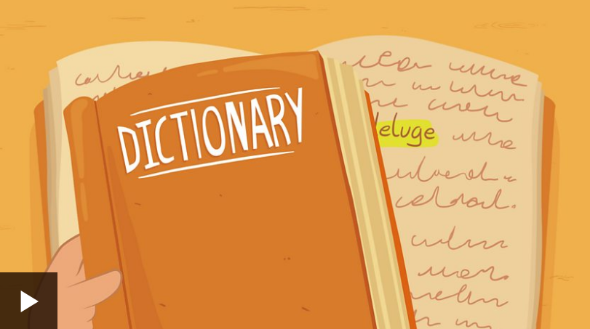
Now watch this short clip to see how to use a dictionary to look up an unfamiliar word.

Slide 14
Now use a dictionary (or online dictionary if you don’t have a dictionary) to look up the words that are unfamiliar to you.
Then write down the word and its definition. Remember to use your neatest handwriting.
Challenge: Can you write a sentence using the new word correctly?

