Slide 1
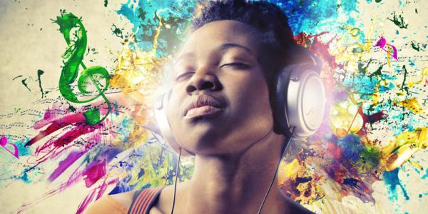
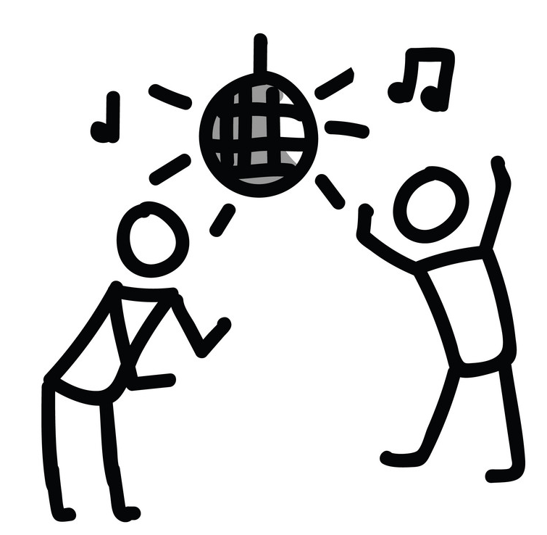
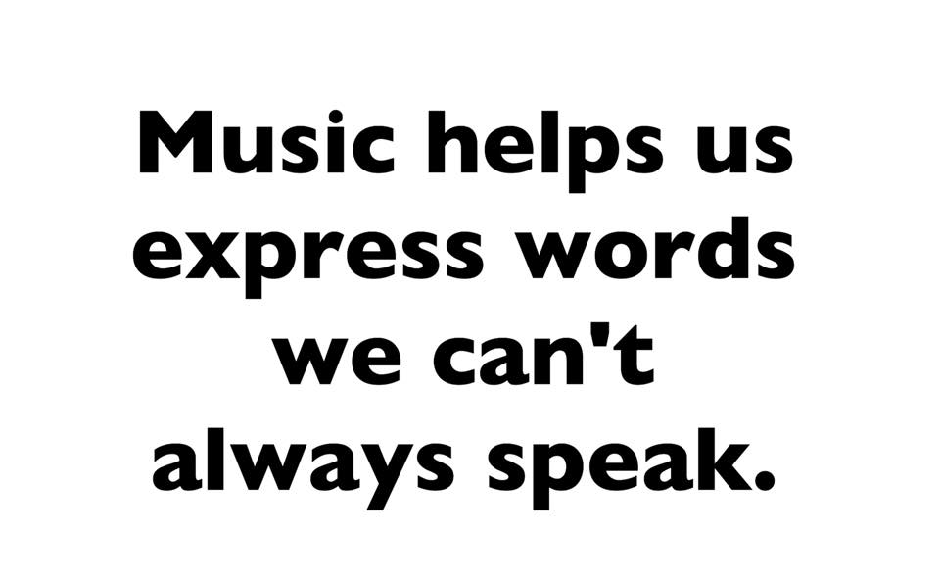
How does Music make you feel?

Slide 2
Today we’re going to be thinking about music and the impact that it has on our lives.
Music in TV and Film is used to create a mood. You know if someone is happy or good things are happening because the music is happy. You also know if something is scary or if something bad is going to happen because the music doesn’t make you feel good anymore.
Follow the link below to the BBC bitesize ‘How does music make you feel?’
Watch the short ‘feel and emotion’ clip.
https://www.bbc.co.uk/bitesize/topics/zcbkcj6/articles/zc7m7p3

Slide 3
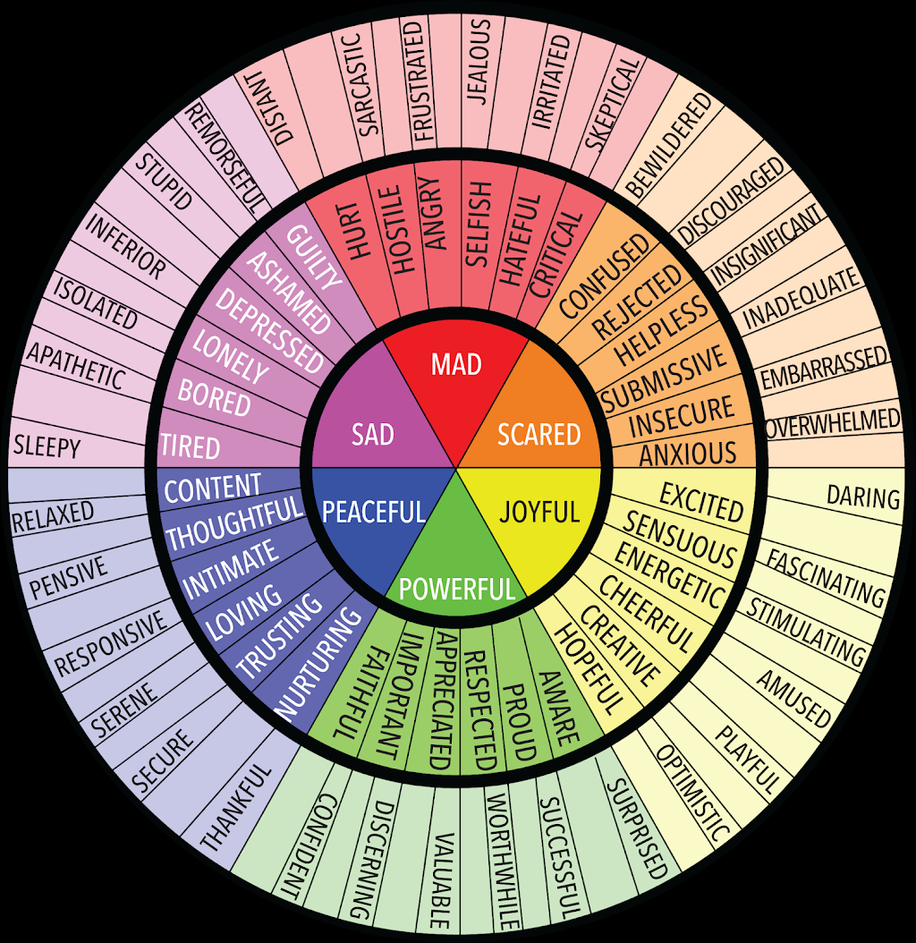
Listen to these two choir performances. How do they make you feel?
Use the Emotions wheel to help you.
https://www.bbc.co.uk/bitesize/topics/zbnrmfr/articles/zrwkhbk
https://www.bbc.co.uk/bitesize/topics/zbnrmfr/articles/zjhxgwx
Listen to them again. Try to think about why they make you
feel like that? What is it about them? Think about the pace,
rhythm, melody.
Remember there are no right or wrong answers here.
These are your ideas and your feelings.

Slide 4
Now, think about songs or pieces of music that you know that make you feel different ways.
Use the emotions wheel to help you think about different feelings you could have.
We can also think about different ways we might act.
What song or piece of music would you listen to if you were
doing exercise? Imagine you were doing a Joe Wicks workout
or going for a run.
What song or piece of music would make you want
to dance?
Which song or piece of music would you play if you were
sleepy or just wanted to chill?
If you can, practise your online safety and access some music
outlets like YouTube, iTunes or Spotify and listen to some different music.
You could even ask your family if they have any ideas ☺

