Slide 1
02.11.21
LO: To add a 2-digit and a 1-digit number (crossing 10)

Slide 2



Learning Journey – Addition and Subtraction
In this unit we will…
Add and subtract multiples of 100
Add and subtract 1s
Add and subtract 3-digit and 1-digit numbers – not crossing 10
Add a 2-digit and 1-digit number – crossing 10
Subtract a 1-digit number from a 3-digit number – crossing 10
Subtract a 1-digit number from 2-digits – crossing 10
Add 3-digit and 1-digit numbers – crossing 10
Add and subtract 3-digit and 2-digit numbers – not crossing 100
Subtract a 2-digit number from a 3-digit number – crossing 100
Add 3-digit and 2-digit numbers – crossing 100
Add and subtract 100s
Subtract a 2-digit number from a 2-digit number – crossing 10
Add two 2-digit numbers – crossing 10 – add ones and add tens
Spot the pattern – making it explicit

Slide 3
Vocabulary:
addition
subtraction
column method
mental method
exchange
place value grid

Slide 4


Slide 6

We can use number bonds to help us add!
6
6 $+$ 4 $=$ 10

Slide 7

3
3 $+$ 7 $=$ 10

Slide 8

5
5 $+$ 5 $=$ 10

Slide 9

1
1 $+$ 9 $=$ 10

Slide 10
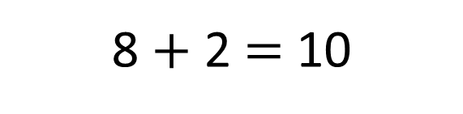
8
8 $+$ 2 $=$ 10

Slide 11
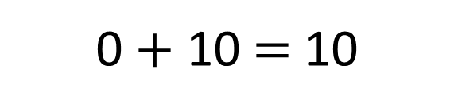
0
0 $+$ 10 $=$ 10

Slide 12

7
7 $+$ 3 $=$ 10

Slide 13
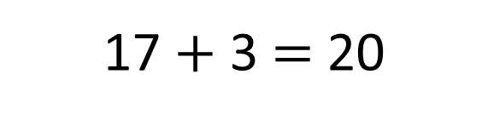
17
17 $+$ 3 $=$ 20

Slide 14
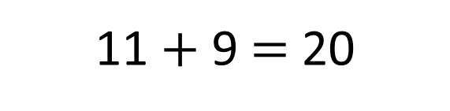
11
11 $+$ 9 $=$ 20

Slide 15
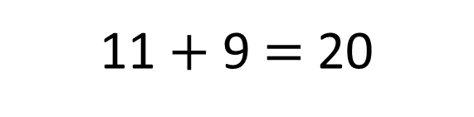

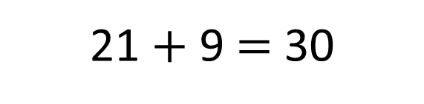
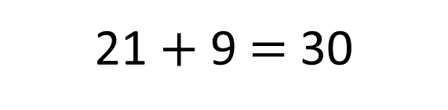
1 $+$ 9 $=$ 10
11 $+$ 9 $=$ 20
21
21 $+$ 9 $=$ 30
21 $+$ 9 $=$ 30

Slide 16
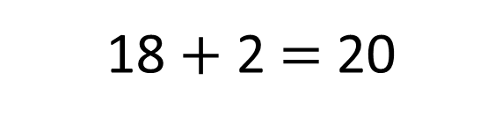
18
18 $+$ 2 $=$ 20

Slide 17
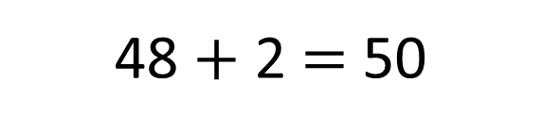
48
48 $+$ 2 $=$ 50

Slide 18

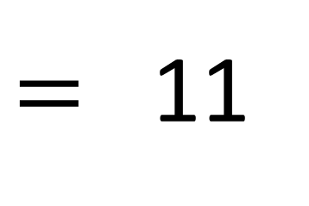
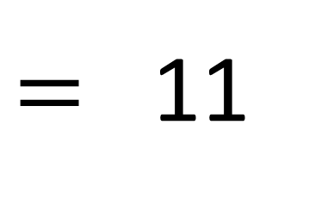
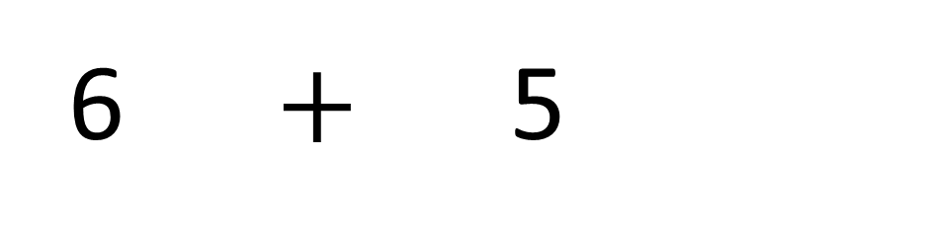
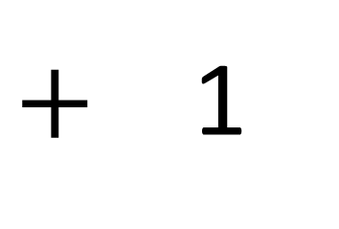
+ 4
+ 1
6
7
8
9
10
11
12
13
$=$ 11
6 $+$ 5
4
1
$+$ 1
10
$=$ 11

Slide 19
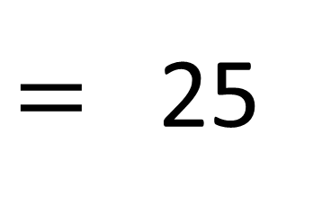
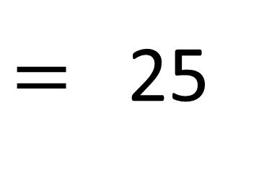
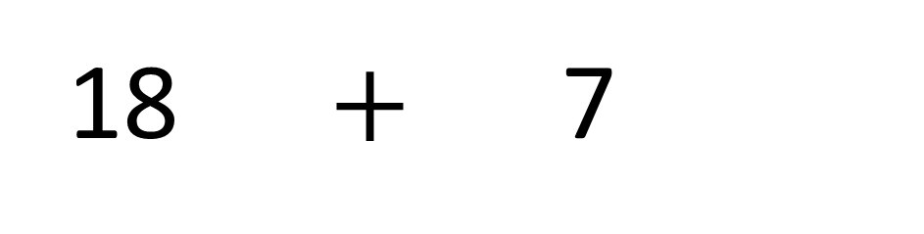
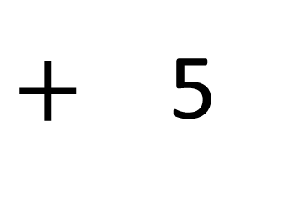
+ 2
+ 5
18
19
20
21
22
23
24
25
$=$ 25
18 $+$ 7
2
5
$+$ 5
20
$=$ 25

Slide 20

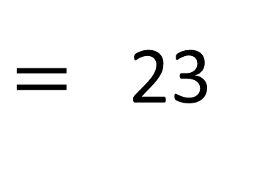
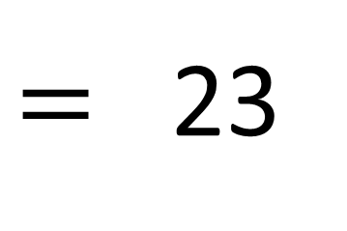
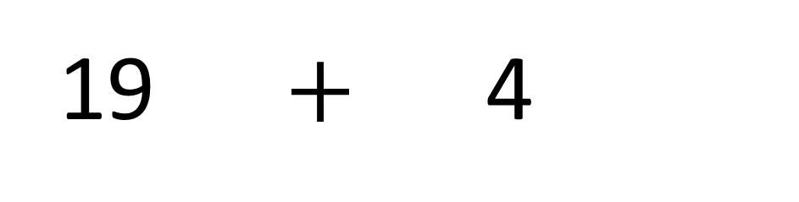
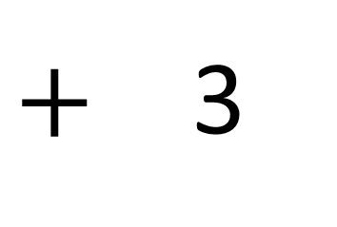
+ 1
+ 3
Have a think
19
20
21
22
23
24
25
26
$=$ 23
19 $+$ 4
1
3
$+$ 3
20
$=$ 23

Slide 21
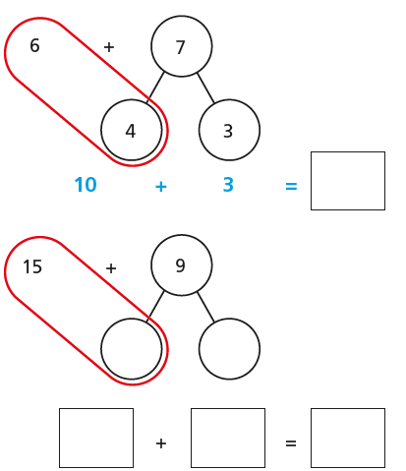


Slide 22
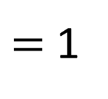
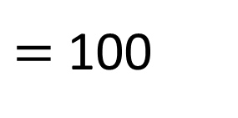
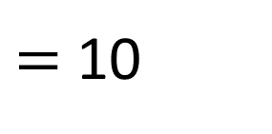
$=$ 1
$=$ 10
$=$ 100

Slide 23
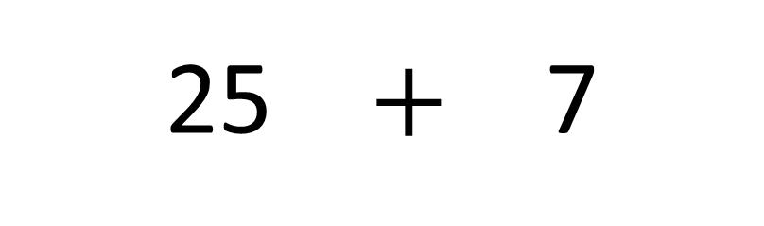

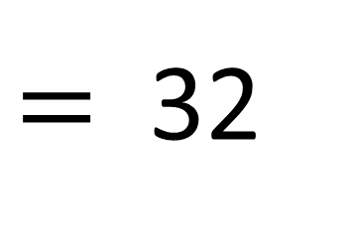
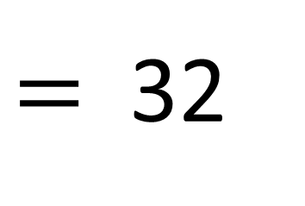
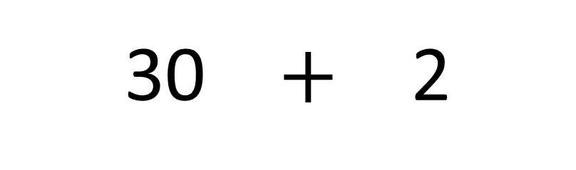
$$+$$
25 $+$ 7
$=$ 32
30 $+$ 2
$=$ 32

Slide 24
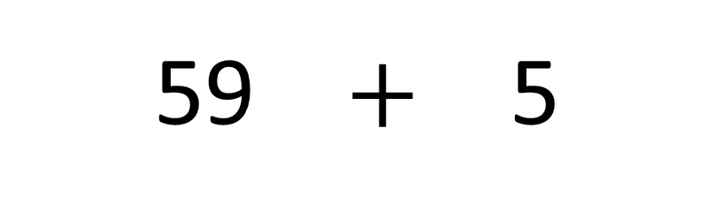

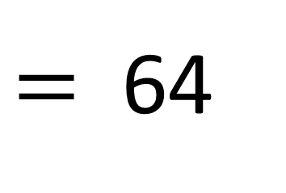
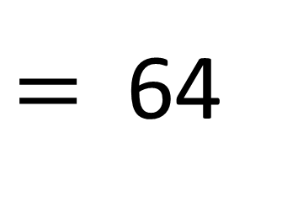
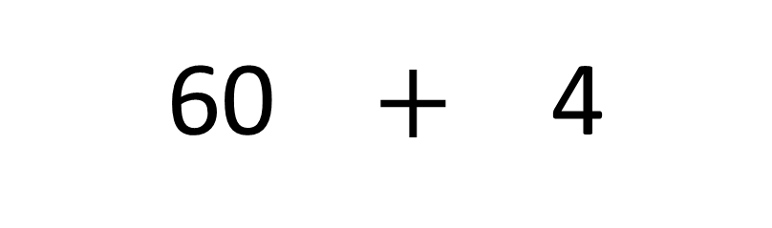
Have a think
$$+$$
59 $+$ 5
$=$ 64
60 $+$ 4
$=$ 64

Slide 25
Have a go at the rest of the questions

Slide 26

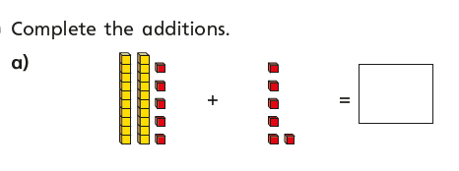
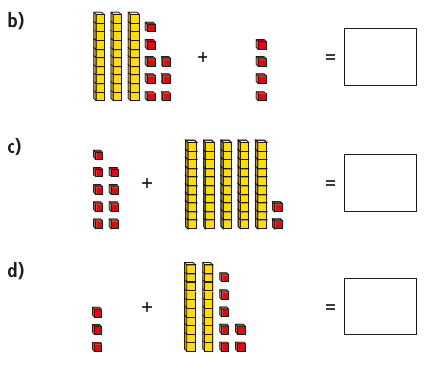

Slide 27
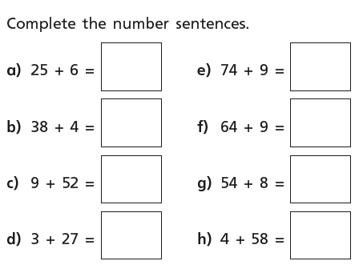

Slide 28
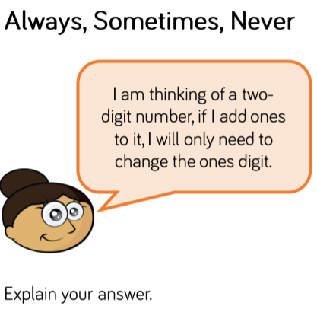
Star Challenge!

