Slide 1

20.1.22
LO – I can use my knowledge of multiplication and division to work out problems.

Slide 2
Whiteboards and pens ready Year 4 …
You have two minutes to answer the question on the next slide…

Slide 3

2 $×$ 3 $=$ $×$ 3 $=$ 9 2 $×$ $=$ 8
4 $×$ 2 $×$ 2 $=$
4 $×$ 2 $×$ 3 $=$
5 $×$ 4 $×$ 2 $=$

Slide 4
6
2 $×$ 3 $=$ $×$ 3 $=$ 9 2 $×$ $=$ 8
4 $×$ 2 $×$ 2 $=$
4 $×$ 2 $×$ 3 $=$
5 $×$ 4 $×$ 2 $=$
3
4
16
24
40

Slide 5
Let’s concentrate and use our growth mindset…

Slide 6






Ron puts 3 different coloured cubes into a box.
He covers his eyes and picks a cube out.
What could Ron have picked?
Yellow
Red
Blue
3 possibilities

Slide 7
Ron now has two boxes.
He picks one cube out of each box.
What combinations could Ron pick?
Yellow
/ Green
Yellow
/ Black

Slide 8
Ron now has two boxes.
He picks one cube out of each box.
What combinations could Ron pick?
Yellow
/ Green
Yellow
/ Black
Red
/ Green
Red
/ Black

Slide 9
Ron now has two boxes.
He picks one cube out of each box.
What combinations could Ron pick?
Yellow
/ Green
Yellow
/ Black
Red
/ Green
Red
/ Black
Blue
/ Green
Blue
/ Black
6 possibilities

Slide 10

Ron adds a third cube to the second box.
What combinations could Ron pick now?
Have a think
Orange
/ Yellow
Orange
/ Red
Orange
/ Blue
Yellow
/ Green
Yellow
/ Black
Red
/ Green
Red
/ Black
Blue
/ Green
Blue
/ Black
9 possibilities

Slide 11

Ron moves the cubes.
There are the same number of cubes so there will still be 9 combinations.
Orange
/ Yellow
Orange
/ Red
Orange
/ Blue
Have a think
Yellow
/ Green
Yellow
/ Black
Red
/ Green
Red
/ Black
Blue
/ Green
Blue
/ Black
9 possibilities

Slide 12
Ron moves the cubes.
There are the same number of cubes so there will still be 9 combinations.
8 possibilities

Slide 13



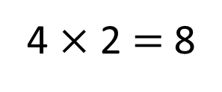
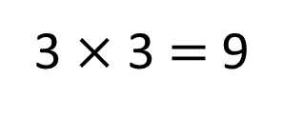
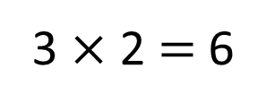
What do you notice?
3
6 possibilities
3 $×$ 2 $=$ 6
2
Have a think
3
9 possibilities
3 $×$ 3 $=$ 9
3
4
8 possibilities
4 $×$ 2 $=$ 8
2

Slide 14
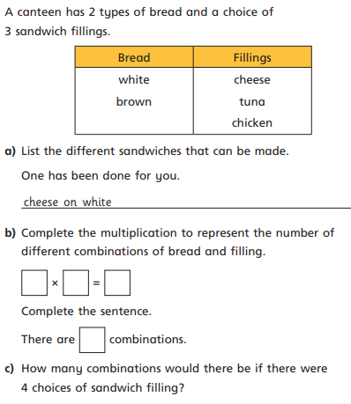
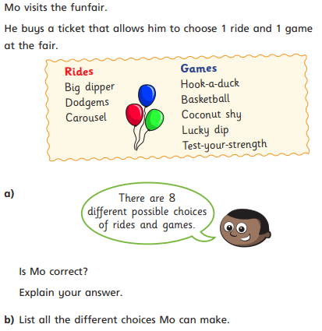
Have a go at the questions 1 – 4 on the worksheet
Answer questions 1 and 2 from your sheet. TTYP and work together to find the answers to these questions.

Slide 15



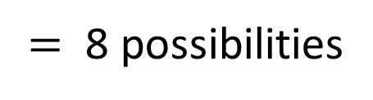
Ice cream | Sauce
Vanilla | Blueberry
Chocolate | Raspberry
Strawberry
Mint
Have a think
4
$$×$$
2
$=$ 8 possibilities
Va / Bl
Va / Ra
Ch / Bl
Ch / Ra
St / Bl
St / Ra
Mi / Bl
Mi / Ra

Slide 16



Ice cream | Sauce | Topping
Vanilla | Blueberry
Chocolate | Raspberry
Strawberry
Mint
Ice cream | Sauce
Vanilla | Blueberry
Chocolate | Raspberry
Strawberry
Mint
Flake
Sprinkles
4
$$×$$
2
$$×$$
2
$$=$$
16 possibilities
Va / Bl
Va / Ra
Ch / Bl
Ch / Ra
Va / Bl / Fl
Va / Ra / Fl
Ch / Bl / Fl
Ch / Ra / Fl
Va / Bl / Sp
Va / Ra / Sp
Ch / Bl / Sp
Ch / Ra / Sp
St / Bl
St / Ra
Mi / Bl
Mi / Ra
St / Bl / Fl
St / Ra / Fl
Mi / Bl / Fl
Mi / Ra / Fl
St / Bl / Sp
St / Ra / Sp
Mi / Bl / Sp
Mi / Ra / Sp

Slide 17
Ice cream | Sauce | Topping
Vanilla | Blueberry
Chocolate | Raspberry
Strawberry
Mint
Ice cream | Sauce
Vanilla | Blueberry
Chocolate | Raspberry
Strawberry
Mint
Flake
Sprinkles
Wafer
4
$$×$$
2
$$×$$
3
$$=$$
24 possibilities

Slide 18
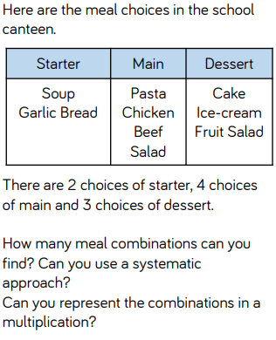
Have a go at the rest of the questions on the worksheet
Let’s look at another example.

Slide 19
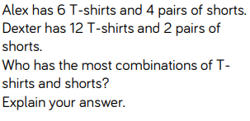
Have a go at the rest of the questions on the worksheet
Challenge question.

