Slide 1
Thursday 13th January 2022
LO: To describe using show don’t tell

Slide 2
One of the features in our toolkit is using show don’t tell.
We learnt about this on Monday, can you remember what it is and give an example?

Slide 3
Now, let’s say our story out loud with actions.
As you do this, notice which parts use show don’t tell.

Slide 4
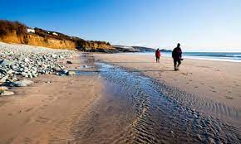
Adventure at Sandy Cove

Slide 5
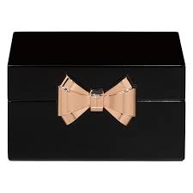
“Hurry up,” shouted Joe as he climbed over the rocks. Carefully, Rahul followed. The two boys stopped at a rock pool and began to search for shells. “Hey, what’s this?” shouted Joe to Rahul. In the rock pool was a small, black box wrapped in plastic. The boys tugged it loose. What was inside? Joe pressed the silver catch and the lid popped open. It was full of jewels!

Slide 6
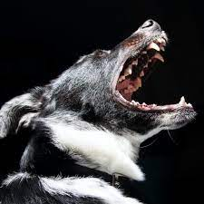
At that moment, a scruffy old man shouted at the boys. His wolf-like dog barked menacingly. Joe snapped the lid down, picked up the box and the two boys began to scramble over the rocks. They slipped and struggled towards the cliffs.

Slide 7
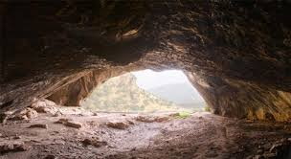
“Quick! Let’s hide in here,” said Joe, rushing into a cave. It was dark and damp inside and they could hear water dripping. They felt their way further in and crouched behind a rock. Rahul’s heart pounded. All at once, the scruffy man appeared at the cave mouth. He shone a torch around. The light cast shadows on the cave wall. The children ducked down and kept as still as stone, but the dog could sense them. It padded closer and closer, growling menacingly. Rahul gripped Joe’s arm. They could see its white teeth, smell its damp hair and feel its hot meaty breath.

Slide 8
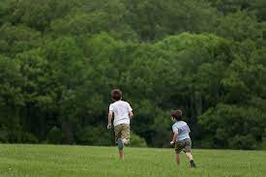
Suddenly there was a distant shout. ‘Here Dog!’ hissed the man, roughly grabbing its collar. “Those boys have got away. Quick. After them!” Joe and Rahul held their breath until they could hear the sound of the man and his dog stumbling back across the rocks. They waited for a long while before creeping out. Even though the beach was empty, the boys ran home as fast as they could.

Slide 9
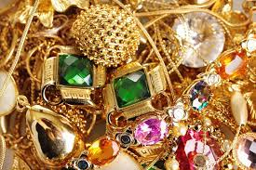
At first Mum didn’t believe them. It was only when Joe opened the box that she decided to call the police. When the police arrived they told Mum that the big house up the road had been burgled only the night before. They had spent all day searching for a trace of the jewels. Their only clue had been the footprints of a large dog. Joe shut his eyes. He could imagine the headlines: ‘PRICELESS JEWELS FOUND BY SCHOOLBOY DETECTIVES. And there was a reward too!

Slide 10
Today we are going to describe a fierce animal using show don’t tell. We are going to use our senses to help us do this.

Slide 11
In the story, the dog is described:
It padded closer and closer, growling menacingly. Rahul gripped Joe’s arm. They could see its white teeth, smell its damp hair and feel its hot meaty breath.
The author describes how the dog moves and the sound it makes. Then he describes what the characters could see, smell and feel.

Slide 12
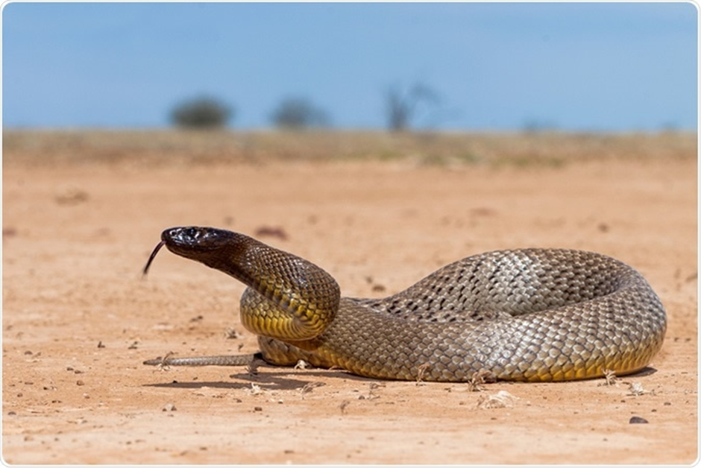
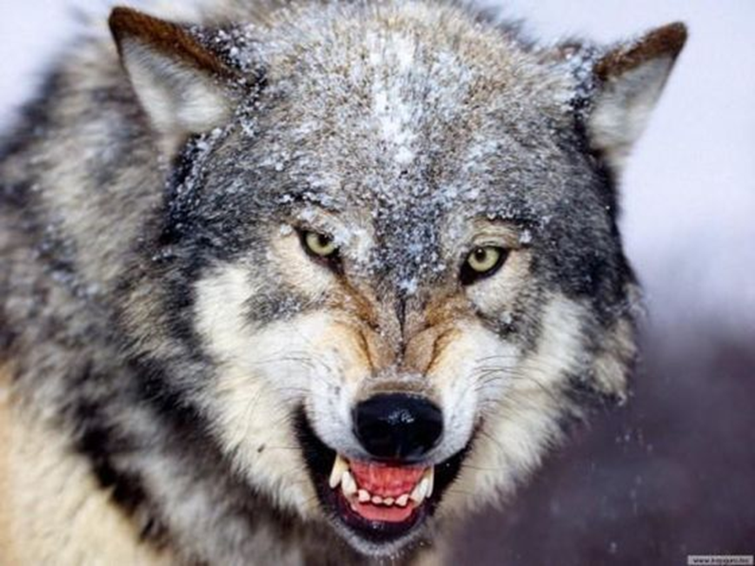
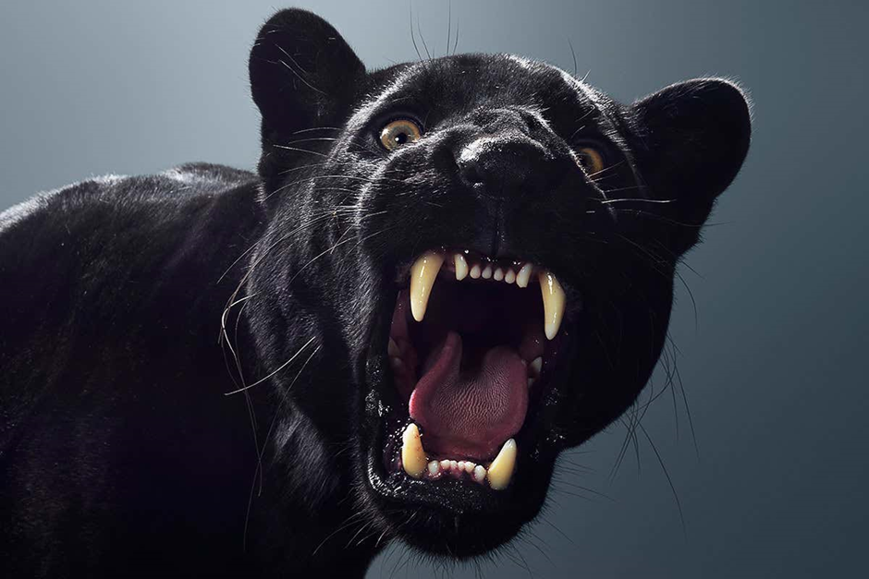
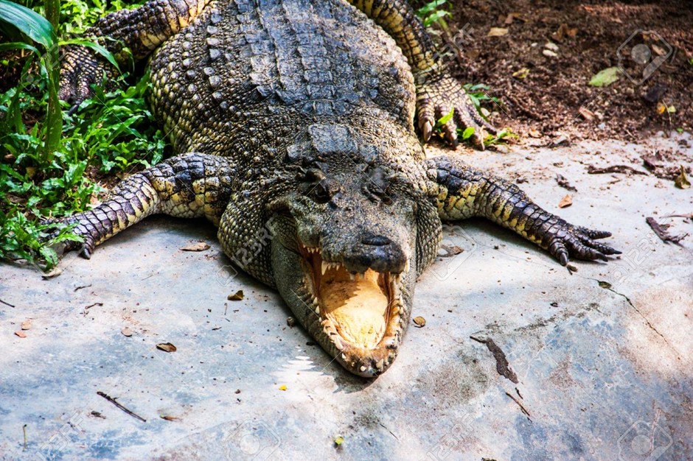
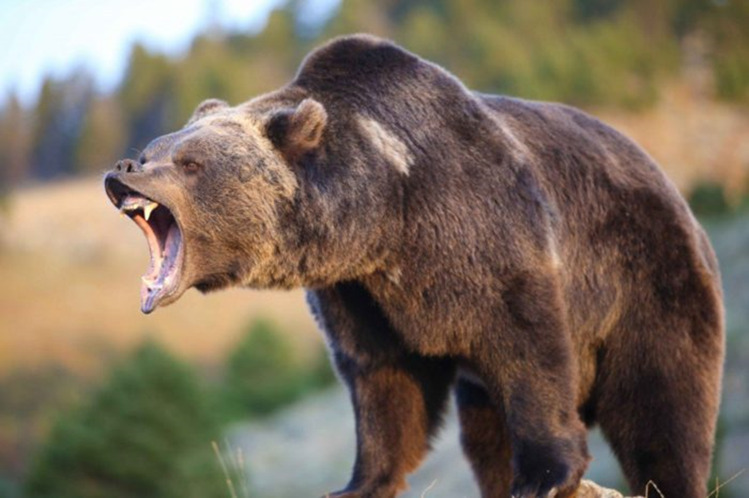
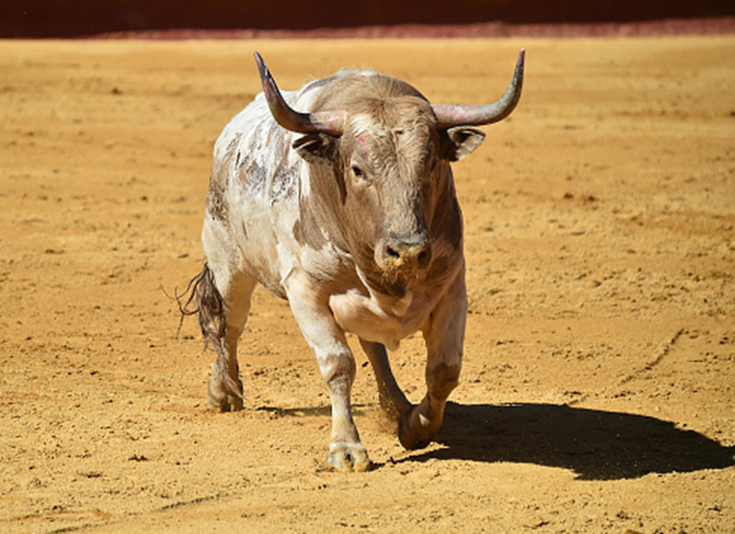

Slide 13
Let’s do a shared write in the same
format.
It __________ closer and closer, __________menacingly. They could see its____________ ____________, smell its ____________ ___________ and feel its __________ _______________.

Slide 14
Now it’s your turn. Choose one of the images and write about the creature using show don’t tell. You can use the same or a similar format.
It __________ closer and closer, __________menacingly. They could see its____________ ____________, smell its ____________ ___________ and feel its __________ _______________.

Slide 15
You could extend your writing…
Its eyes…
Its tail…
Its hooves…
Read through and check your writing. Use your purple pen to make any corrections or improvements.

Slide 16
Now, I am going to read some out and we will see if we can guess which animal it is.

