Slide 1
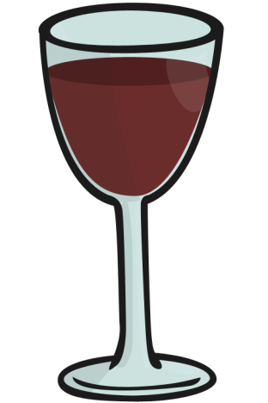
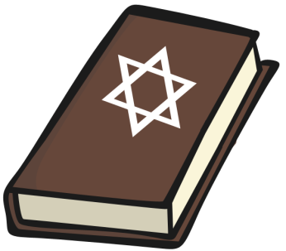
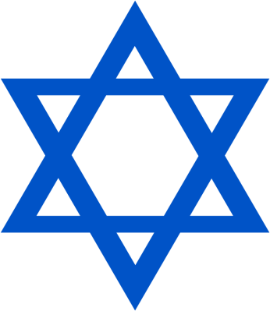
Monday 4th May.
Jews
and
Judaism
Symbols and Artefacts Task Setter

Slide 2
Here are a few symbols and items that are special and mean a lot to Jewish people.
Some of them are used for special occasions only, and some are used all the time.

Slide 3
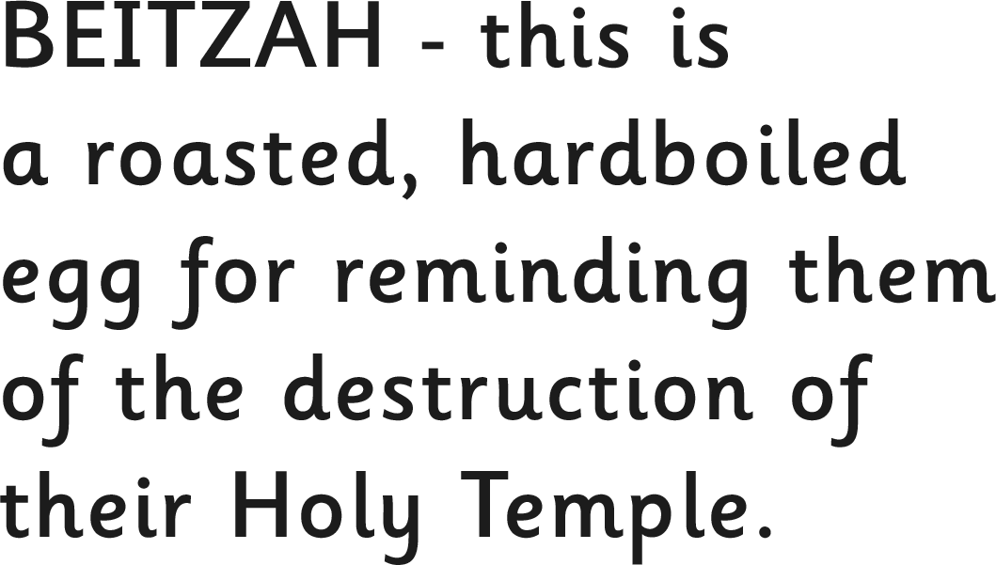
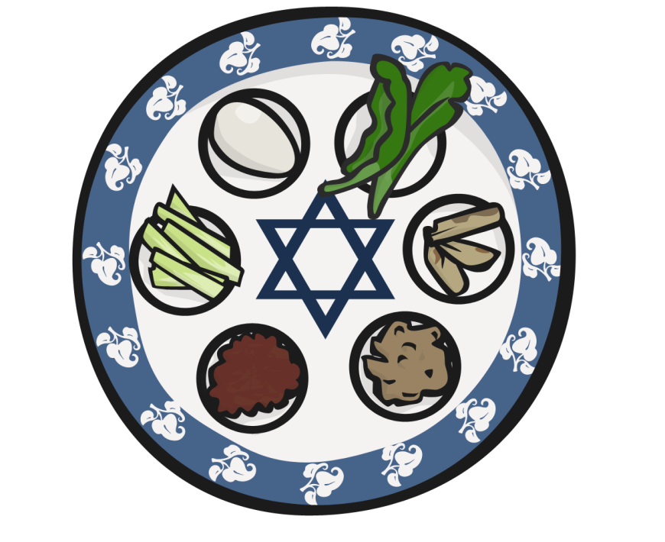
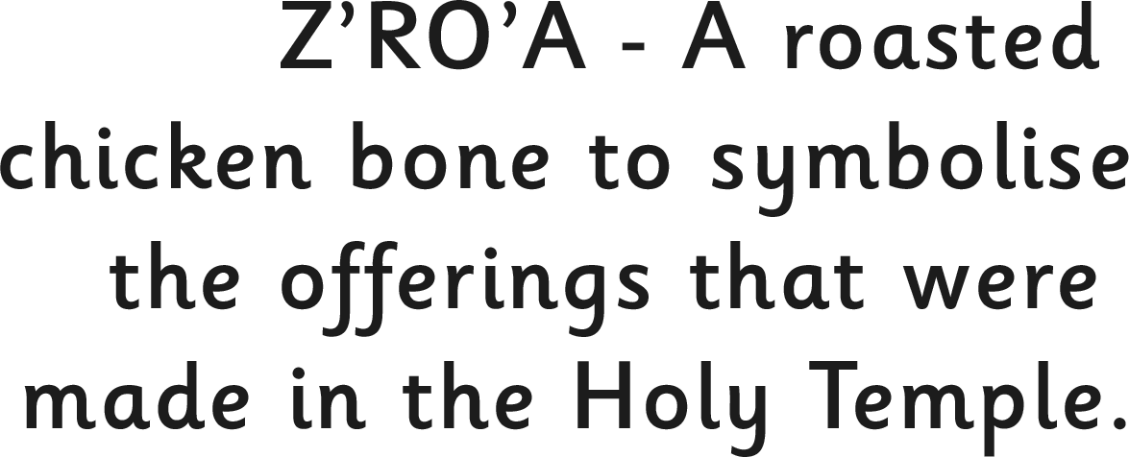
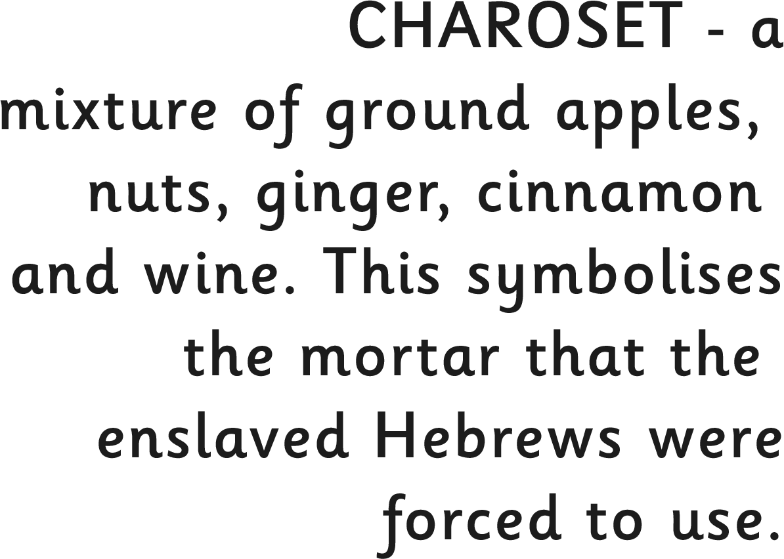
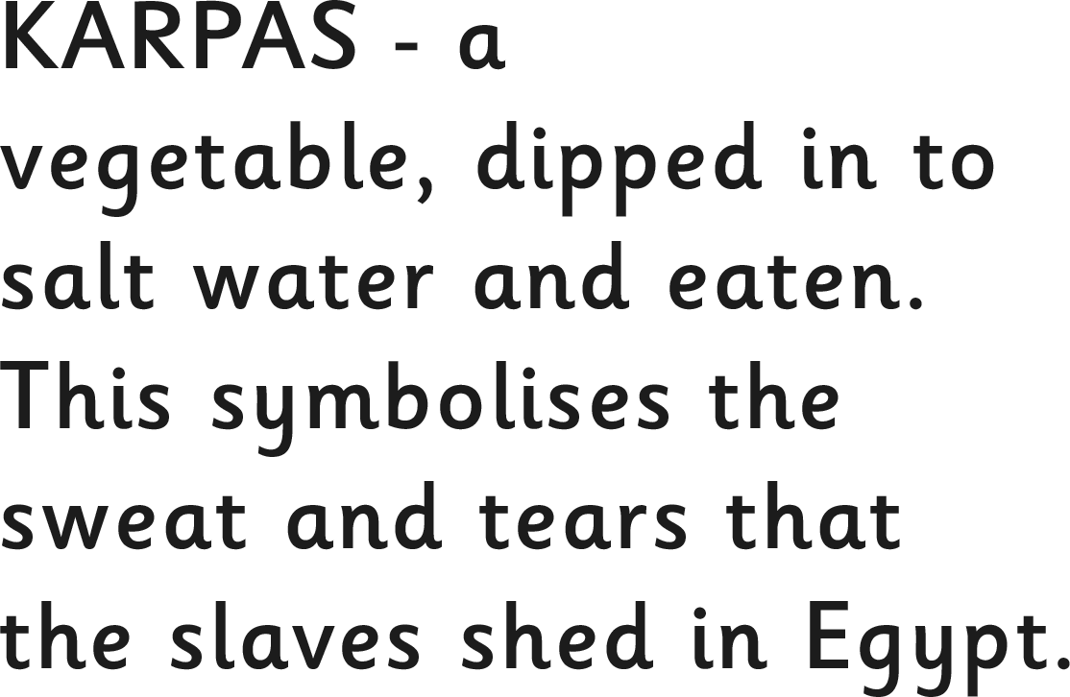

Slide 4
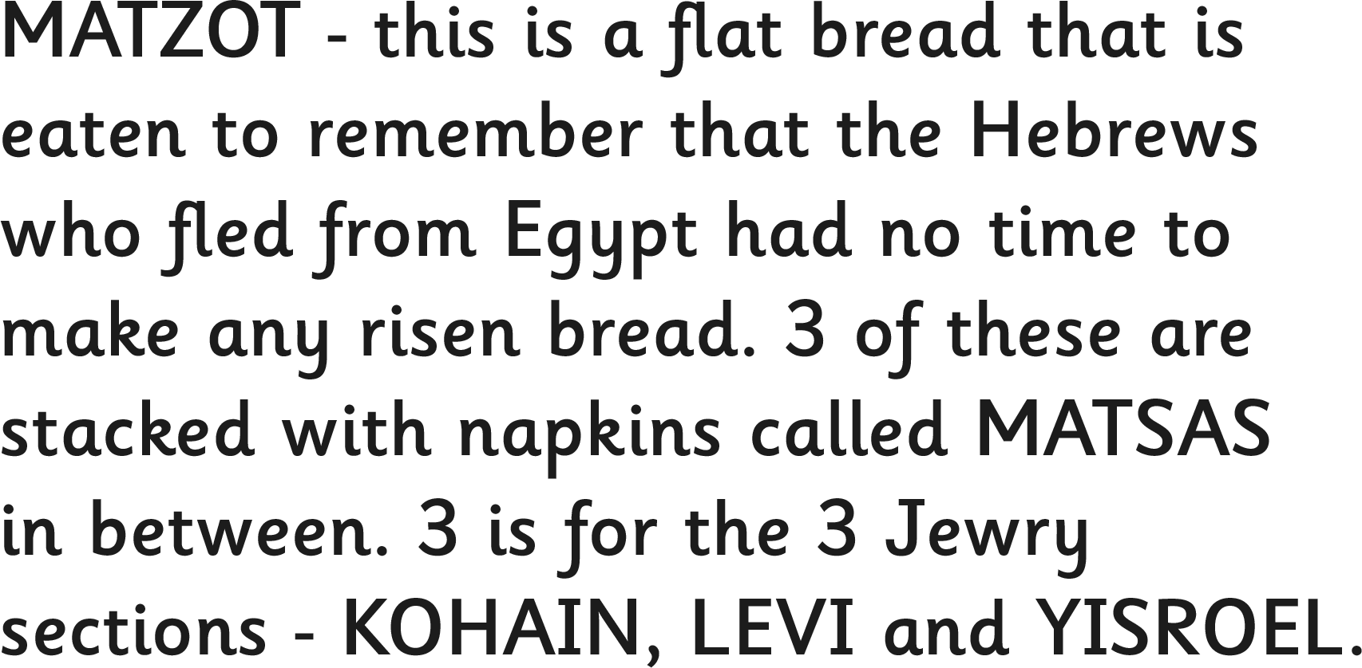

Slide 5
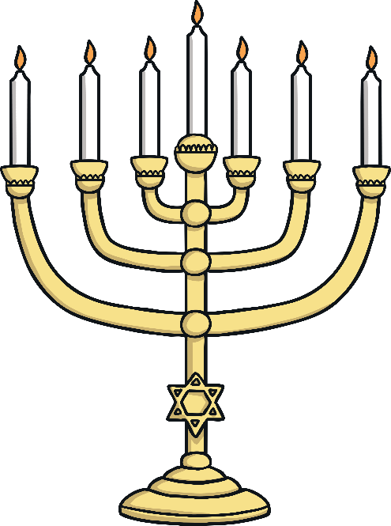
MENORAH CANDLE – this is the oldest symbol of the Jewish people. It represents the burning bush seen by Moses. It is used in many synagogues.
STAR OF DAVID – this is the standard symbol used in all synagogues. It is named after King David of ancient Israel.

Slide 6
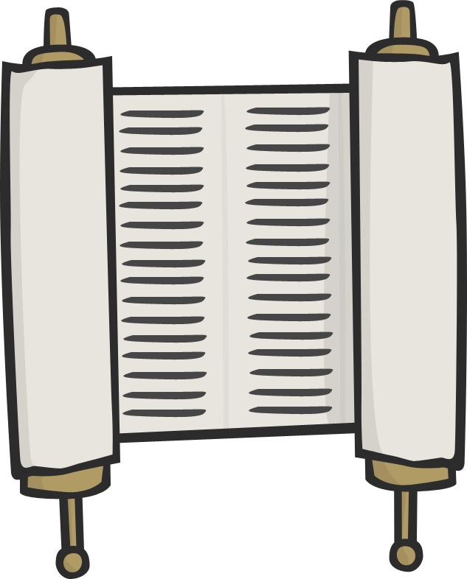
TORAH – this is a scroll and contains the first 5 books of the Holy Bible. A yad (stick) is used to point to the words as it cannot be touched by hands.

Slide 7
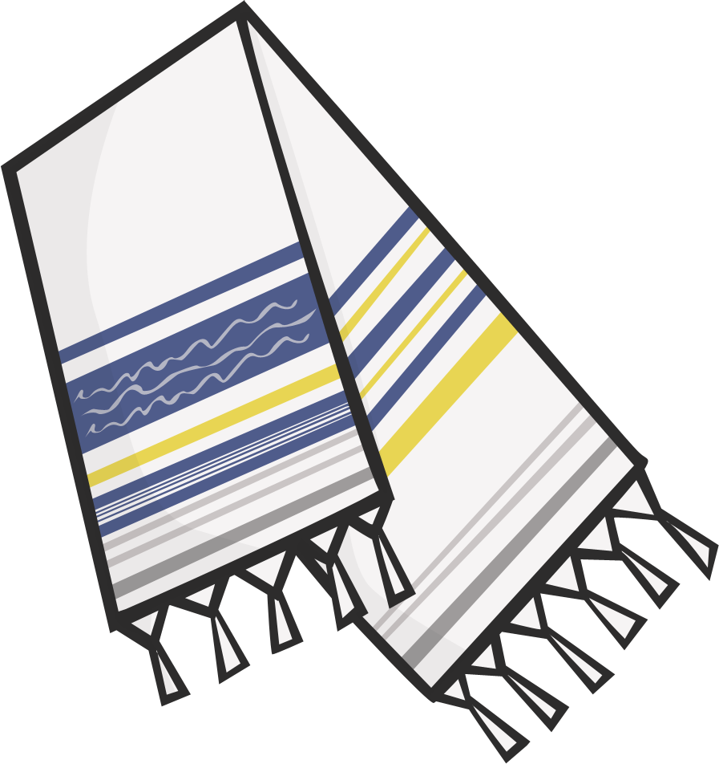
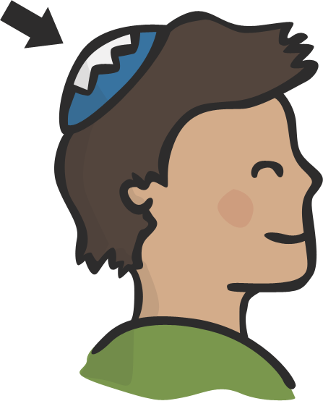
KIPPAH – skull cap worn by
men in the synagogue.
TALLIT – a prayer shawl.

Slide 8
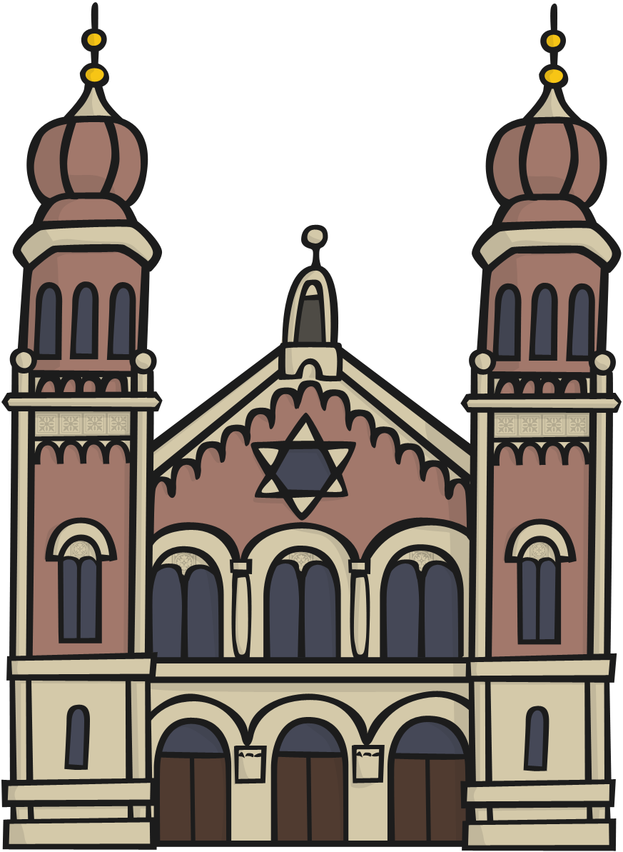
SYNAGOGUE – this is the sacred building that Jewish people go to worship in. Prayer services are performed by Rabbis and Torah scrolls are also used.

Slide 9
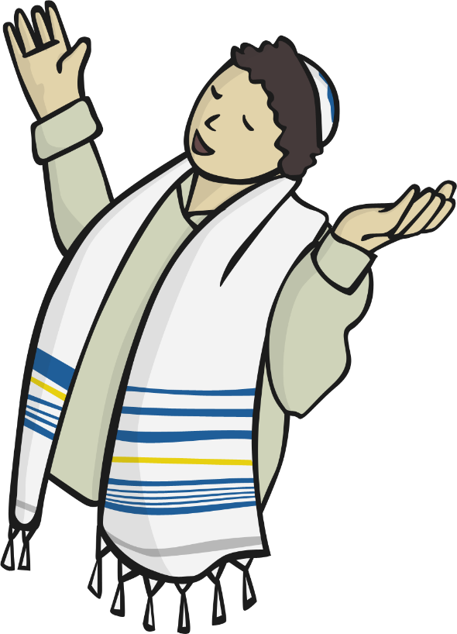
SHEMA – a very important prayer that is said 3 times a day by Jewish people. It reminds them that there is only one God and that God loves them.

Slide 10
TASK: There is a task sheet attached on the computer. Try to see what you can remember but you can use the PowerPoint to help with spellings and the information.

Slide 11
You have completed the task for today.
Well done. ☺

