Slide 1
Friday 28th January 2022
LO: To write a robot story

Slide 2
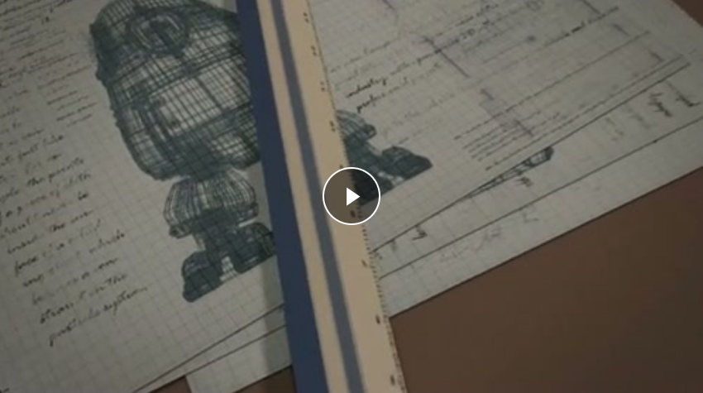
Let’s watch the film again.
Girl and Robot

Slide 3
Today you are going to write your own robot story.
It might be a story about what happens next to the girl and the robot or it might be about the robot you invented. Or it could be about another robot.
Have fun writing your robot story!

