Slide 1

14.1.22
LO – I can divide 2-digits by 1-digit number.

Slide 2
Let’s get our brains in gear:
Let’s chant our 11 x tables.
0 x 11 =
1 x 11 =
2 x 11 =
3 x 11 =

Slide 3

Complete the part whole models.
7 $×$ 10 = 4 $×$ 10 =
7 $×$ 20 = 4 $×$ 20 =
3) 8 $÷$ 4 = 9 $÷$ 3 =
12 $÷$ 4 = 15 $÷$ 3 =
24 $÷$ 4 = 27 $÷$ 3 =
84
84
84
80
14
60

Slide 4
Complete the part whole models.
7 $×$ 10 = 4 $×$ 10 =
7 $×$ 20 = 4 $×$ 20 =
3) 8 $÷$ 4 = 9 $÷$ 3 =
12 $÷$ 4 = 15 $÷$ 3 =
24 $÷$ 4 = 27 $÷$ 3 =
84
84
84
80
4
70
14
60
24
70
40
140
80
2
3
3
5
6
9

Slide 5


I noticed that there are 2 tens and 2 ones in each row!
Have a think
66 ÷ 3 =
22
Tens | Ones
6 ones ÷ 3 = 2 ones
so
6 tens ÷ 3 = 2 tens

Slide 6


84 ÷ 6 =
14
Have a think
Tens | Ones

Slide 7
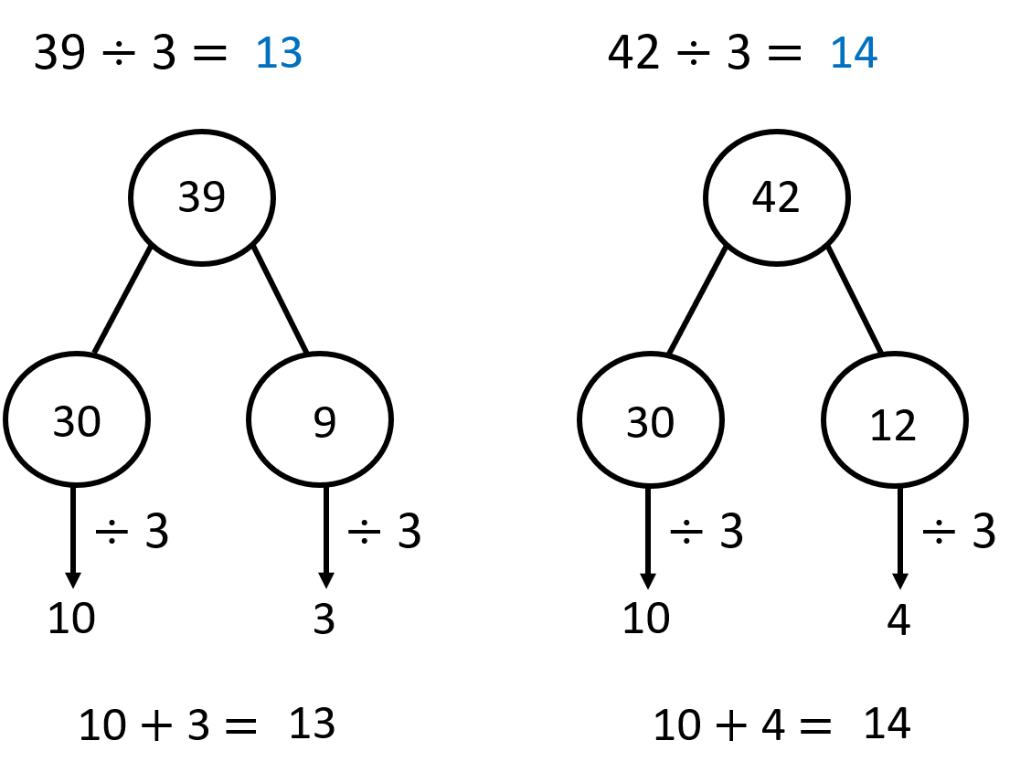
Have a think
How would you partition 96 in these divisions?
1) 96 ÷ 8 =
96
2) 96 ÷ 4 =
3) 96 ÷ 2 =
4) 96 ÷ 6 =
5) 96 ÷ 3 =
÷
÷
What do you notice?

Slide 8
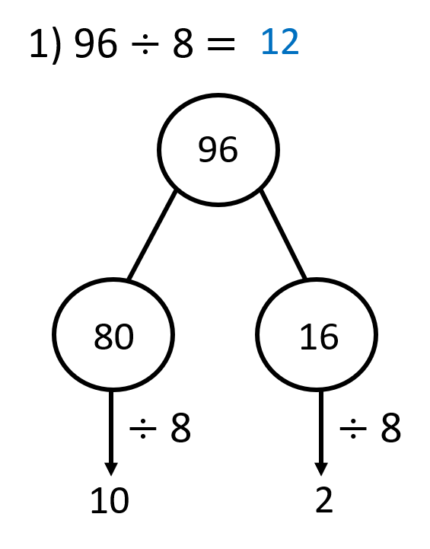




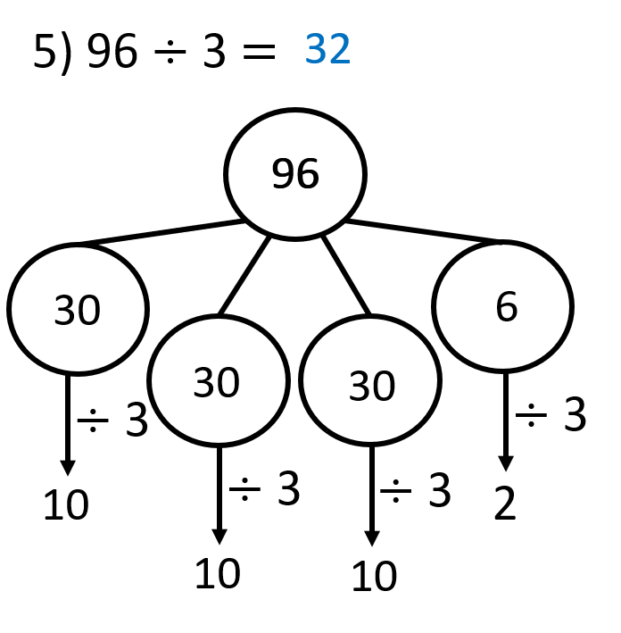

What do you notice?

Slide 9
Using all of the counters, how many 2-digit numbers can you make that are divisible by 3?
What if you had 7 counters? 8 counters? 9 counters?
What do you notice?
Have a think
Tens | Ones
15 ÷ 3 = 5
24 ÷ 3 = 8
33 ÷ 3 = 11
42 ÷ 3 = 14
1
5
51 ÷ 3 = 17
60 ÷ 3 = 20

Slide 10
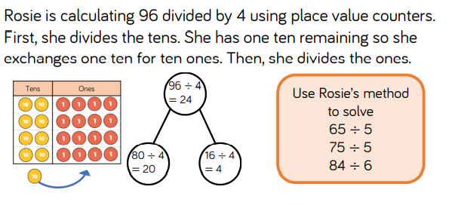
2.

Slide 11
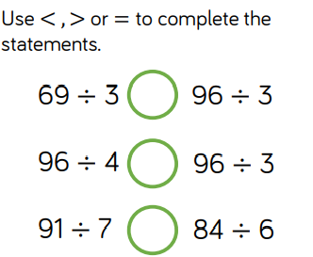
3.

Slide 12
True or False?
Have a think
52 ÷ 4 > 57 ÷ 3
98 ÷ 7 < 84 ÷ 4
Can you decide without having to calculate the answers?

Slide 13

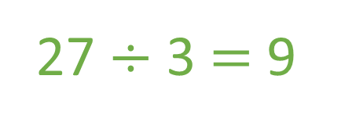
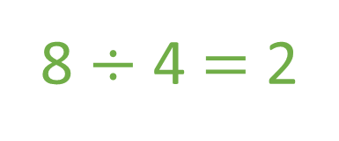
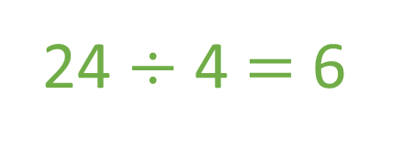
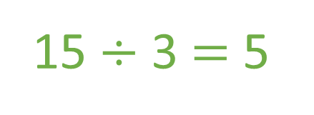
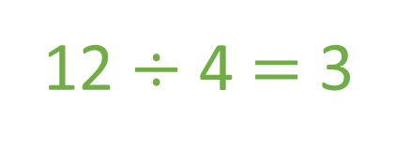
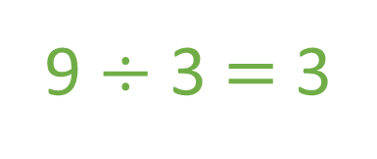
True or False?
52 ÷ 4 > 57 ÷ 3
8 ÷ 4 $=$ 2
9 ÷ 3 $=$ 3
98 ÷ 7 < 84 ÷ 4
12 ÷ 4 $=$ 3
15 ÷ 3 $=$ 5
24 ÷ 4 $=$ 6
27 ÷ 3 $=$ 9

Slide 14

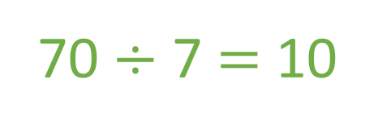
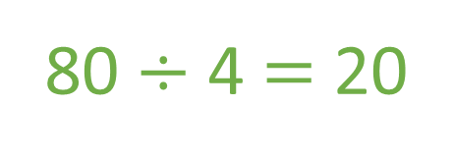
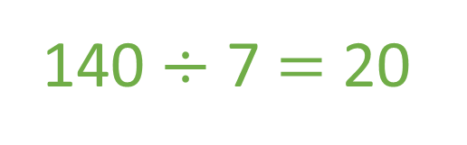
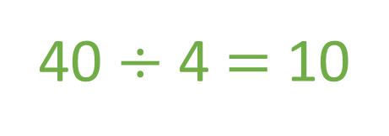
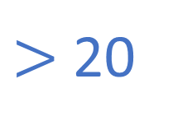
True or False?
52 ÷ 4 > 57 ÷ 3
10 - 20
$>$ 20
98 ÷ 7 < 84 ÷ 4
70 ÷ 7 $=$ 10
40 ÷ 4 $=$ 10
140 ÷ 7 $=$ 20
80 ÷ 4 $=$ 20

Slide 15
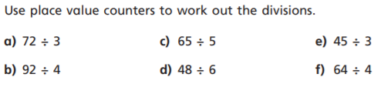
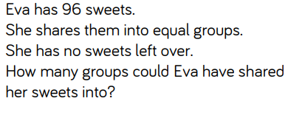
4.
5. Try this challenge question below.

