Slide 1
2.2.22
LO – I understand what a tenth is.

Slide 2
Let’s quickly recap on our 10 x tables.
Let’s think about both multiplication and division facts too.

Slide 3
What fraction is green? Match the fractions to the representations.
Which of the representations show $\frac{\text{1}}{\text{3}}$ ?
$\frac{\text{3}}{\text{5}}$
$\frac{\text{1}}{\text{4}}$
$\frac{\text{3}}{\text{4}}$

Slide 4
What fraction is green? Match the fractions to the representations.
Which of the representations show $\frac{\text{1}}{\text{3}}$ ?
$\frac{\text{3}}{\text{5}}$
$\frac{\text{1}}{\text{4}}$
$\frac{\text{3}}{\text{4}}$

Slide 5
What do you think a tenth is going to be?
TTYP and then we will come together and discuss it.

Slide 6
Have a think
$\frac{\text{7}}{\text{10}}$
What fraction of the flowers are blue?
What fraction of the flowers are orange?
10
There are flowers altogether.
out of flowers are blue.
of the flowers are blue.
This is a fraction.
3
10
$\frac{\text{3}}{\text{10}}$
non-unit

Slide 7
Tenths
$\frac{\text{1}}{\text{10}}$

Slide 8
Have a think
Which of these representations shows $\frac{\text{1}}{\text{10}}$? Why?

Slide 9
Have a think
Tenths
$\frac{\text{1}}{\text{10}}$
$\frac{\text{4}}{\text{10}}$
$\frac{\text{9}}{\text{10}}$
$\frac{\text{1}}{\text{10}}$
$\frac{\text{6}}{\text{10}}$
What fraction is not shaded?

Slide 10
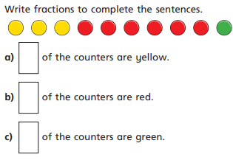
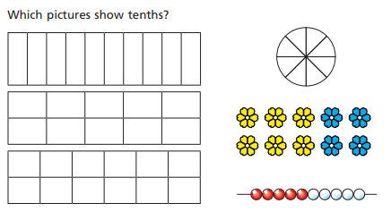
Have a go at questions 1 – 4 on the worksheet
Let’s think about and have a go at the first 2 questions.

Slide 11
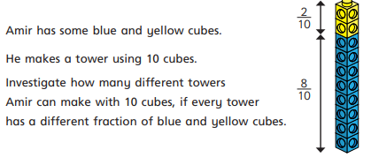
Have a go at questions 1 – 4 on the worksheet
This next question is a problem solving one. You can use cubes or counters to help you if you need to.

Slide 12
$\frac{\text{7}}{\text{10}}$ of the gummy bears are purple.
What fraction could be blue?
What fraction could be yellow?
$\frac{\text{3}}{\text{10}}$
$\frac{\text{2}}{\text{10}}$
$\frac{\text{1}}{\text{10}}$
0
0
$\frac{\text{0}}{\text{10}}$
$\frac{\text{1}}{\text{10}}$
$\frac{\text{2}}{\text{10}}$
$\frac{\text{3}}{\text{10}}$
Have a think

Slide 13
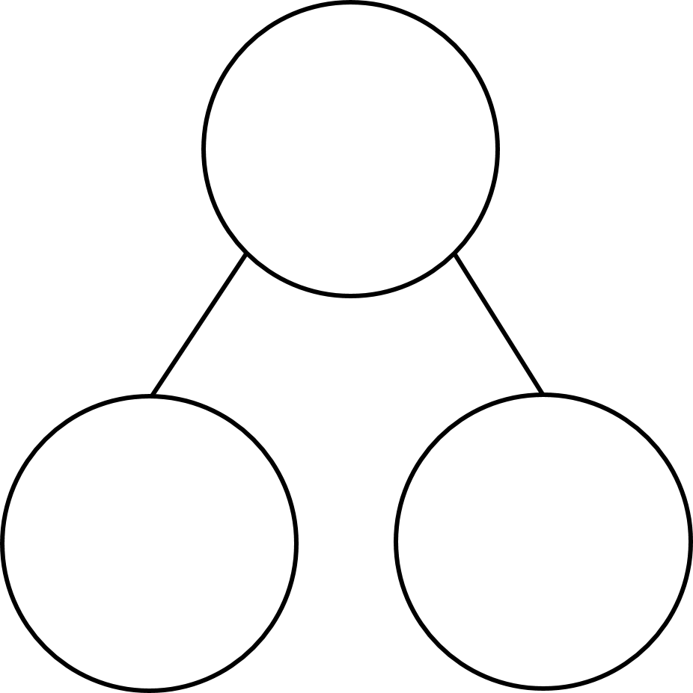
What fraction of the cubes are red?
What fraction are yellow?
$\frac{\text{3}}{\text{10}}$
$\frac{\text{7}}{\text{10}}$
1
$\frac{\text{10}}{\text{10}}$
$\frac{\text{3}}{\text{10}}$
$\frac{\text{7}}{\text{10}}$

Slide 14
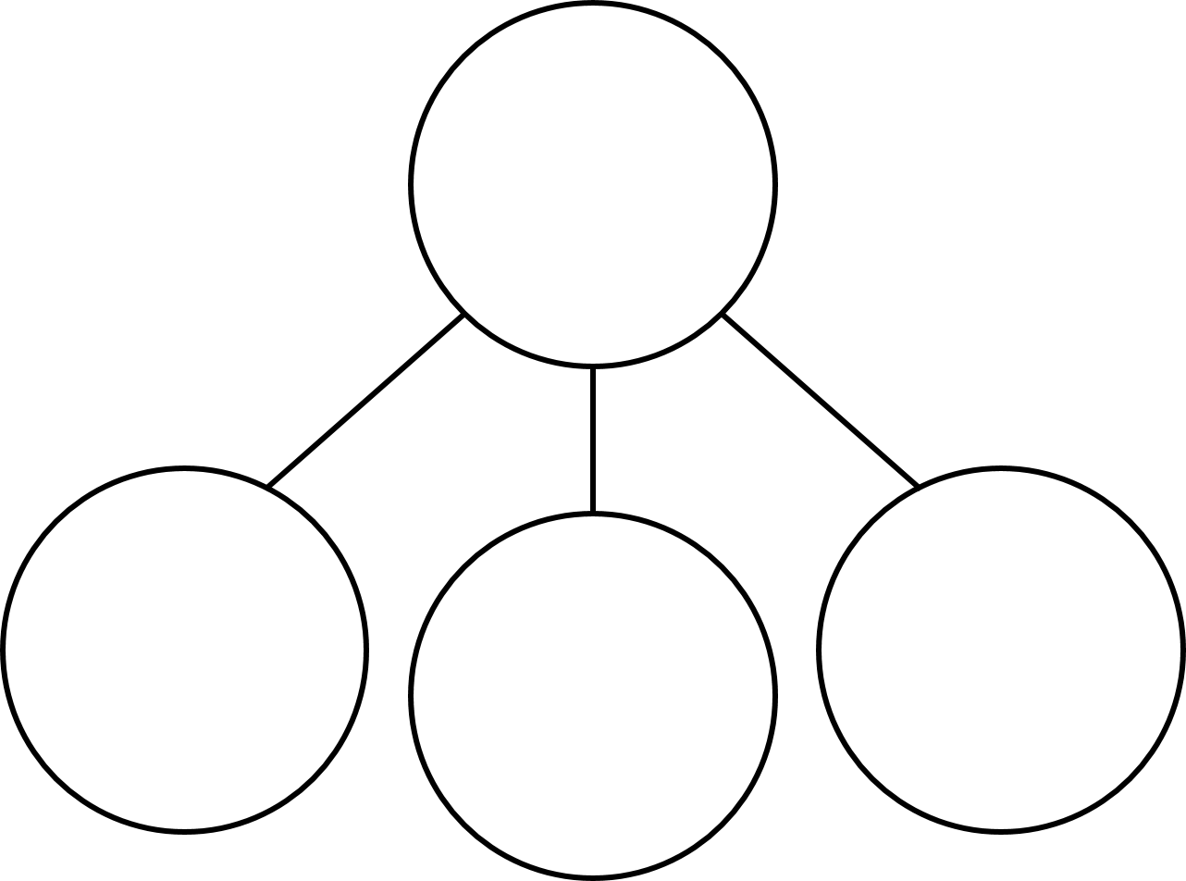
Have a think
What fraction of the cubes are red?
What fraction are blue?
What fraction are yellow?
$\frac{\text{2}}{\text{10}}$
$\frac{\text{5}}{\text{10}}$
$\frac{\text{3}}{\text{10}}$
$\frac{\text{10}}{\text{10}}$
$\frac{\text{2}}{\text{10}}$
$\frac{\text{5}}{\text{10}}$
$\frac{\text{3}}{\text{10}}$

Slide 15
Have a go at the rest of the worksheet
Have a go at question 4.
Can you then think of two examples of your own like these part whole models?
There is a challenge question to try.

