Slide 1
03.11.21
LO: To add 3-digit and 1-digit numbers (crossing 10)

Slide 2



Learning Journey – Addition and Subtraction
In this unit we will…
Add and subtract multiples of 100
Add and subtract 1s
Add and subtract 3-digit and 1-digit numbers – not crossing 10
Add a 2-digit and 1-digit number – crossing 10
Subtract a 1-digit number from a 3-digit number – crossing 10
Subtract a 1-digit number from 2-digits – crossing 10
Add 3-digit and 1-digit numbers – crossing 10
Add and subtract 3-digit and 2-digit numbers – not crossing 100
Subtract a 2-digit number from a 3-digit number – crossing 100
Add 3-digit and 2-digit numbers – crossing 100
Add and subtract 100s
Subtract a 2-digit number from a 2-digit number – crossing 10
Add two 2-digit numbers – crossing 10 – add ones and add tens
Spot the pattern – making it explicit

Slide 3
Vocabulary:
addition
subtraction
column method
mental method
exchange
place value grid

Slide 4


Slide 6
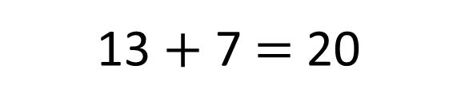
Quick fire number bonds!
13
13 $+$ 7 $=$ 20

Slide 7
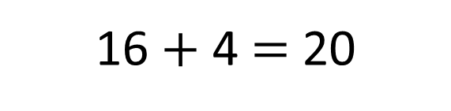
16
16 $+$ 4 $=$ 20

Slide 8
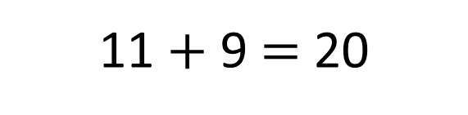
11
11 $+$ 9 $=$ 20

Slide 9
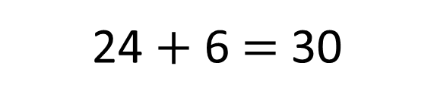
24
24 $+$ 6 $=$ 30

Slide 10
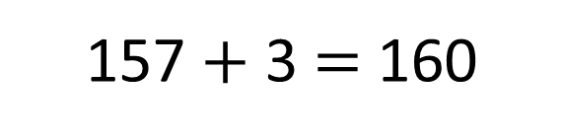
157
157 $+$ 3 $=$ 160

Slide 11


I only know one way to work out additions!
Don’t worry I’ll show you!
There are lots of ways to work out additions…

Slide 12
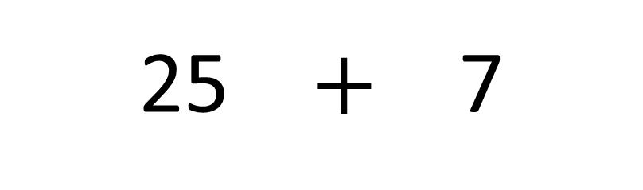

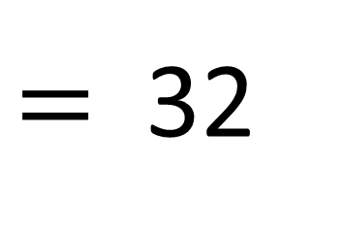
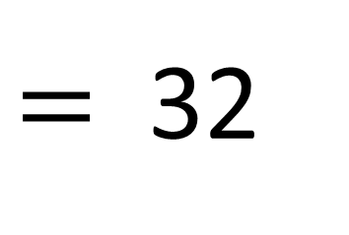
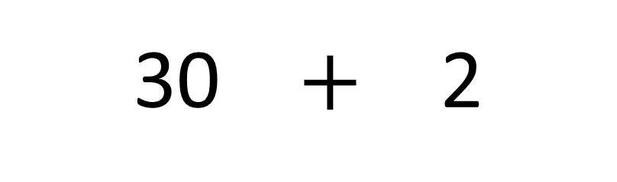
$$+$$
25 $+$ 7
$=$ 32
30 $+$ 2
$=$ 32

Slide 13

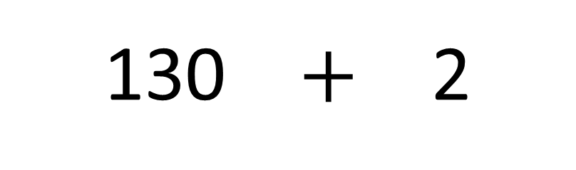

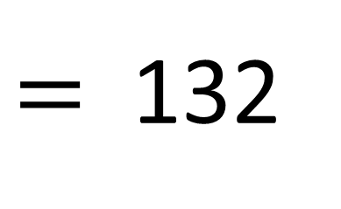
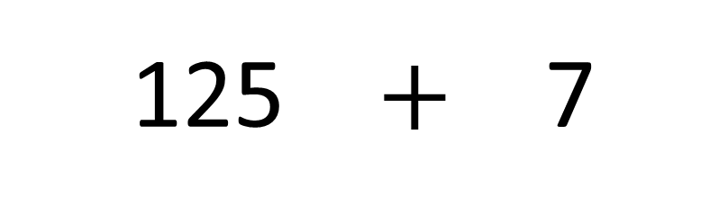
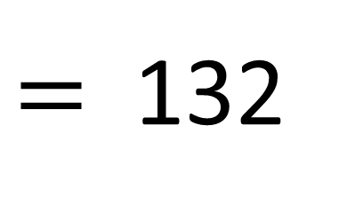
Have a think
$$+$$
125 $+$ 7
$=$ 132
130 $+$ 2
$=$ 132

Slide 14



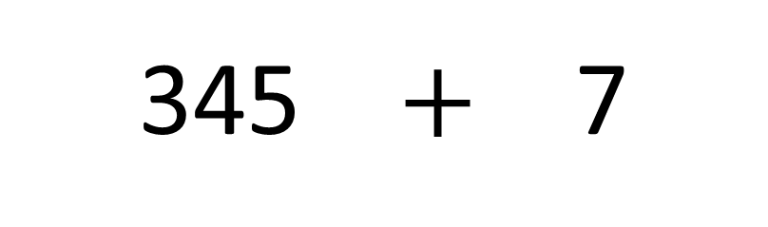
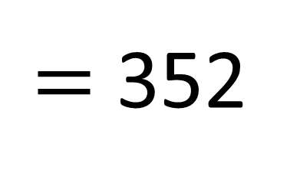
 | H | T | O
Have a think
+
345 $+$ 7
$=$ 352

Slide 15

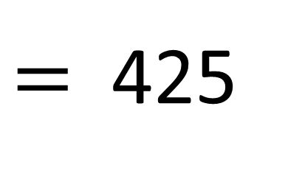
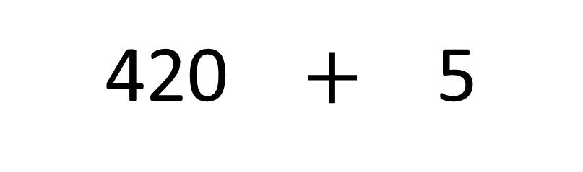
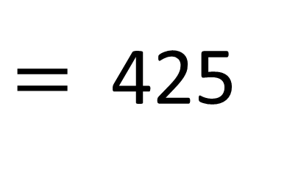
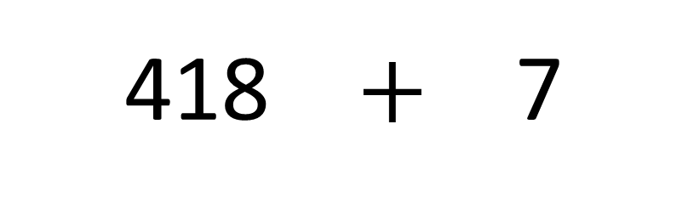
+ 2
+ 5
Have a think
418
419
420
421
422
423
424
425
418 $+$ 7
$=$ 425
2
5
420 $+$ 5
$=$ 425

Slide 16
Wow there are lots of ways I could do it!
Well done Tiny!

Slide 17
Have a go at the questions on the worksheet

Slide 18

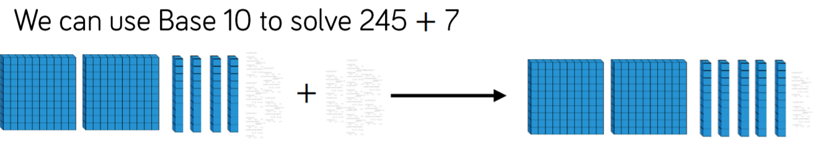
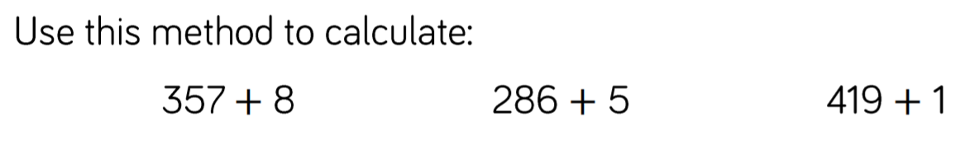

Slide 19
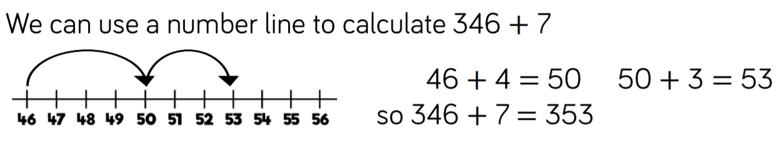
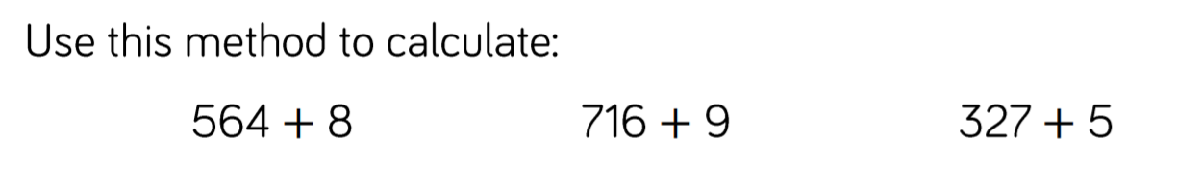

Slide 20
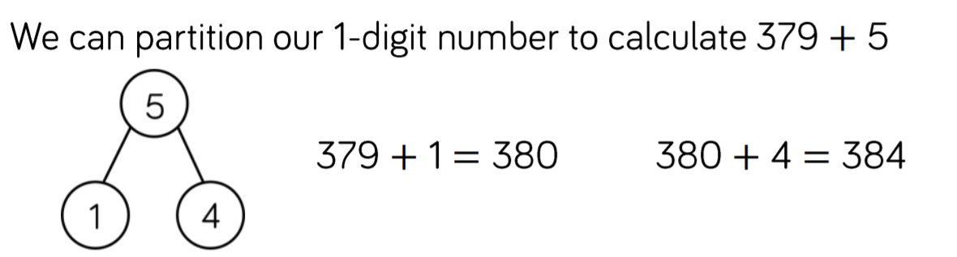
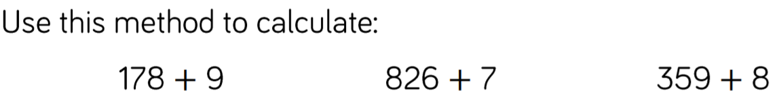

Slide 21

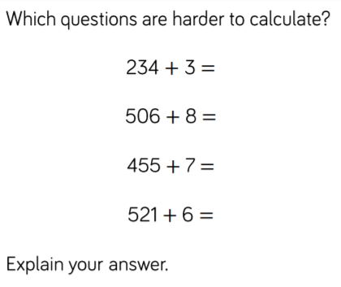

Slide 22
