Slide 1
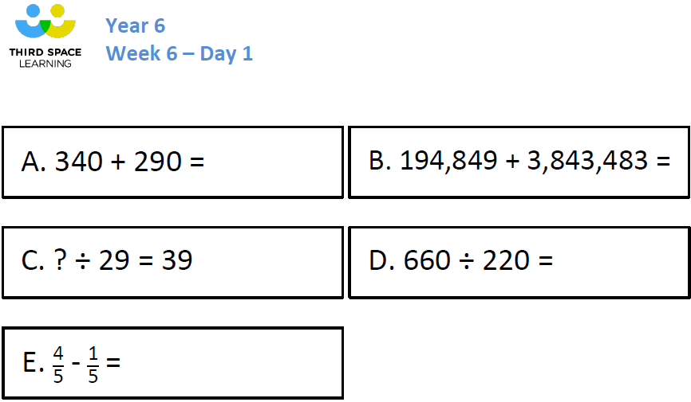

Slide 2
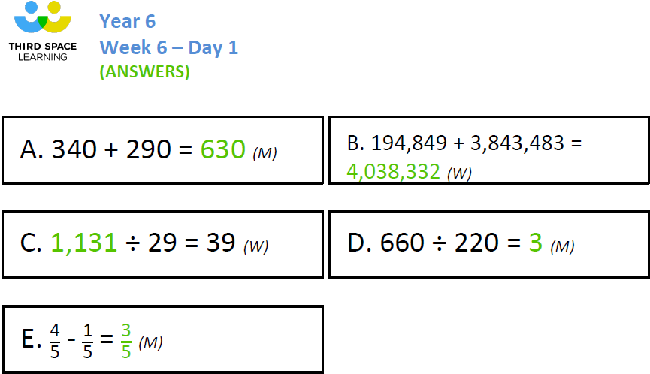

Slide 3
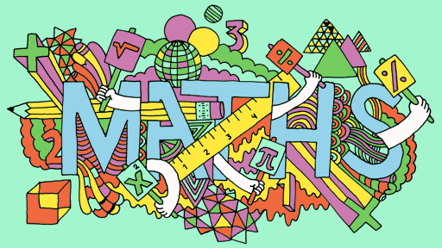
19.10.21 LO: Short Division Year 6 Maths

Slide 5
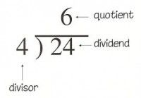
Today we are going to continue to practise our short division skills. Let’s recap the method we are using. Remember to use accurate mathematical vocabulary.

Slide 6
261 $÷$ 3 $=$
87
3 | 2 | 6 | 1
0
8
7
2
2

Slide 7
Let’s spend 20 minutes practising some examples. Choose the sheet you feel will help to secure the method, and move on to a challenge when you are ready.

Slide 8
Calculate:
1,248 $÷$ 2
1,248 $÷$ 4
1,248 $÷$ 8
What did you do each time?
What was your strategy?
What do you notice? Why?

Slide 9
When we are using division in real-life problems, we sometimes need to decide whether to round our answers up or down. Look at the following 2 problems and speak to your partner; would you round up or down?
Q1. Curtis (our new caretaker) is putting tables up in the hall for the children’s lunch. 8 children will sit around each table. There are 85 children. How many tables will Curtis need to put out?
Q2. Mrs McKie is giving out new pencils for the year. She has 432 pencils. She puts them into bundles with 10 in each bundle. How many complete bundles will she have?
Or round down ?
Work with your partner to write a round up and a round down division problem.
How could you make your question easier? How could you make it harder?

