Slide 1
Light
This half term, our science topic is:

Slide 2
LO: To know what a shadow is.
LO: To predict using cause and effect.

Slide 3
Vocabulary
light dark/darker/darkest bright/brighter/brightest dim
light source (various) eye reflect reflective shiny dull shadow
block (transparent, opaque)
These are some of the words we will be using over the course of the unit.

Slide 4
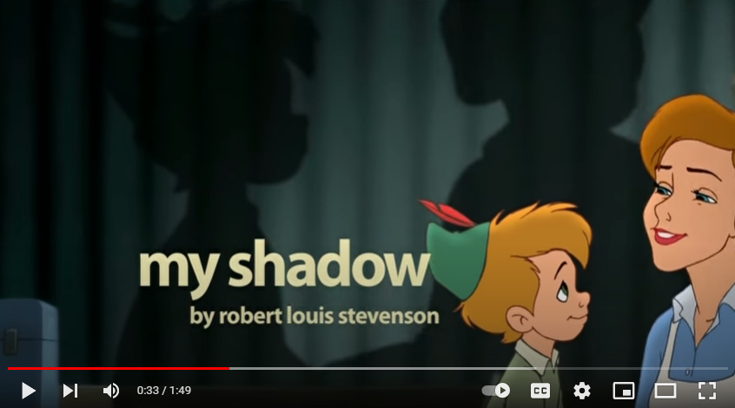
What is going on in this poem?

Slide 5
What do you think a shadow is?
Let’s have a look at the images on the next slide while we think about this.

Slide 6
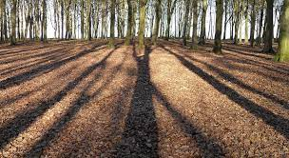
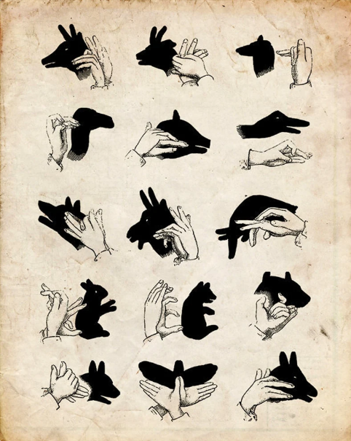
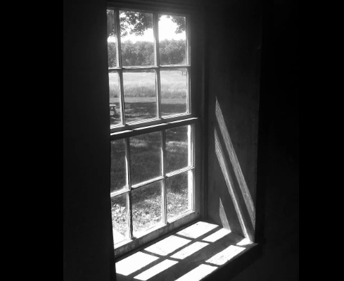
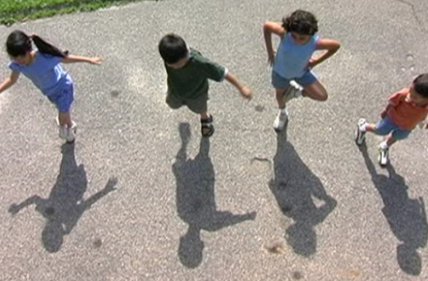
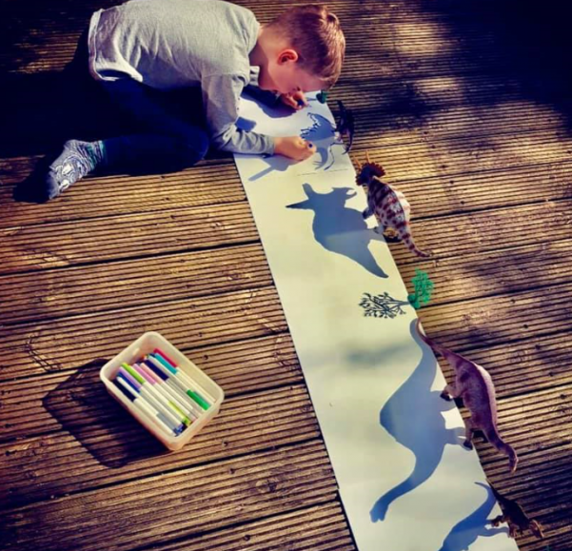
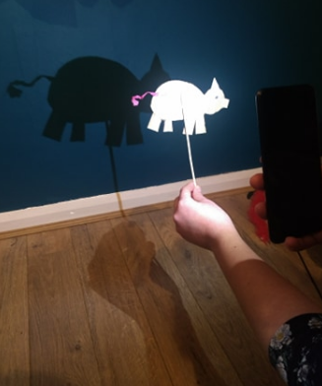
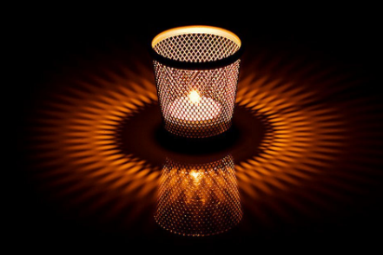

Slide 7
What is a shadow?
A shadow is a dark area where light from a light source is blocked by an opaque object.

Slide 8
Let’s have some fun and investigate shadows!
BEFORE: say what you think might happen.
AFTER: say what actually happened.
WHY: can you explain why?
Try one or more of the following activities…

Slide 9
Go outside and investigate the shadows your body makes. Can you make shadows to create the letters in your name.
Go outside at different times of day and record the shadows an object makes. What changes? What stays the same?
Use a torch or desk lamp to see what shadows an object makes. What happens when you move the object nearer/further away?

Slide 10
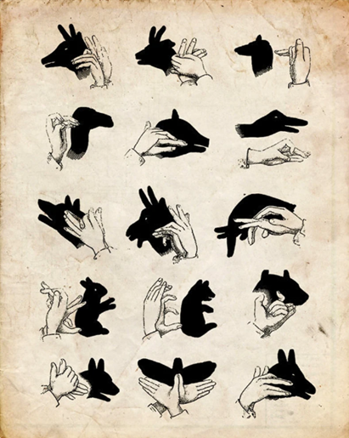
Next, can you create animal shadows using your hands?
Use the sheet to help you.

Slide 11
Tell your partner 3 things you have learnt about shadows.

Slide 12
Finally, here are a three video clips that follow on from some of the questions you were asking in the last science lesson. I hope you find them interesting!

Slide 13
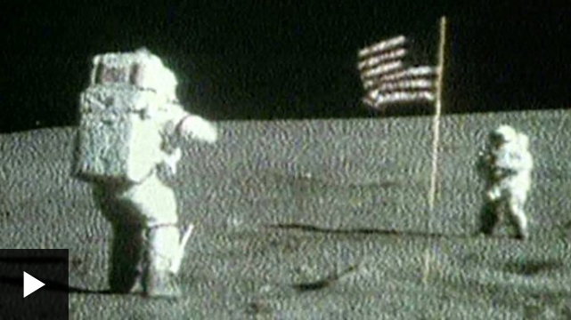
The Moon

Slide 14
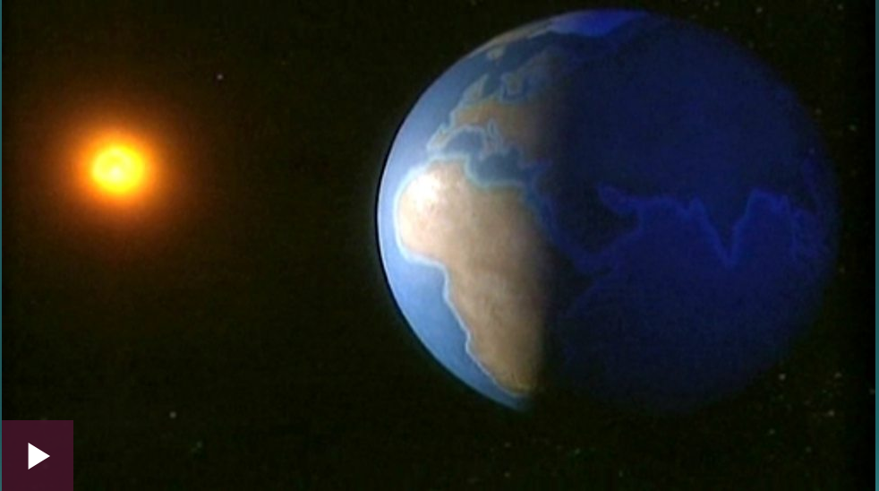
Day and Night

Slide 15
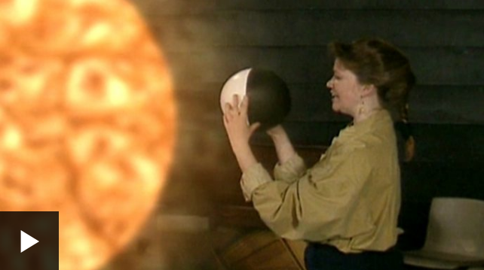
The Moon and its orbit around Earth

