Slide 1
Journey to the Jungle

Slide 2
Thursday 3rd February 2022
LO: To write a jungle poem.

Slide 3
Let’s start by saying the text out loud with actions.

Slide 4
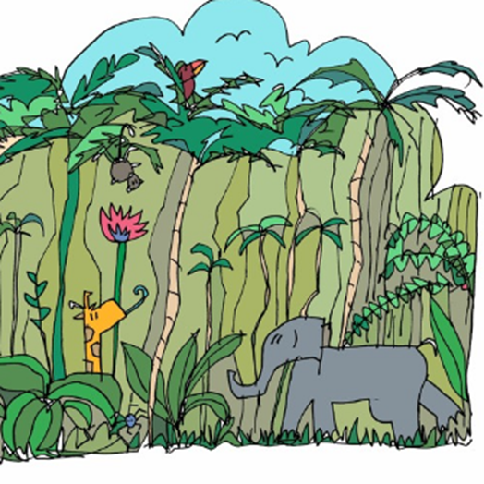
Click on the picture to listen (From 0.22 seconds)

Slide 5
Jungle Log: 31st January, 2022
Today has been an amazing day of discovery! I woke early and got ready for my trek into the Atlanti Jungle. I was excited and couldn’t wait to see what lay ahead of me. I packed my rucksack and put on my sturdy walking boots. I made sure my camera was working because I wanted to record as much of the day as possible. I left the camp at 6am.

Slide 6
First, I trudged through the dense forest and collected samples of the plant life. My favourite was a thorny bush. It had tiny, yellow flowers growing on it, which smelt like ice cream! Next, I studied some of the mesmerising insects that were crawling up the rough bark of every tree. One insect looked like a caterpillar but had 2 sets of wings and tiny hands on the ends of its 20 legs. Excitedly, I photographed as many creatures as I could because I wanted to show my explorer friends what I had discovered.

Slide 7
After a short tea break, I measured the circumference of the tallest trees to work out how old they were. One measured 10 metres around and was so tall that I couldn’t see the top of it. It reminded me of the beanstalk in a famous children’s story. Next, I trekked to a clearing and found a beautiful plunge pool. The water was turquoise and tiny neon fish were splashing on the surface. I tried to catch one, but they were too fast for me. Then it was time for a rest. I lounged on pink grass, soaking up the purple sun beams and listened to the strange jungle noises around me.

Slide 8
Finally, I headed back to camp because the sun began to set. It sets quickly in Oreno and I was worried I might get lost. When I got to my tent, I unpacked my rucksack and stored my plant samples safely. I’m really looking forward to where my wardrobe will take me next week!

Slide 9
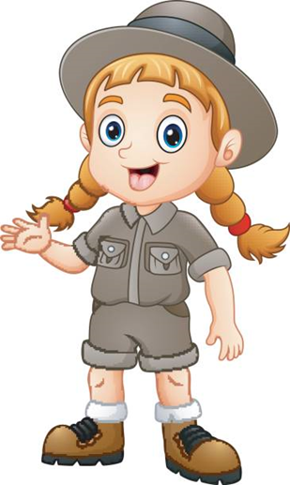
10 things in an explorer’s rucksack
Here’s a poem I wrote when I got back from exploring Atlanti. It’s a list poem and it is all the magical things I’d like to find in my rucksack.

Slide 10
10 Things in an Explorer’s Rucksack
A sizzling sun beam scorching the sky,
The sound of rain splashing on mud,
A rhino’s footprint,
A hat made of stars,
10000 leaf skeletons glittering in the wind,
The sweetest fruit from an ice cream tree,
A never-ending flapjack,
The smell of jungle clouds,
A feather from a Soupee bird,
A pair of very sore feet.

Slide 11
Write a list poem
Now have a go at writing your own poem. What magical things would you like to find in your rucksack when you go exploring?

Slide 12
★ Try to make your items sound exciting by using alliteration – where words start with the same sound e.g. sizzling sun, lazy lion, towering trees
★ Use precise, powerful verbs that show things in a more exciting way e.g. scorching, splashing, glittering
★ Choose unusual things to add to your bag. Be as inventive as you can e.g. a hat made of stars, boots made of spider webs
★ Exaggerate things. Make them: the biggest, the tallest, the sweetest, the fastest
★ Invent new things e.g. a Soupee bird, the smell of clouds

Slide 13
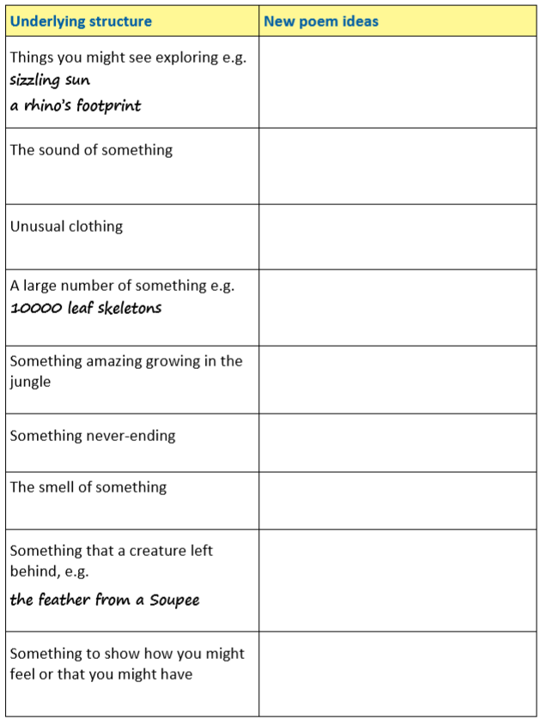
★ Use this planner to help you sort your ideas for your poem. Then, using the tips on the previous slide, write your poem in your neatest handwriting.

