Slide 2
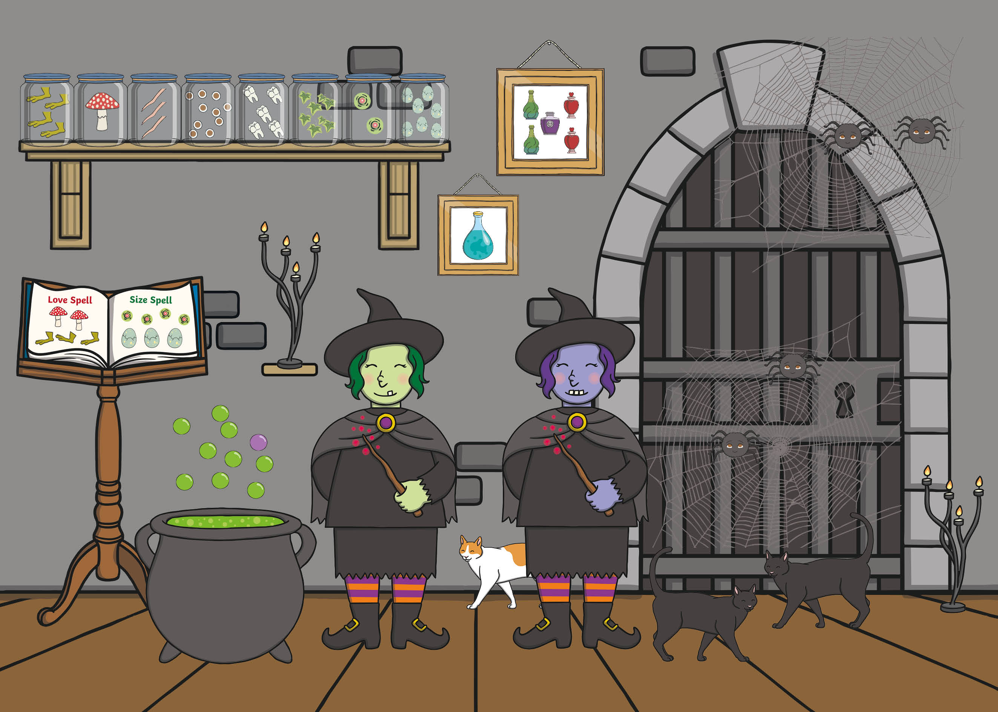

Slide 3
back to the picture
next

Slide 4
back to the picture
next

Slide 5
back to the picture
next

Slide 6
back to the picture
next

Slide 7
back to the picture
next

Slide 8
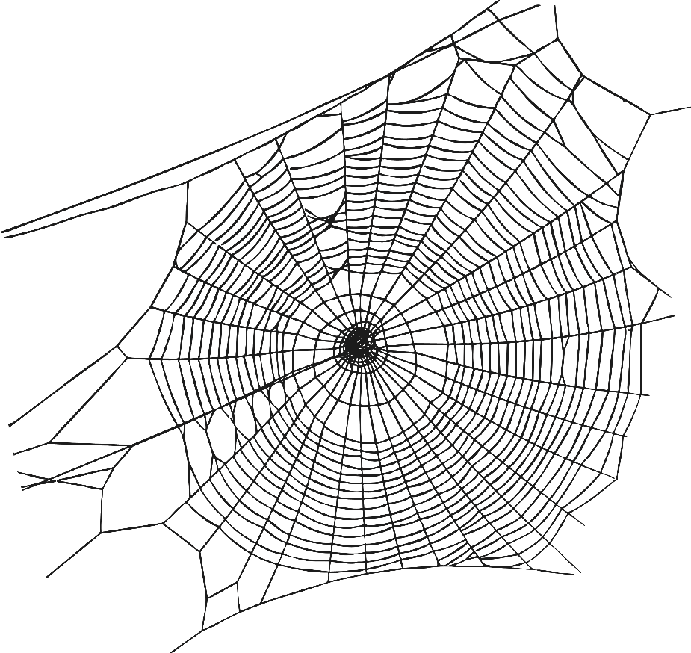
back to the picture
next

Slide 9
back to the picture
next

Slide 10
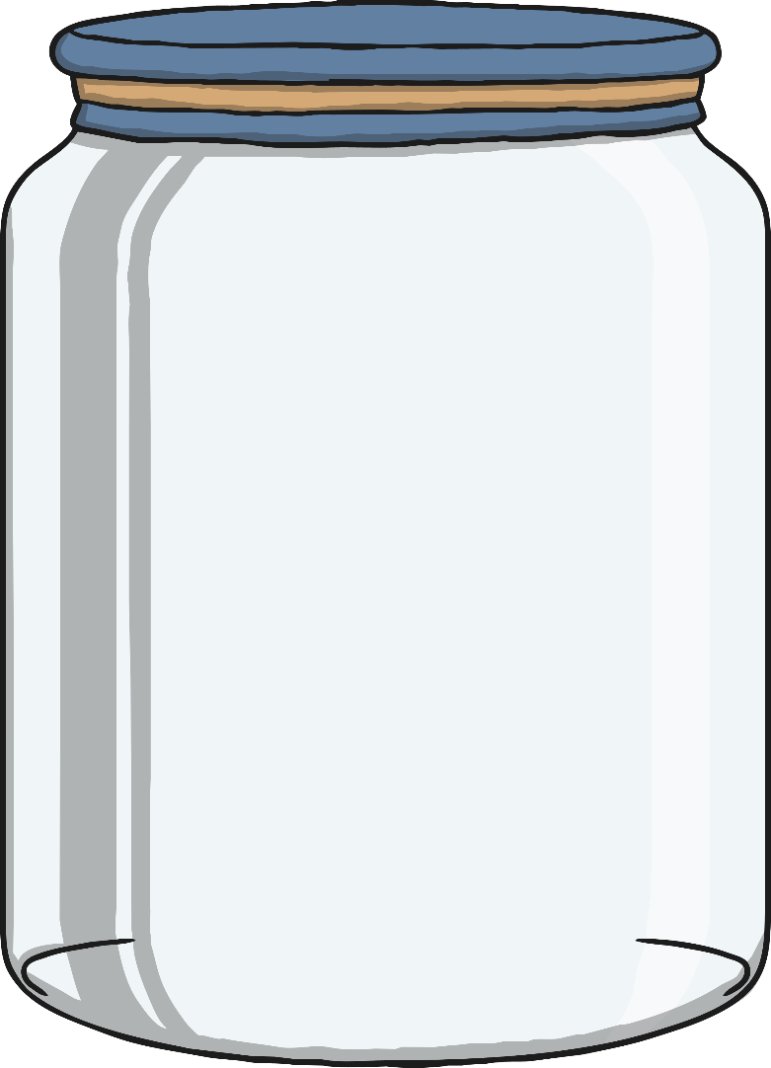
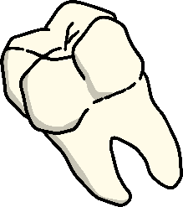
back to the picture
next

Slide 11
back to the picture
end

