Slide 1
3
13
The long vowel /a/ sound spelled ‘ai’

Slide 2
3
The long vowel /a/ sound spelled ‘ai’
13
Introduction | Today children will look at the long vowel /a/ spelled with the digraph ‘ai’. Ask children if they can correctly identify any words with the long vowel /a/ sound. Write down the words they say with the ‘ai’ spelling and ask them if they can identify what digraph is making the sound.
Main Teaching Activity | Show children the power point slide with the images and ask them to write down on their white board what each image is. If they need support then you can click once to make some of the letters for each word appear. Share the answers together.
Independent Activity | Using the spelling list words get children to work in pairs to try and find two new words that they can make from each word. For example: straight – rats – this strainer – rain – rent
Spellings
straight
painter
fainted
waist
strainer
chained
claimed
failure
snail
waiter

Slide 3
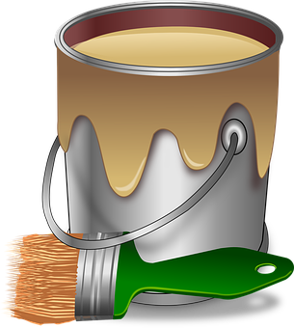
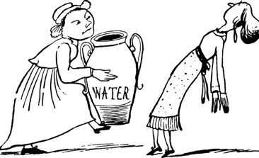
What can you see? Write down what these images are:
st _ _ _ _ _ t
ch _ _ _
_ a _ _ t
w _ _ s _
f _ _ n t
s _ _ _ l
w _ _ _ _ r

Slide 4
What can you see? Write down what these images are:
Answers:
st r a i g h t
ch a i n
p a i nt
w a i s t
f a i n t
s n a i l
w a i t e r

Slide 5
Stage: 3 | The long vowel /a/ sound spelled ‘ai’ Name:
List: 13
Spellings | 1st Attempt | 2nd Attempt | 3rd Attempt | 4th Attempt | 5th Attempt
straight
painter
fainted
waist
strainer
chained
claimed
failure
snail
waiter

Slide 6
Stage: 3 | The long vowel /a/ sound spelled ‘ai’ Name:
List: 13
Unscramble each block to find your hidden spelling words.
Spellings
straight
painter
fainted
waist
strainer
chained
claimed
failure
snail
waiter
snail
i | n | s
a | l
w | i | s
t | a
i | t | r
g | s | a
h | t
c | i | a
 | h | n
 | e | d
i | a | t
 | w | e
 |  | r
i | t | e
n | r | s
 | a | r
e | t | a
r | p | i
 |  | n
i | a | m
e | c | l
d
e | i | a
 | l | f
 | u | r
f
a | e | n
i | d | t

Slide 7
Stage: 3 | The long vowel /a/ sound spelled ‘ai’ Answers:
List: 13
Unscramble each block to find your hidden spelling words.
Spellings
straight
painter
fainted
waist
strainer
chained
claimed
failure
snail
waiter
snail | waist | straight | chained | waiter
strainer | painter | claimed | failure | fainted
i | n | s
a | l
w | i | s
t | a
i | t | r
g | s | a
h | t
c | i | a
 | h | n
 | e | d
i | a | t
 | w | e
 |  | r
i | t | e
n | r | s
 | a | r
e | t | a
r | p | i
 |  | n
i | a | m
e | c | l
d
e | i | a
 | l | f
 | u | r
f
a | e | n
i | d | t

