Slide 1
Tuesday 26th January
L.O. To begin learning the 2 times table.
Multiplication and division

Slide 3



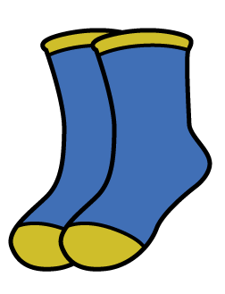
1) How many cookies?
2) How many socks?
3) Complete the number track
2 | 4 | 6 |  |  | 12 |  | 16 |  |  |  | 24

Slide 4
1) How many cookies?
2) How many socks?
3) Complete the number track
6
12
2 | 4 | 6 |  |  | 12 |  | 16 |  |  |  | 24
10
14
18
20
8
22

Slide 6






Jack has built some towers using cubes.
How many towers has he built?
4
2
How many cubes are in each tower?
8
How many cubes has he used in total?
4
$$×$$
2
$$=$$
8
or
2
$$×$$
4
$$=$$
8

Slide 7







Whitney has also been building towers using cubes.
Have a think
How many towers has she built?
6
2
How many cubes are in each tower?
How many cubes has she used in total?
12
6
$$×$$
2
$$=$$
12
or
2
$$×$$
6
$$=$$
12

Slide 8



Dexter has also been building towers using
cubes.
Have a think
2
How many towers has he built?
7
How many cubes are in each tower?
How many cubes has he used in total?
14
2
$$×$$
7
$$=$$
14
or
7
$$×$$
2
$$=$$
14

Slide 9
Have a go at questions
1 - 3 on the worksheet

Slide 10
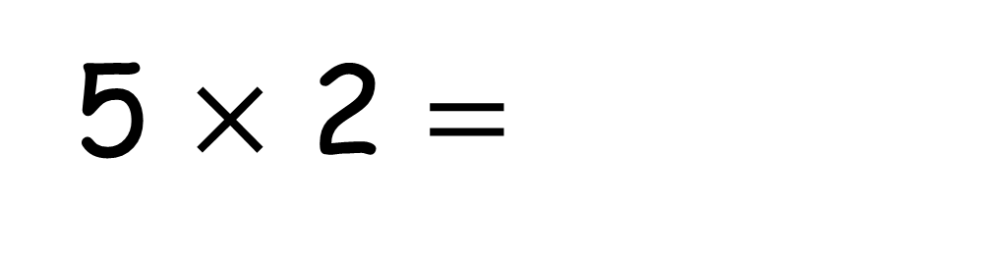
10
5 $×$ 2 $=$

Slide 11
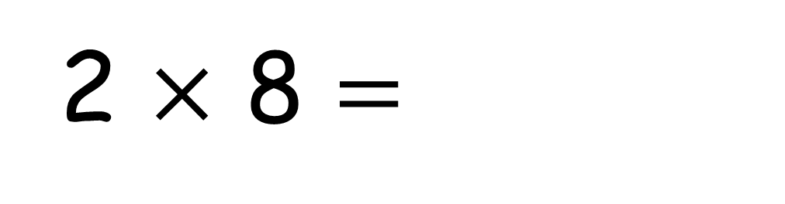
16
2 $×$ 8 $=$

Slide 12
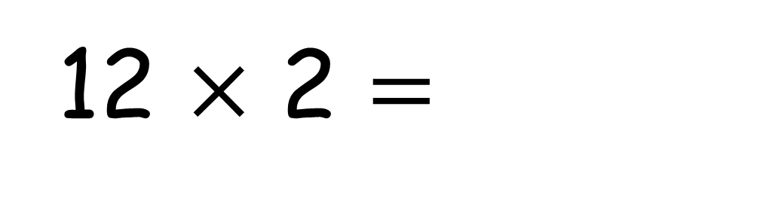
12 $×$ 2 $=$
24

Slide 13
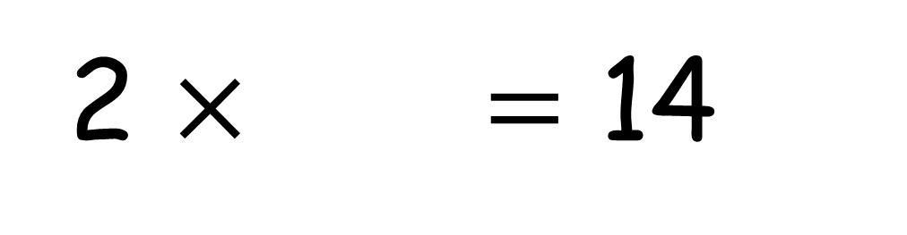
2 $×$ $=$ 14
7

Slide 14
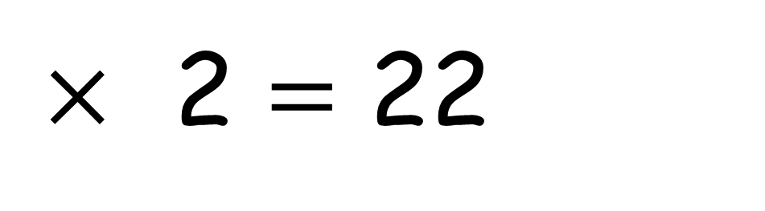
11
$×$ 2 $=$ 22

Slide 15
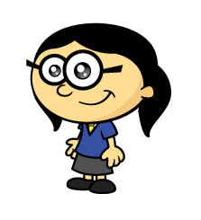
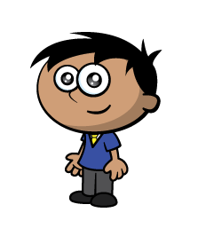

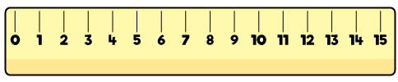


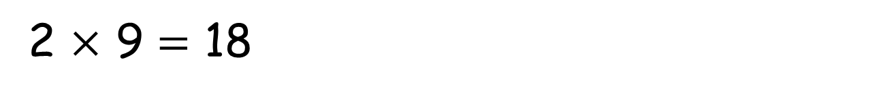
Annie’s plane flew twice as far as Amir’s.
Amir’s plane flew 9 metres.
How far did Annie’s fly?
9
9
9
2 $×$ 9 $=$ 18
Annie’s plane flew 18 metres.

Slide 16
Have a go at questions
4 - 5 on the worksheet

Slide 17
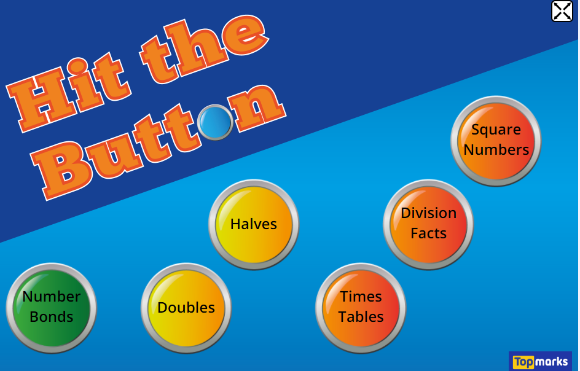
If you enjoyed that and want to practice your 2 times tables more, then click on the link below!
https://www.topmarks.co.uk/maths-games/hit-the-button

