Slide 1
10.11.21
L.O. – I can subtract two 4-digit numbers with more than one exchange.

Slide 2
1) 7,614 $−$ 6,344 $=$
2) 1 thousand $=$ ______ hundreds
3) 1 hundred $=$ ______ tens
4) 1 thousand $=$ ______ tens
If you finish, look at the 9x table in the times tables grid in the front of your maths book. We are going to be looking at a method to help us remember them next.

Slide 3
1) 7,614 $−$ 6,344 $=$
1,270
2) 1 thousand $=$ ______ hundreds
10
10
3) 1 hundred $=$ ______ tens
100
4) 1 thousand $=$ ______ tens

Slide 4
Let’s watch this video to help us learn a method that will help us with our 9x tables.

Slide 5
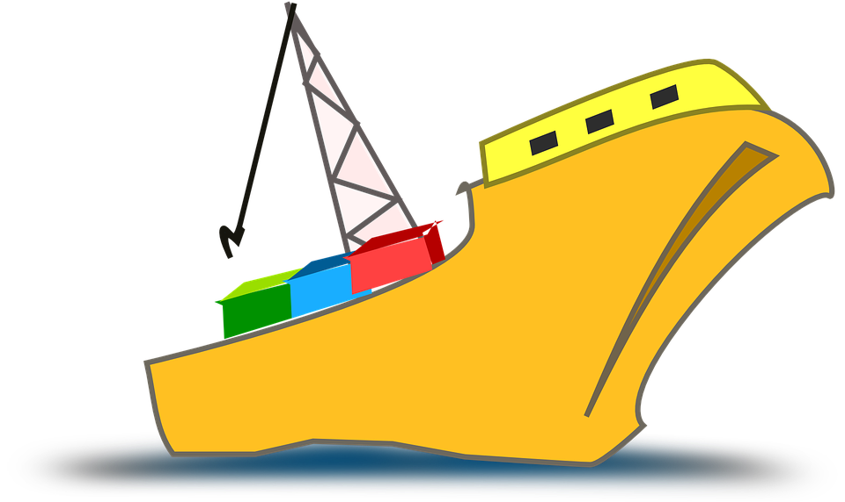
A cargo ship’s journey is 4,065 km.
It has sailed 2,128 km.
How much further does it need to sail?
1,937 km
Th | H | T | O
4,065 km
Th | H | T | O
4 | 0 | 6 | 5
2 | 1 | 2 | 8
3
1
5
1
2,128 km
?
$$−$$
Sailed
Still to sail
1
9
3
7

Slide 6
3,402 $−$ 1,309 =
2,093
Have a think
Th | H | T | O
3 | 4 | 0 | 2
1 | 3 | 0 | 9
Th | H | T | O
3
9
1
1
$$−$$
2
0
9
3

Slide 7
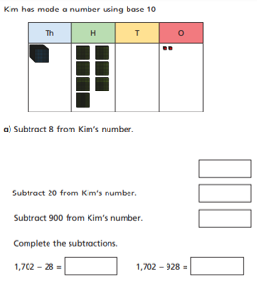
Have a go at question 1 on your worksheet.

Slide 8
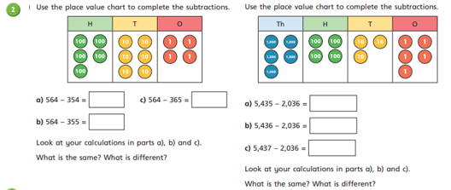
Now, let’s work through question 2.

Slide 9
5,114 people attend the theatre. 2,309 are adults and 1,457 are girls. How many boys attend?
Th | H | T | O
2 | 3 | 0 | 9
1 | 4 | 5 | 7
Have a think
Th | H | T | O
5 | 1 | 1 | 4
3 | 7 | 6 | 6
4
1
0
1
0
1
+
5,114
$$−$$
3
7
6
6
1
3
4
8
1
Th | H | T | O
5 | 1 | 1 | 4
2 | 3 | 0 | 9
Th | H | T | O
2 | 8 | 0 | 5
1 | 4 | 5 | 7
2,309
7
9
4
1
0
1
?
1
1
1,457
$$−$$
$$−$$
2
8
0
5
1
3
4
8

Slide 10
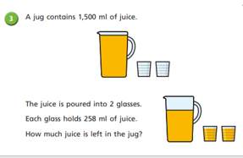
Try and work through this word problem using the methods we have looked at today.

Slide 11
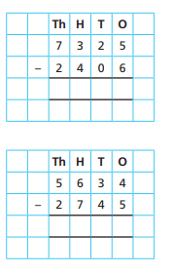
Plenary
Let’s complete these calculations together as a class.

