Slide 1
This term in PSHE our topic is: Dreams and Goals
Lesson 4 – Working as a team

Slide 2
LO: To enjoy facing new learning challenges and working out the best ways for me to achieve them.
LO: To break down a goal into a number of steps and know how others could help me to achieve it.

Slide 3
Vocabulary:
Garden Decoration Dream Goal
Team work Enterprise Design
Cooperation

Slide 4
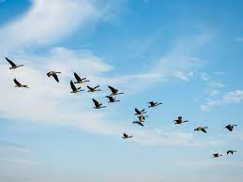
Calm Me
Use the Calm Me script.

Slide 5
Garden decorations
Last week, you worked with your team to plan how you would make some garden decorations. Today you are going to make those decorations in your teams, following the plan.
Remember to make your label/leaflet too.

Slide 6
Teamwork
Before we start, who can tell me how we can demonstrate good teamwork?
(If you are at home, make a garden decoration using something you have in the house or garden. There are some ideas on the next slide. Then, make a leaflet or poster to help to sell your decoration.)

Slide 7
