Slide 2
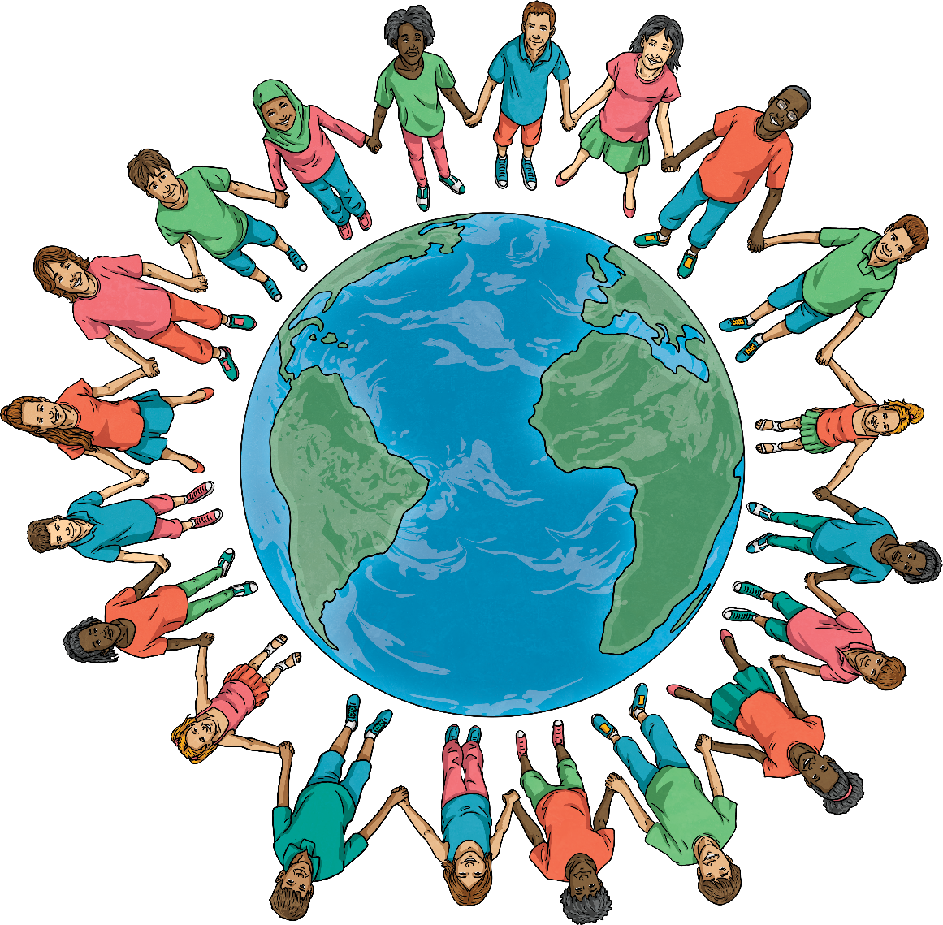
What Is World Religion Day?
World Religion Day is celebrated annually on the third Sunday of January.
The aim of World Religion Day is to promote understanding and peace between all religions and to encourage people to learn about other faiths and their followers.
It was initially started by followers of the Bahá’í faith.

Slide 3
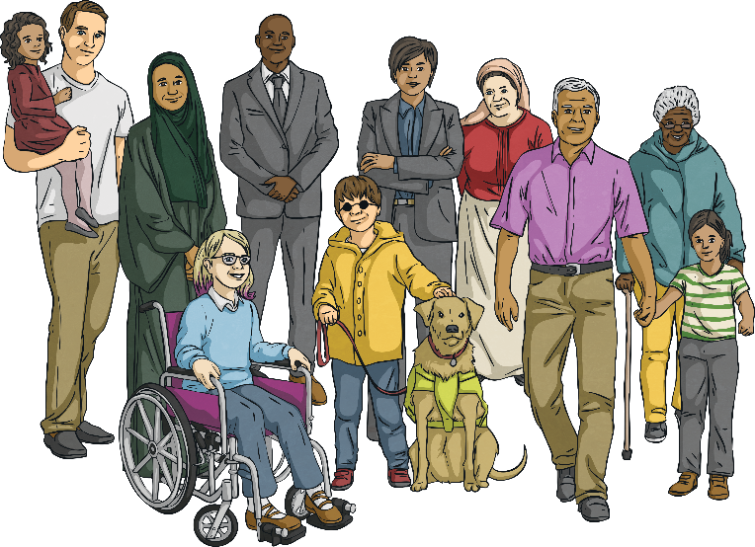
The Bahá’í Faith
The Bahá’í faith was founded in 1863 in Iran. The Bahá’í faith believes that:
All religions have common features and that all religions should be respected;
All human beings are different but equal;
There is one God who is known by different forms in all religions, such as Buddha, Moses, Jesus and the Prophet Muhammad (Peace Be Upon Him);
The diversity between the religions is due to the way people think about god;
We all have the same rights regardless of our religion or creed.

Slide 4
The Bahá’í Faith
The National Spiritual Assembly of the Bahá’í of the United States came up with the idea of World Religion Day in 1949 and the first World Religion Day took place the following year, in 1950. It was decided that for one day a year, all religions should be celebrated and their similarities appreciated.
Since then, World Religion Day has moved on from being a strictly Bahá’í celebration and is now seen as a wider celebration of inter-faith harmony and understanding.

Slide 5
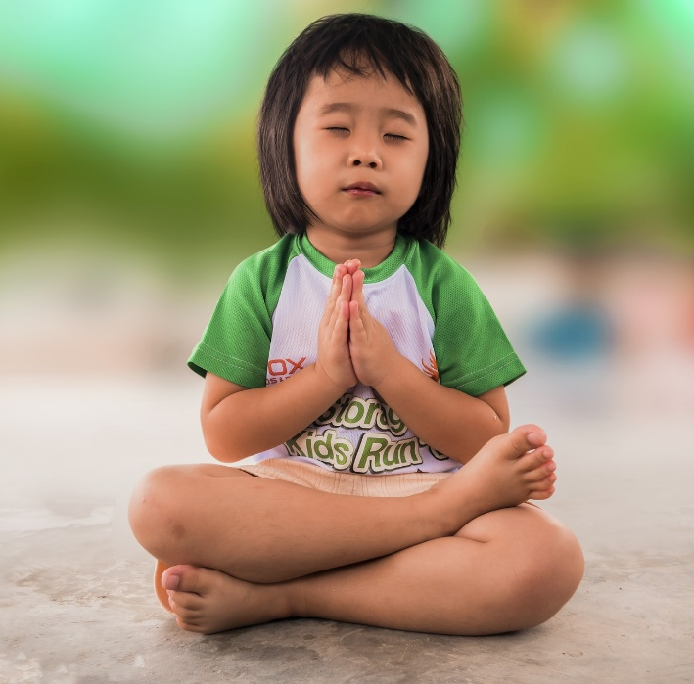
Why Do We Celebrate World Religion Day?
World Religion Day invites members of all religious groups from across the globe to recognise that all religions have a common spiritual goal. It aims to promote inter-faith understanding and harmony and unite people, regardless of their beliefs.
World Religion Day also seeks to overcome historical differences between religious groups. Throughout history, many conflicts and wars have been caused by arguments over religion and beliefs. The day aims to overcome this and achieve a peaceful understanding between faiths.

Slide 6
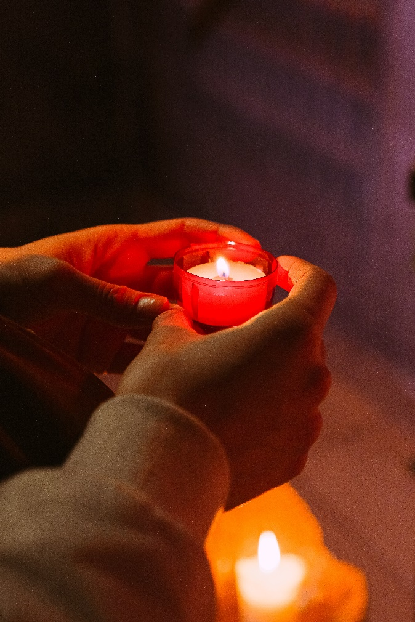
How Do We Celebrate World Religion Day?
World Religion Day is celebrated in a variety of ways. Many organisations celebrate the day by holding interfaith events, where faith leaders get together to give talks and lectures.
People are encouraged to talk with and to listen to people from faiths different from their own and to understand the basic principles of other religions.
There is time to reflect on the universal message of the six main religions – treating each other with respect and understanding, to create a better world for everyone.

Slide 7
How Many Countries Celebrate World Religion Day?
UK
USA
Brazil
China
Kenya
Israel
Australia
India
Russia
Japan

Slide 8
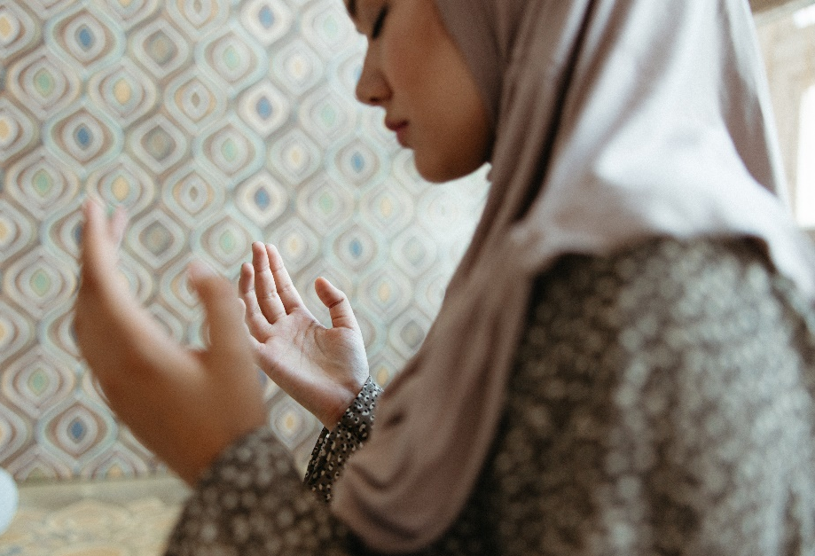
What Are the Six Major Religions?
Nearly 75% of the world practices one of these six religions:
Christianity:
Judaism:
Hinduism:
Buddhism:
Sikhism:
World Religion Day promotes their similarities and the role religion has played in uniting people across the planet.
Islam:

Slide 9
Christianity
Followers: Christians
Place of worship: church
Holy book: Bible
Beliefs:
God created the world;
The Holy Trinity - there is only one God, who is God the Father, God the Son and The Holy Spirit;
God sent his Son, Jesus Christ, to save humanity from their sins;
Jesus died on the cross and then rose from the dead after his crucifixion;
The Ten Commandments - given by God to Moses and written in the Bible.

Slide 10
Judaism
Followers: Jewish people
Place of worship: synagogue
Holy book: Torah
Beliefs:
There is only one God;
Special agreement (or covenant) with God to uphold His laws;
Faith of action - Jews are judged by how they live, rather than what they believe;
The Shabbat (the seventh day of creation is the most important day of the week – Jewish people stop working and make time for God and family.

Slide 11
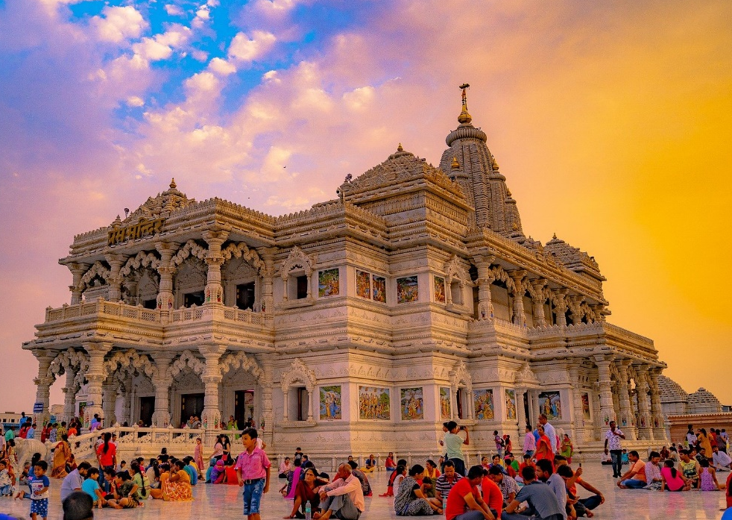
Hinduism
Followers: Hindus
Place of worship: mandir
Holy book: Vedas
Beliefs:
Hindus believe in a universal soul called Brahman;
Reincarnation - Hindus believe that this is governed by Karma;
Trimurti - the three aspects of the universal supreme God, known as Vishnu, Brahma and Shiva;
Truth is eternal - pursue knowledge and understanding of the truth;
Tridevi - goddesses who are equally as important as the Trimurti – Saraswati, Lakshmi and Parvati;
Dharma - Hindus believe it is necessary to always do the right thing;
Moksha - the ultimate goal for all Hindus meaning liberation from the cycle of birth and rebirth.

Slide 12
Buddhism
Followers: Buddhists
Place of worship: Buddhist temple
Holy book: Tripitaka
Beliefs:
Buddha was human, not a god;
The Three Jewels – the Buddha, the dharma (teachings of Buddha) and the sangha (community and practitioners);
The Four Noble Truths – the truth of suffering (Dukkha), the truth of the origin of suffering (Samudaya), the truth of the end of suffering (Nirodha) and the path to the end of suffering (Magga).

Slide 13
Sikhism
Followers: Sikhs
Place of worship: gurdwara
Holy book: Guru Granth Sahib
Beliefs:
There is only one God and all humans are children of God;
Everyone is equal and should be treated the same;
Reincarnation;
Live honestly;
Share with others;
The Five Ks – Kesh (uncut hair), Kanga (a wooden comb), Kara (a steel bracelet), Kachera (cotton underwear) and Kirpan (steel sword).
Always keep God in mind;

Slide 14
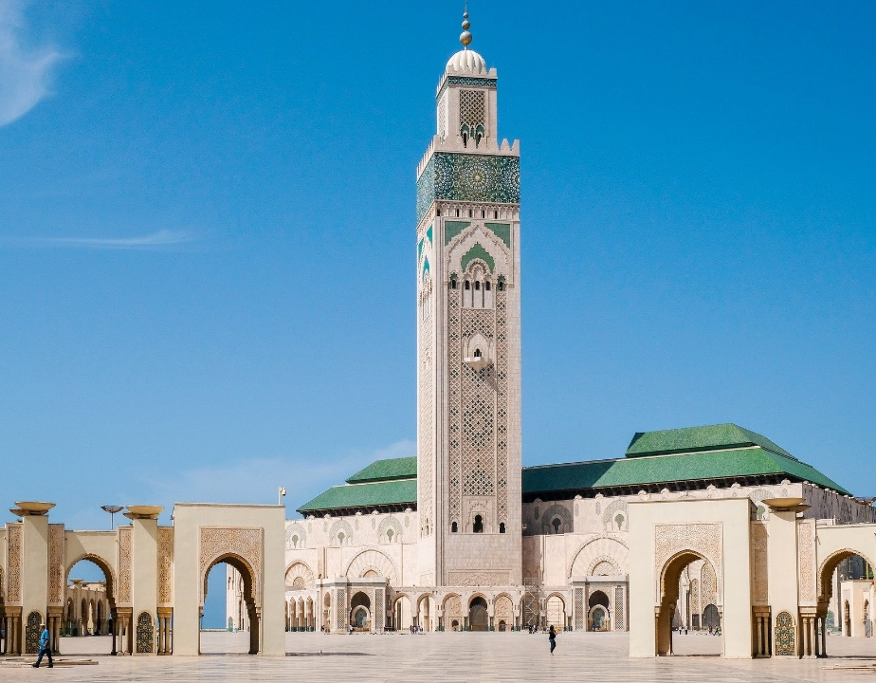
Islam
Followers: Muslims
Place of worship: mosque
Holy book: Qur’an
Beliefs:
Allah is the one and only God;
Prophets (special messengers);
Muhammad (PBUH) was the final prophet;
The Day of Judgement - when all people will be judged by their beliefs and deeds;
The Qur’an - God's revealed book containing The Five Pillars of Islam.
Predestination - the belief that whatever God wills to happen, happens;

Slide 15
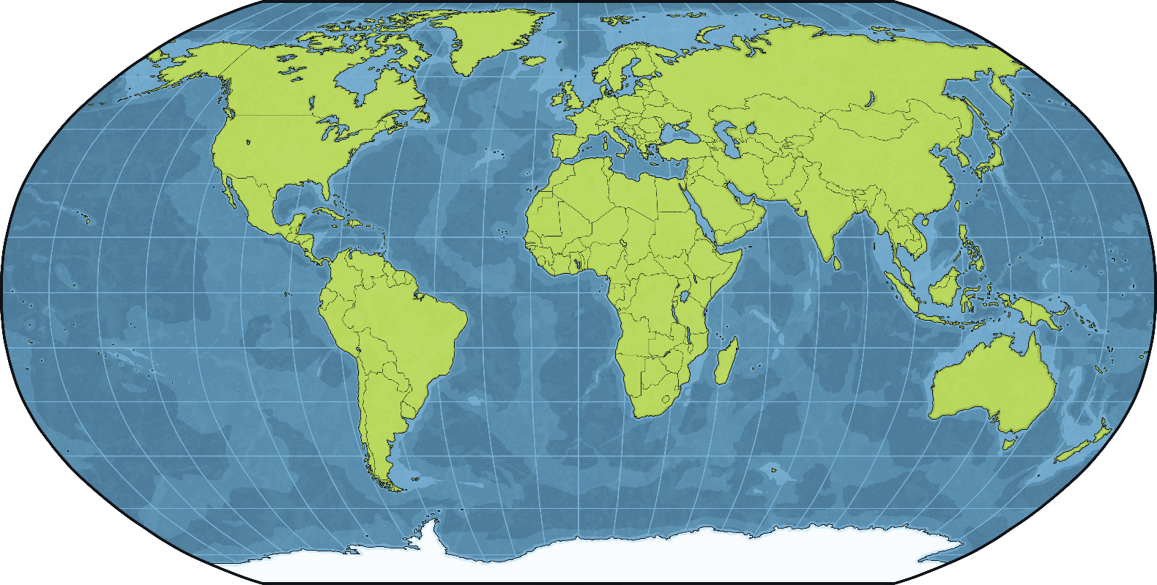
Countries and Religions
Just as some countries can share similar traditions and festivals, they can also share many religions.

Slide 16
Similarities
The Bahá'í faith believes that all religions have things in common and teaches that all religions should be respected.
What do all religions have in common?
The love of a higher being or God;
A holy book;
A place of worship.
World Religion Day is celebrated to promote interfaith understanding, which means involving many different religions and uniting them together.

Slide 17
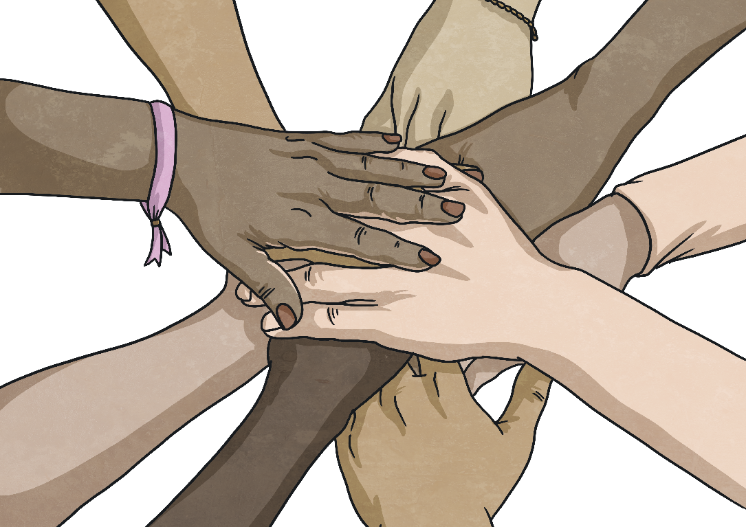
Similarities
It is important that there is harmony and that people feel comfortable to unite together, whatever their faith.
Many events are held around the world and people are asked to look at the similarities across different religions.
Special religious services are held around the world, celebrating these similarities.
When we learn about other religions, we can work together to create a better world.

Slide 18
Similarities
Christianity:
In everything, do to others as you would have them do to you.
Judaism:
What is hateful to you, do not do to your neighbour.
Hinduism:
This is the sum of duty; do not do to others what would cause pain if done to you.
Buddhism:
Treat not others in ways that you would find hurtful.
Sikhism:
I am a stranger to no one and no one is a stranger to me. I am a friend to all.
Islam:
Not one of you truly believes until you wish for others what you wish for yourself.
Can you spot similarities here?
What words are repeated?
What could you do in your life to show this?

Slide 19
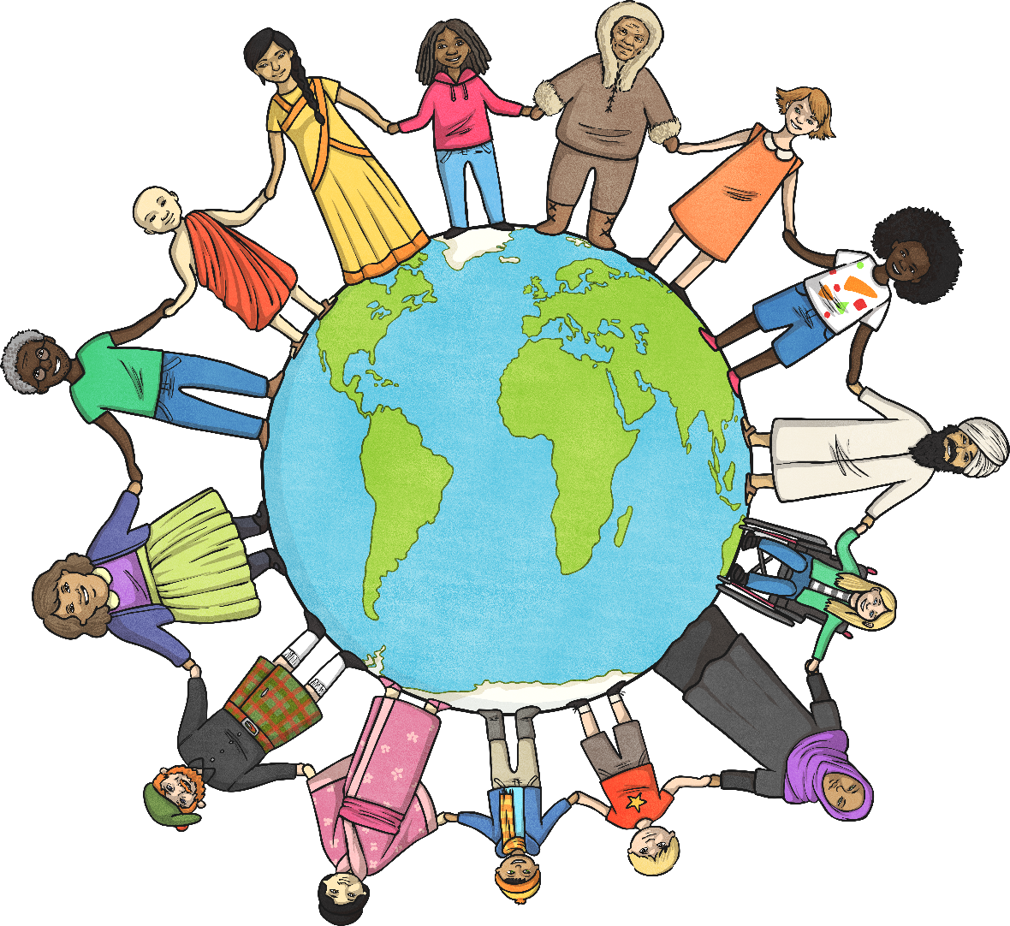
Reflection
All religions share the same key messages –
treat each other with respect and love one another.
Celebrate World Religion Day this January to promote interfaith understanding, harmony and help to unite everyone, whatever their faith.

Slide 20
Task 1
Think about what you have read and learned about world religions from this PowerPoint.
Using the ‘world thoughts activity sheet’, can you write down all the words that they think people should try to think about when making the world a better place?

Slide 21
Islam. In Year 4, we are going to look at the Islamic religion. You may have learnt about this religion in Year 2. Can you remember any facts about the Islam religion? Make a thought shower of what we already know.

Slide 22
Use these websites and links to learn more about the Islamic religion. https://www.bbc.co.uk/religion/religions/islam/ataglance/glance.shtml https://www.bbc.co.uk/religion/religions/islam/beliefs/beliefs.shtml https://www.bbc.co.uk/religion/religions/islam/holydays/holydays.shtml https://www.bbc.co.uk/religion/religions/islam/practices/fivepillars.shtml

Slide 23
Task 2
You now need to make a presentation about the Islamic religion. Think about the best way that you can present what you have found out about the Islamic religion.
You could create a poster, a PowerPoint presentation, a leaflet. Remember, you might want to include some illustrations too. Good luck and enjoy ☺

