Slide 1
23.03.21 LO: To know how to multiply by 8.

Slide 2
Vocab
array
bar model
remainder
repeated addition
multiplication sentence
division statement
equal
multiply
divide
times-tables
sharing
grouping
division facts
factor

Slide 4
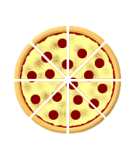
Each pizza has been cut into 8 slices.
How many slices are there in total?
What would the multiplication statement be?

Slide 5
A spider has eight legs. How many legs are there on four spiders?
___ + ___ + ___ + ___ = ___ x ___ = ___
If there are ___ spiders, there will be ___ legs altogether.

Slide 6
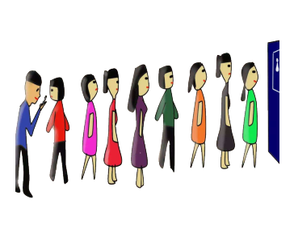
A ticket to see a play is £8.
9 people are waiting to buy tickets.
___ + ___ + ___ + ___ + ___ + ___ + ___ + ___ + ___ = ___ x ___ = ___
The total cost is £___

Slide 7
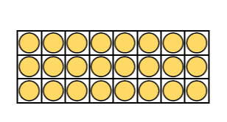
Arrange 24 counters in an array and complete the calculations.
___ + ___ + ___ = ___ x ___
___ + ___ + ___ + ___ + ___ + ___ + ___ + ___ = ___ x ___

Slide 8
When we multiply by 8 a little tip is that you double, double and double again.
5 x 2 = ___
5 x 4 = ___
5 x 8 = ___

Slide 9
In your books, fill in the table to show that multiplying by 8 is the same as double, double and double again.
Complete the challenge question if you finish!

Slide 10
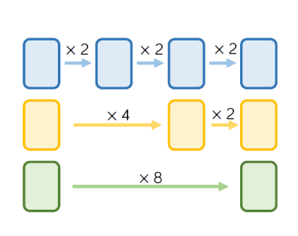
Class discussion:
Start each function machine with the same number.
What do you notice about each final answer?

