Slide 1
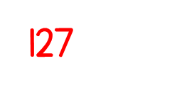
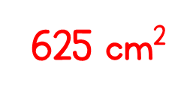
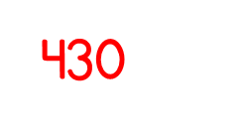
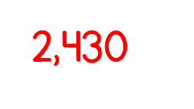
Year 5 | Week 3 | Day 4

Slide 4
1) 55 $÷$ 5 $=$
2) $÷$ 5 $=$ 1,100
3) 550 $÷$ 50 $=$

Slide 5
1) 55 $÷$ 5 $=$
2) $÷$ 5 $=$ 1,100
3) 550 $÷$ 50 $=$
11
5,500
11

Slide 7
Eva has 13 straws. She wants to make them into triangles. How many triangles can she make?
13 $÷$ 3 $=$
4 r1

Slide 8
Tommy has 14 straws. He wants to make them into triangles. How many triangles can he make?
Dora has 15 straws. She wants to make them into triangles. How many triangles can she make?
Jack has 16 straws. He wants to make them into triangles. How many triangles can he make?
Have a think

Slide 9
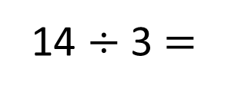
Tommy has 14 straws. He wants to make them into triangles. How many triangles can he make?
14 $÷$ 3 $=$
4 r2

Slide 10
Dora has 15 straws. She wants to make them into triangles. How many triangles can she make?
15 $÷$ 3 $=$
5

Slide 11
Jack has 16 straws. He wants to make them into triangles. How many triangles can he make?
16 $÷$ 3 $=$
5 r1

Slide 12
Have a think
Could these calculations be correct?
3,924 $÷$ 3 $=$ 1,307 r3
3,242 $÷$ 4 $=$ 810 r2
5,626 $÷$ 5 $=$ 1,124 r6
Could be correct | Definitely incorrect

Slide 13
5,291 $÷$ 4
$=$ 1,322 r3
Thousands | Hundreds | Tens | Ones
4 | 5 | 2 | 9 | 1
1
3
2
2
r3
1
1

Slide 14
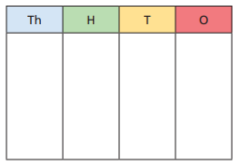
Have a go at questions 1 - 3 on the worksheet Stick in 1 and 3 (work out the calculations for 3 in your book, before writing the answers in the table).
Use a place value chart and counters to help if you need to.

Slide 15
Have a think
5,627 $÷$5 $=$ 1,126
The 5 times table is in a pattern: 5, 10, 15, 20 ..
5,627 is a whole number but it doesn’t end in a 5 or a 0 so the answer must have a remainder.
5,627 $÷$5 $=$ 1,125 r2

Slide 16
There are 349 people at a wedding. They are sitting at tables in groups of 8
How many tables are needed?
8 | 3 | 4 | 9
0
4
3
r5
3
2
We need 44 tables.
We need 43 tables.
Have a think

Slide 17
Have a go at the rest of the worksheet Stick in 6,7 and 8 when you get to them

