Slide 1
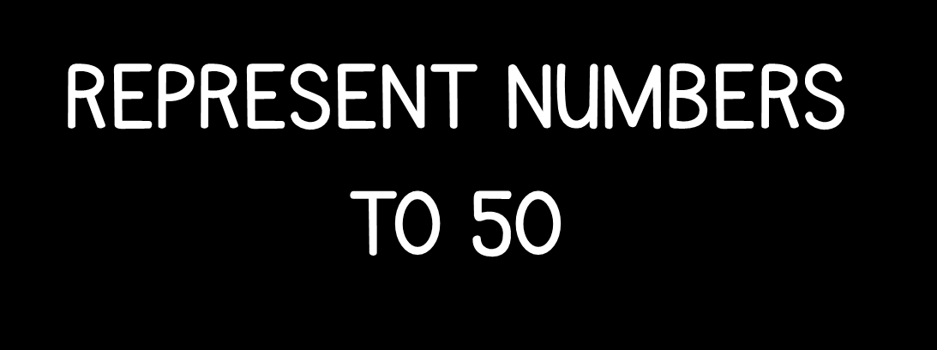

Slide 3
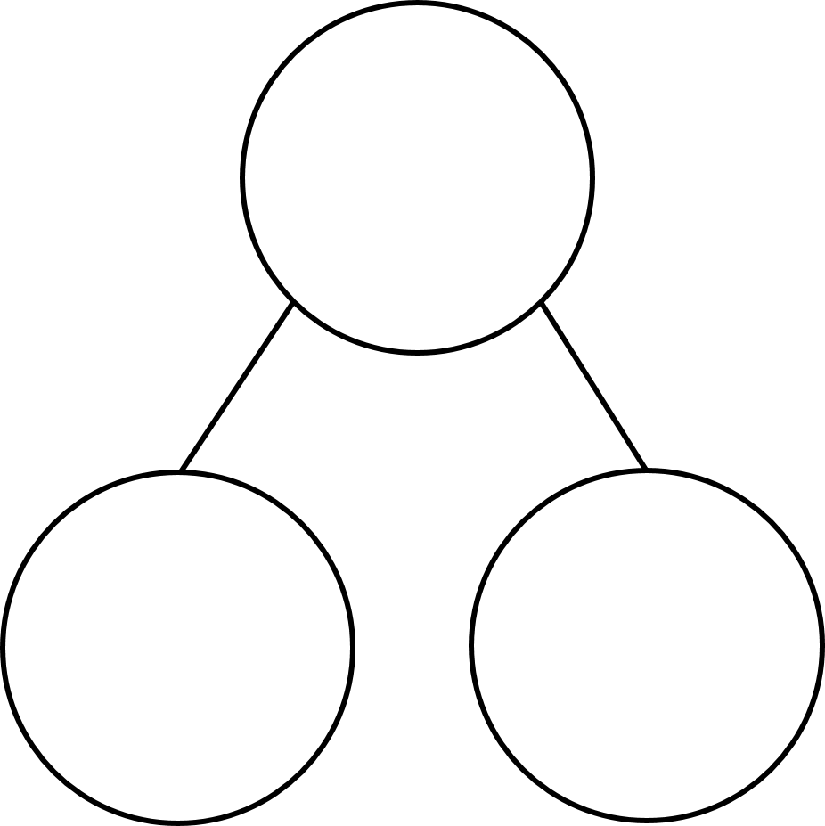
Part whole model
16
1 ten and 6 ones =
16

Slide 4

Part whole model
Have a think
38
3 tens and 8 ones =
38

Slide 5
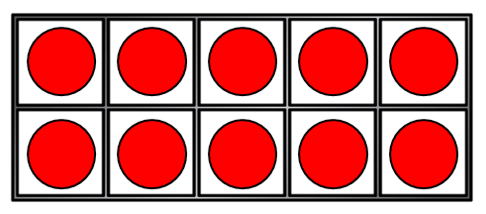
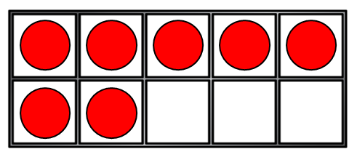
Part whole model
27
2 tens and 7 ones =
27

Slide 6
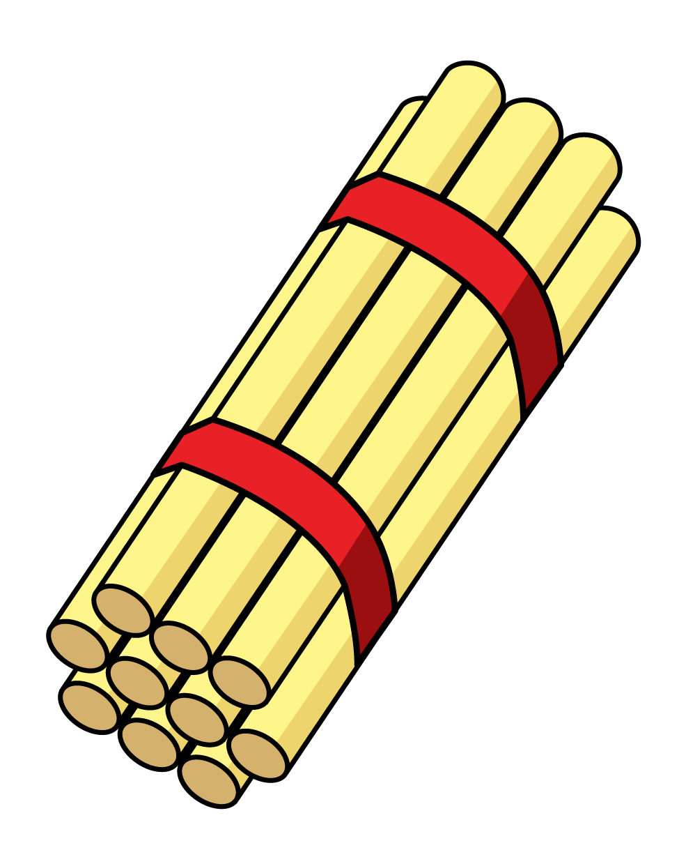

Part whole model
Have a think
41
4 tens and 1 one =
41

Slide 7
Can you match the representation to the correct number in your pairs?

Slide 8
Fluency
Match the numbers.
2 tens
7 ones
12
twenty-three
1 ten
2 ones
23
twenty-seven
2 tens
3 ones
27
twelve

Slide 9
Fluency
Match the numbers.
3 tens
2 ones
19
nineteen
3 tens
5 ones
32
thirty-two
1 ten
9 ones
35
thirty-five

Slide 10
Representing numbers to 50
13
thirty
31

Slide 11
What is missing?
Have a think
35
23
50

Slide 12
Have a go at the questions on your worksheet.

