Slide 1
Monday 23rd November.
LO – I understand what a symbol is and recognise some important Christian symbols.

Slide 2
Aim
I can name and explain the key symbols of Christianity.
Success Criteria
I can name and explain the key symbols of Christianity.
I can create an information card to explain one of the Christian symbols.

Slide 3
Symbols
What are symbols?
Symbols are marks or characters used as conventional representations of an object, function, or process.
Can you think of anywhere you might see a symbol?
Photo courtesy of JeepersMedia@flickr.com - granted under creative commons licence – attribution
Photo courtesy of theimpulsivebuy@flickr.com - granted under creative commons licence – attribution
Photo courtesy of Mr ATM@flickr.com - granted under creative commons licence – attribution
Photo courtesy of O.Taillon@flickr.com - granted under creative commons licence – attribution
Photo courtesy of JeepersMedia@flickr.com - granted under creative commons licence – attribution
Photo courtesy of jturbanos@flickr.com - granted under creative commons licence – attribution

Slide 4
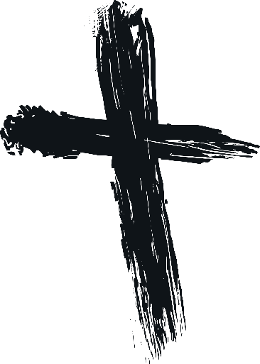
Symbols
What are these symbols?
How are these symbols used in Christianity?
Why are these symbols used?

Slide 5
Cross
The cross is an important symbol for Christians. It reminds them that Jesus died on a cross. It is particularly important because Christians believe that Jesus died on the cross to show his love for humanity, and by dying in this way, sins are forgiven and all have a chance of entering heaven.
Jesus dying on the cross is known as the crucifixion and a cross symbol showing Jesus on the cross is called a ‘crucifix’.

Slide 6
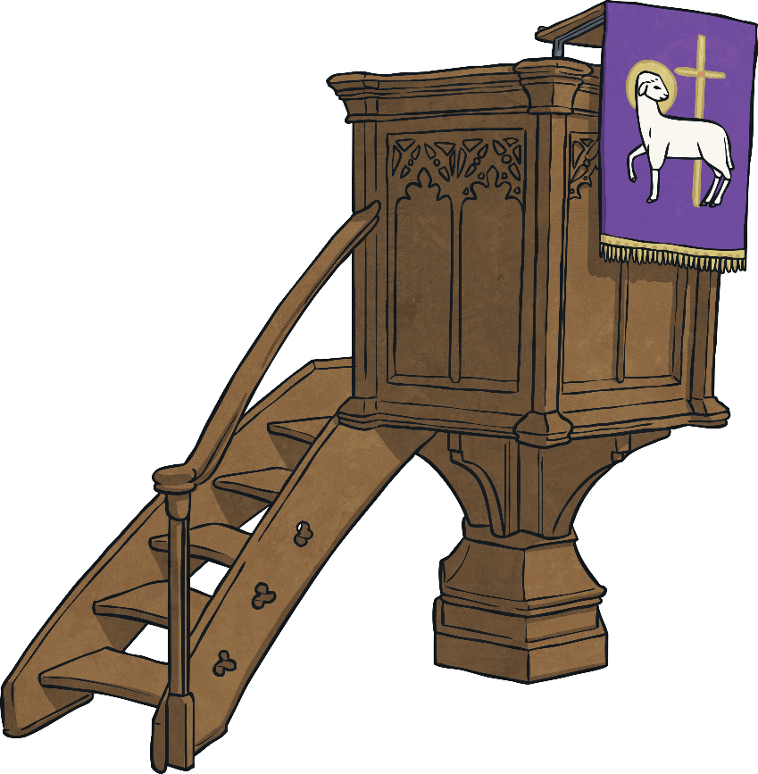
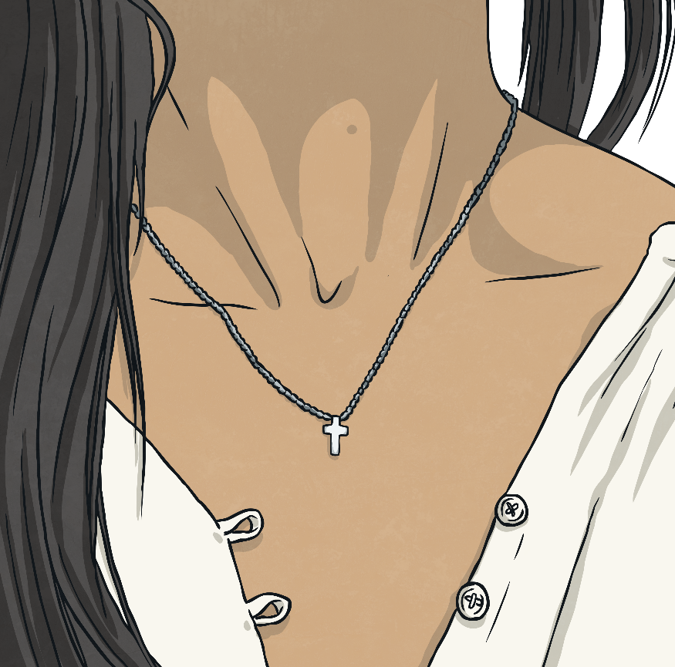
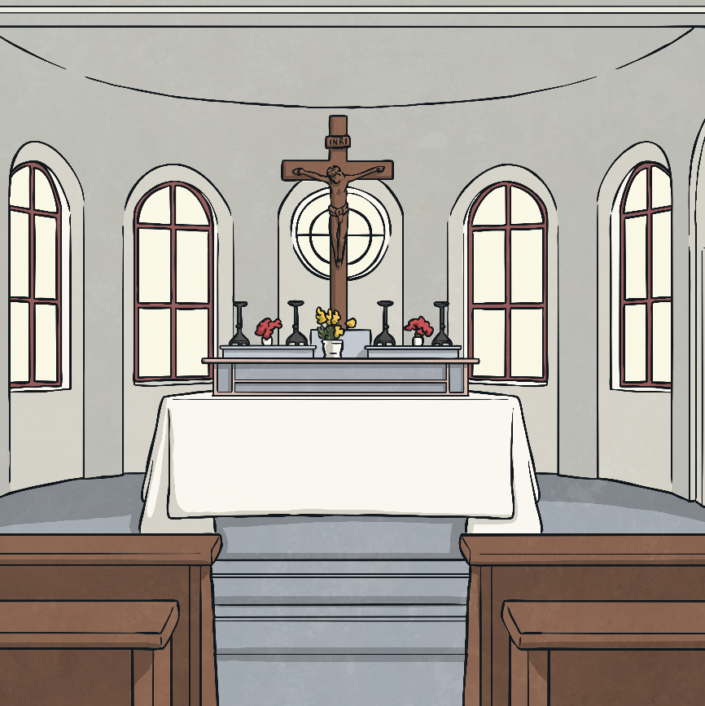
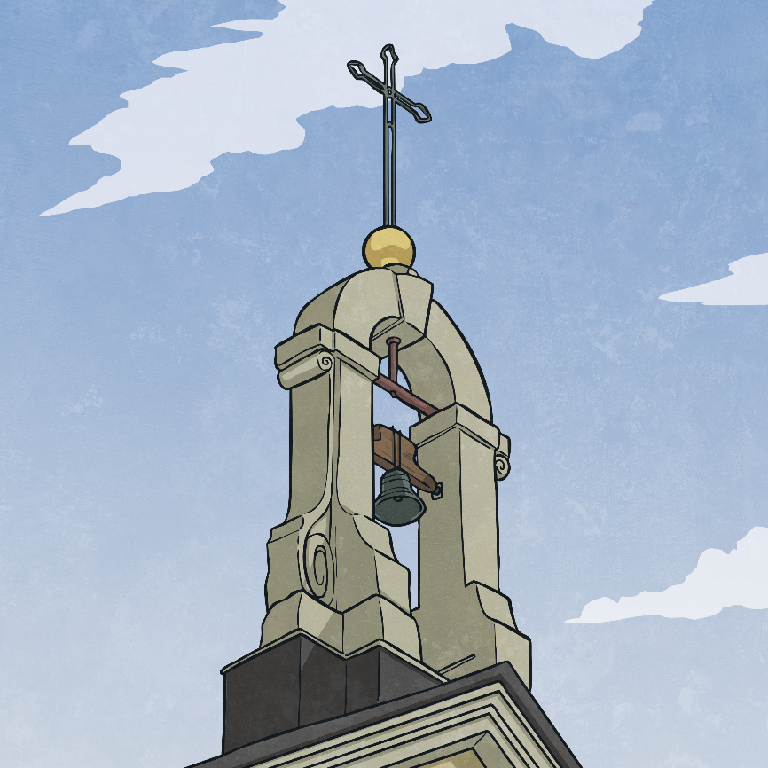
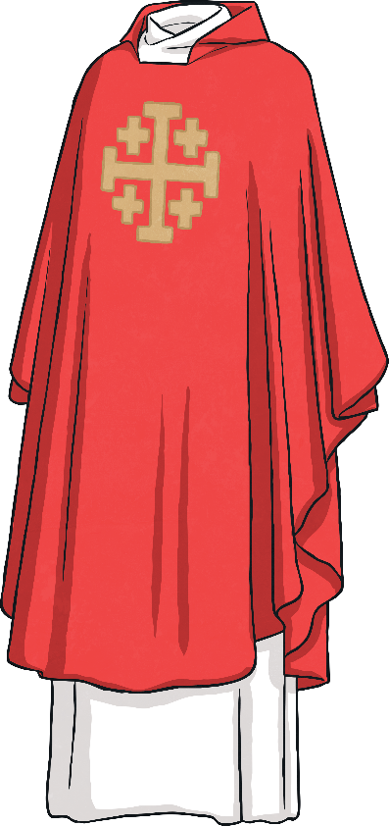
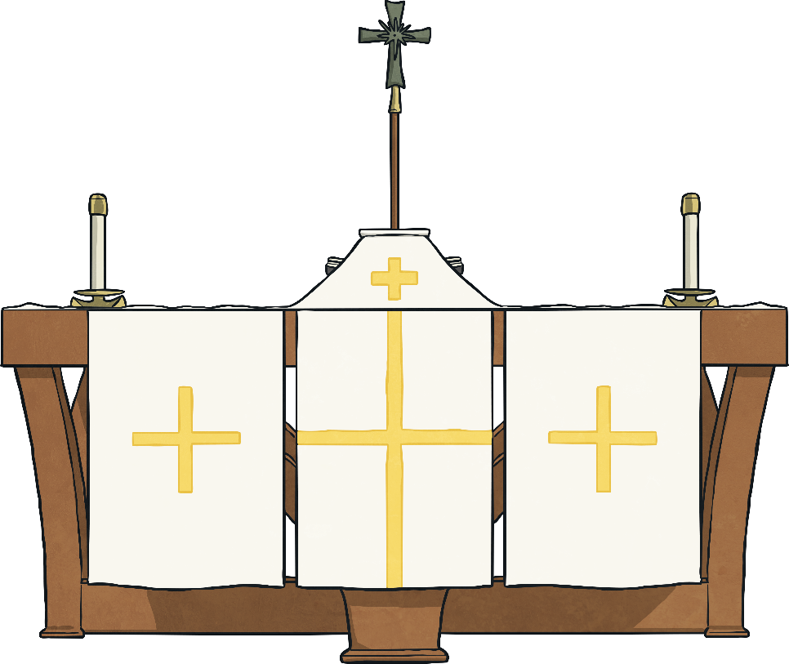
Cross
Look at places where the cross symbol is used within Christianity:

Slide 7
Dove
Do you know anything about this symbol already?

Slide 8
Dove
The dove symbol is often associated with peace.
For Christians, the dove symbol also represents the Holy Spirit. When Jesus died, he promised the disciples that even though he wouldn’t be there any more as a man, he would not be leaving them alone – he sent the Holy Spirit.
Christians think of the Holy Spirit as a presence with them, a feeling that God is there with them always, guiding, helping, revealing.
The dove is associated with the Holy Spirit in the Bible in Luke, chapter 3, verse 22 (New International Version).
“… and the Holy Spirit descended on him in bodily form like a dove. And a voice came from heaven; ‘You are my Son, whom I love; with you I am well pleased.’”

Slide 9
Ichthus
The Ichthus (also spelt Ichthys and also known as the ‘fish’) was a secret symbol for early Christians.
It was used to show that they were followers of Jesus Christ, and to state that they were Christians.
During this time the Romans were persecuting Christians so the Ichthus symbol was used as a secret code between Christians.
Christians would draw the Ichthus symbol in the mud, dirt, sand or on walls to communicate that they were Christians to each other without the Romans realising.
Draw the Ichthus symbol on your whiteboard.

Slide 10
Task today.
You are going to write about some of the Christian symbols that we have learnt about today.
Use sub-headings, draw the symbol and then write about it.

Slide 11
Aim
I can name and explain the key symbols of Christianity.
Success Criteria
I can name and explain the key symbols of Christianity.
I can create an information card to explain one of the Christian symbols.

