Slide 1
Monday 18th October and Tuesday 19th October
L.O. I can innovate a set of instructions.

Slide 3
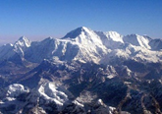
Colossal
Extremely large

Slide 4
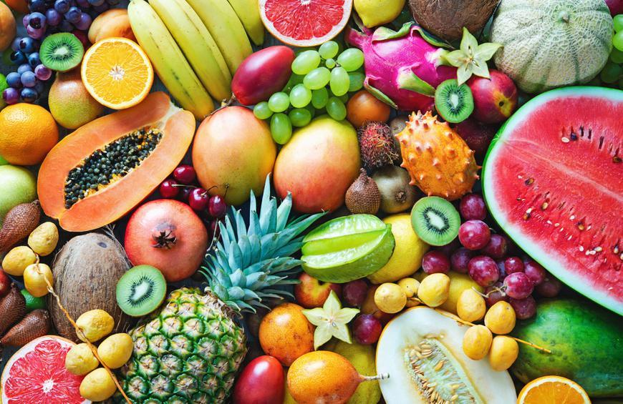
Exotic
From a distant foreign country

Slide 5
Species
A kind of or sort of
e.g. a kind of bird or a kind of shark.

Slide 6
Enchanted
Something under a spell or charm.

Slide 7
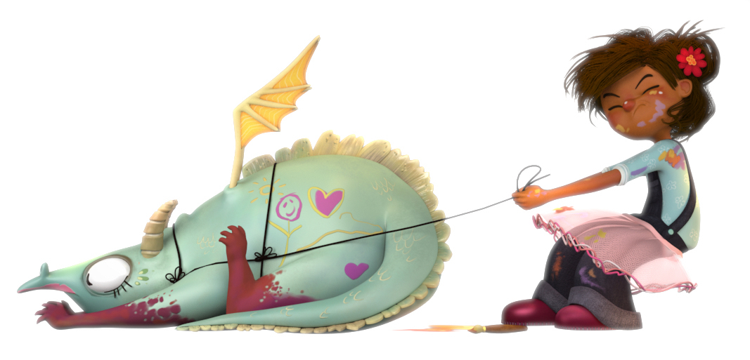
How to keep a pet dragon

Slide 8
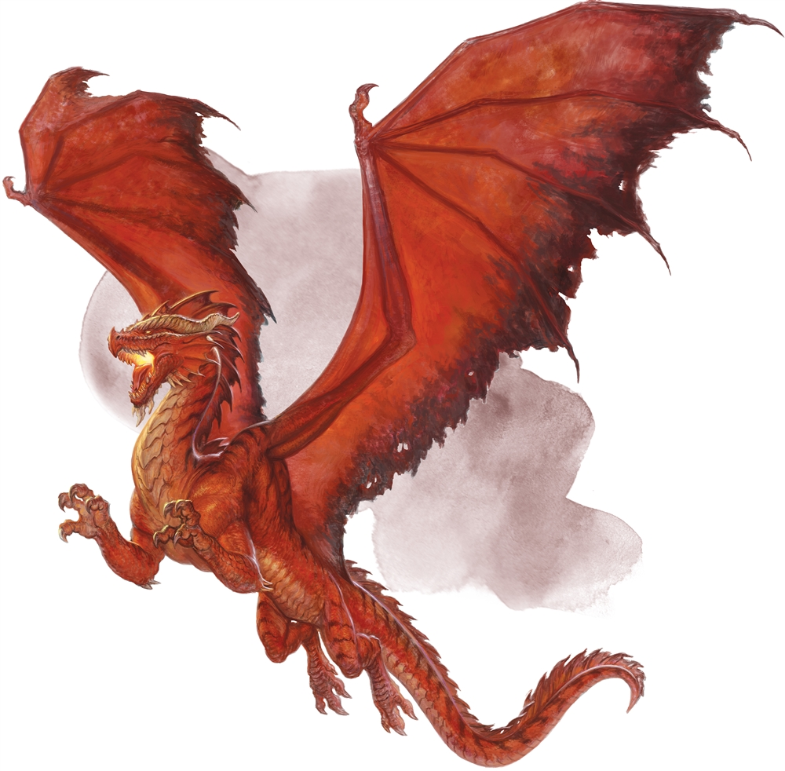
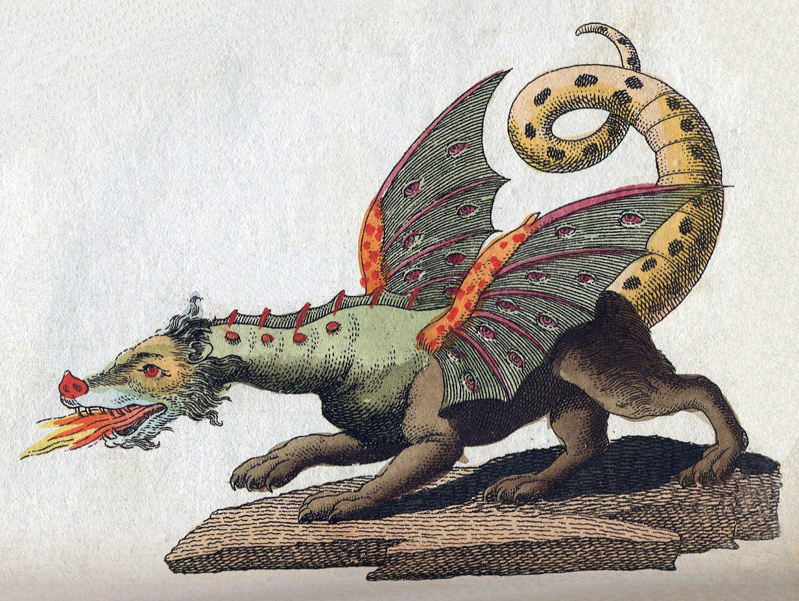
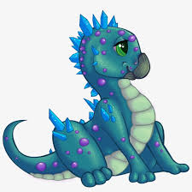
Quickly draw your own pet dragon

Slide 9
Introduction
How could you start your instructions?
You might ask if the reader is fed up of having an untrained dragon.

Slide 10
What do you need?
What would you need to keep a pet dragon?

Slide 11
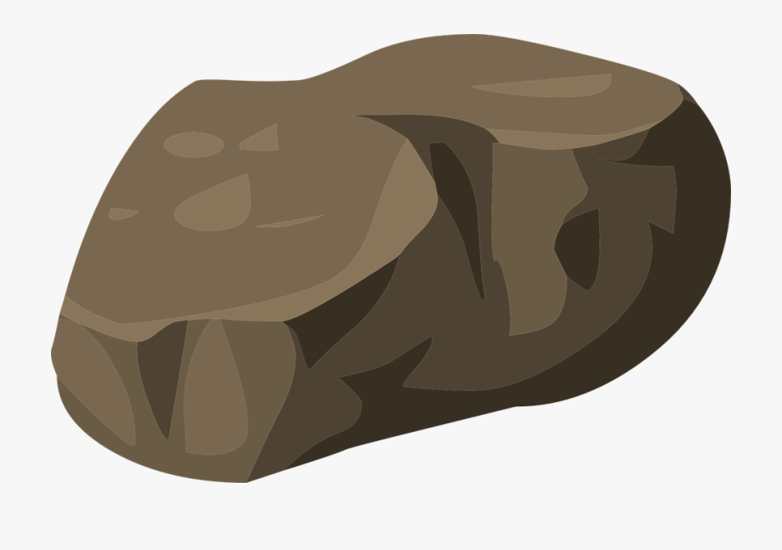
What do you do?
What do you have to do, in order to look after a pet dragon?
First,
Next,
After that,
Then,
Finally,

Slide 12
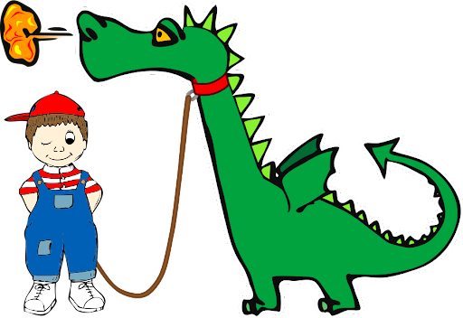
Conclusion
What will happen if they follow your instructions?
Will their dragon be perfectly trained?
Will their dragon be well behaved?
Will they be able to send their dragon to dragon school?

Slide 13
Bossy verbs

Slide 14
Wednesday 20th October
L.O. I can innovate the instructions ‘How to trap a dragon’.

Slide 16
Colossal
Extremely large

Slide 17
Exotic
From a distant foreign country

Slide 18
Species
A kind of or sort of
e.g. a kind of bird or a kind of shark.

Slide 19
Enchanted
Something under a spell or charm.

Slide 20
Vocabulary recap
Choosing one new word from this week, write a superb sentence in your book with that word.
When you have written and checked your first sentence, you can write a second.

Slide 21
Starting your instructions
Today you are going to START your instructions and tomorrow you will finish them. You are NOT writing your full set of instructions today.
Title
Introduction
What you need

Slide 22
Thursday 21st October
L.O. I can innovate the instructions ‘How to trap a dragon’.

Slide 23
Toolkit

Slide 24
Bossy verbs
Bossy verbs give people instruction- they tell people what to do!
Shut the door.
Carefully chop the apple.
Put the diamonds down!

Slide 25
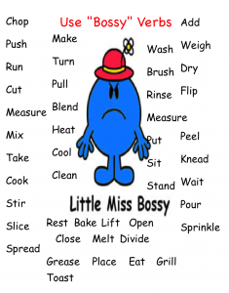

Slide 26
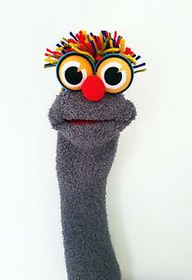
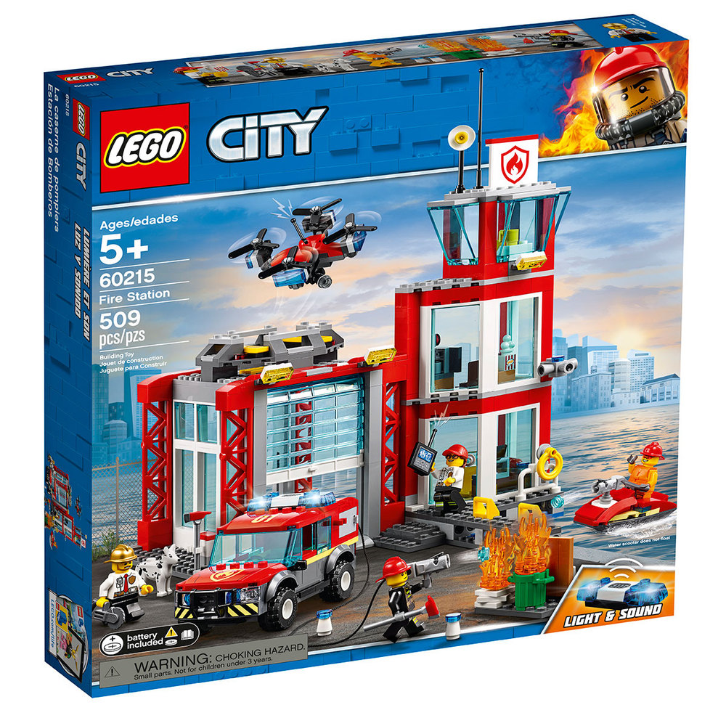
Title
The title tells you what the instructions are about.
How to make a sock puppet!
How to build a Lego fire station.

Slide 27
List of equipment
The list tells you what you will need in order to be able to complete the steps in the instructions.
You will need:
A spoon
2 eggs
1 bowl

Slide 28
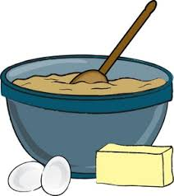
Chronological order
The steps are written in order.
e.g. first crack the eggs, then add the sugar and finally dribble in some honey.

Slide 29
Bullet points or numbers
Bullet points or numbers are used to separate the different steps in the instructions.
Fold the piece of paper in half
Then cut 2 triangles
Next draw a circle on the piece of paper

Slide 30
Finishing your instructions
Today you are going to FINISH your instructions!
What you do
Conclusion

